Slide 1
Nature and Health in the Covid-19 world – a public health perspective
Healthy Parks Healthy People Europe Launch webinar
29 June 2020

Slide 2
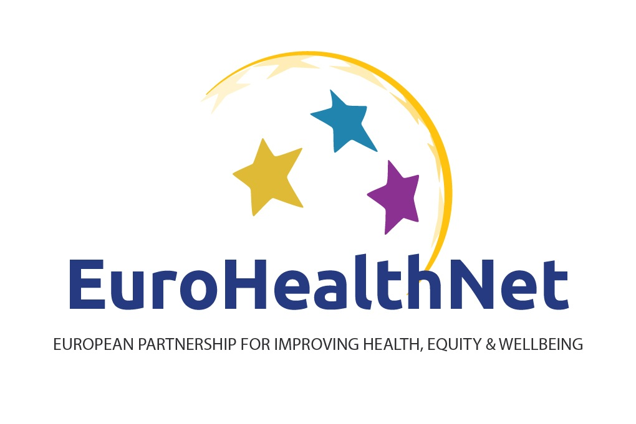
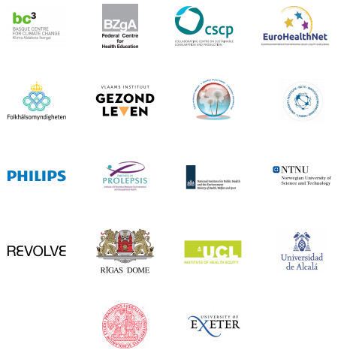
Who we are

Slide 3
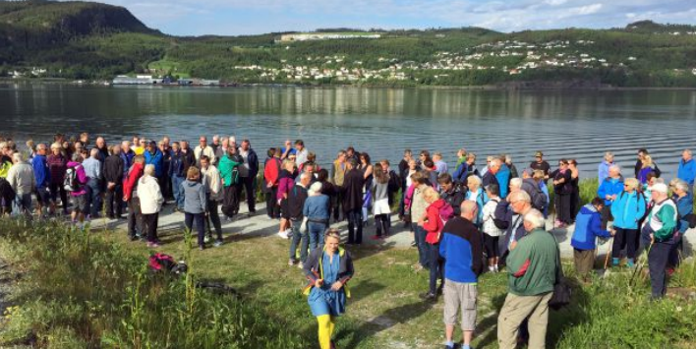
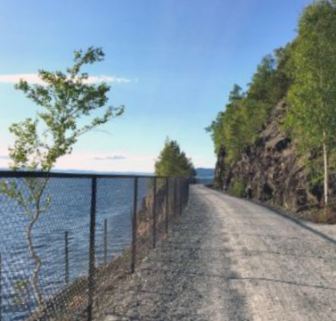
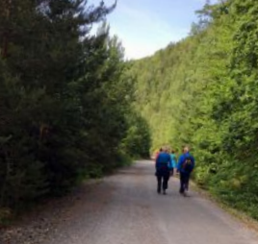
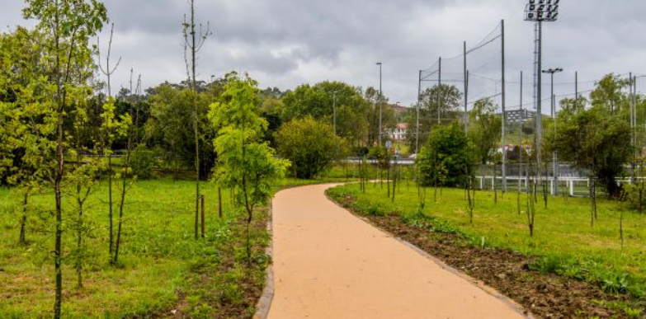
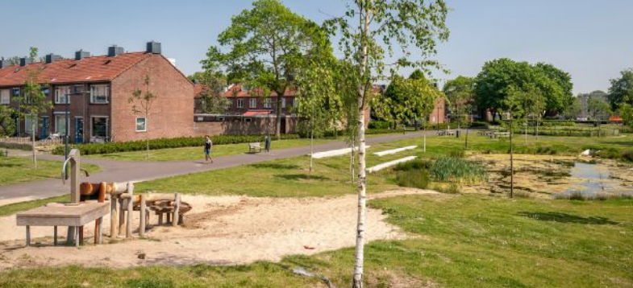
TRIPLE-WIN: Environment, health, health equity

Slide 4
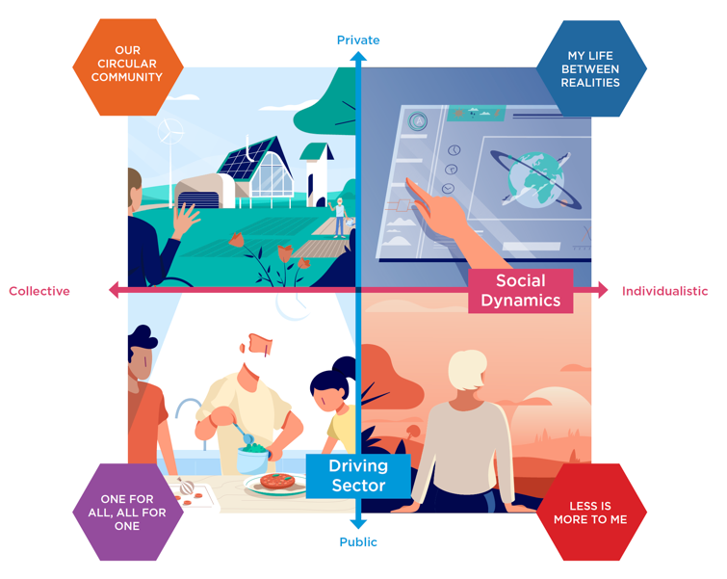
FORESIGHT
PUBLIC HEALTH FORESIGHT IN LIGHT OF COVID-19 (EuroHealthNet, RIVM)
Key challenges & opportunities
Short & long-term

Slide 5
“BUILDING BACK BETTER”
Quality, inclusive, accessible design
Meaningfully engage communities
Foster connection early
Social prescribing
Collaborative cross-sectoral working
Supportive EU context

Slide 6
RESOURCES
INHERIT: https://inherit.eu/
INHERIT Policy Toolkit: https://inherit.eu/policy-toolkit/
INHERIT key outcomes booklet: https://inherit.eu/Inherit-Conference-booklet-DIGITAL.pdf
Policy roundtable report: Urban Open Spaces: enabling activities to maximise positive impacts on environmental sustainability, health and equity: https://inherit.eu/wp-content/uploads/2019/11/Urban-Opens-Spaces-Roundtable-1.pdf
Urban Green Space: Creating a Triple Win for Environmental Sustainability, Health, and Health Equity through Behavior Change, Int. J. Environ. Res. Public Health 2019, 16(22), 4403; https://doi.org/10.3390/ijerph16224403
Contact: a.godfrey@eurohealthnet.eu

