Slide 1
Green Health Partnerships in Scotland - connecting people to parks and protected areas
Bridget Finton – Policy & Advice Officer, People and Places Activity
Scottish Natural Heritage (SNH)
Notes:
Scotland’s Nature agency –
Our remit is nature conservation, landscape and public amenity; and we own and manage some of Scotland’s NNRs
My role includes helping to develop SNH’s contribution to a Healthier Scotland
I represent SNH on the WCPA Specialist Group on Health & Wellbeing, chaired by Jo Hopkins from Parks Victoria, Australia – pioneers of HPHP
I want to tell you about a major piece of work I’m involved in – helping to develop large-scale Green Health P’ships to connect People and Nature
This work is part of a broader initiative ….

Slide 2
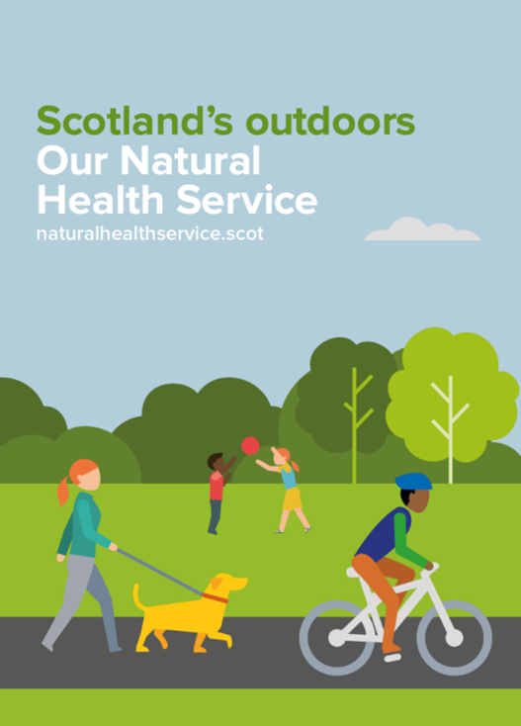
Making more use of Scotland’s outdoors
Connecting people and nature
Linking with other sectors
Demonstrating the benefits
Achieved by:
Joining up partners and existing work
Tackling health inequalities through better targeting
Increasing participation to achieve health outcomes
Notes:
…. to make more use of Scotland’s outdoors as ‘ONHS’
SNH is working in partnership with public and voluntary sector organisations across key policy themes, building on the evidence base &
the policy framework linking natural environment and human health, to help deliver Public Health Priorities around place, mental health and physical activity
This initiative contains a range of activity, with a specific focus on improved collaboration between the environment and health sectors
to maximise the contribution of the natural environment, including Parks & Protected Areas, to physical, mental and social health and wellbeing

Slide 3
Green Health Partnerships
Multi-sector
Responding to local priorities
Agreed strategy & Action Plan
Highland
Dundee
North Ayrshire
Lanarkshire
Environment;
Sport;
Leisure;
Health;
Education;
Transport
Notes:
A key part of this activity is the establishment of Green Health Partnerships – a high-level strategic intervention that’s influencing and delivering lots at local level –
- So I’m just providing an outline here:
These partnerships cover large geographic areas, are led by area health boards and local authorities, involve stakeholders from a range of sectors, policy themes and communities,
and have the main aims of - expanding Nature-based or ‘Green Health’ opportunities, and mainstreaming the approach into local health policy and practice
They are multi-sector collaborations that have responded to local health & social care policies, plans and priorities,
have identified mutual strategic objectives, and are working together to deliver agreed Action Plans
Scotland has 4 GHPs – in these geographic areas. Part of their work is to help health & care practitioners connect people to Parks and Protected Areas

Slide 4
Examples of how GHPs are working
Up-skilling healthcare staff – presentations, briefings, events, taster sessions – to show what sites and nature-based projects and interventions are available
Green health directories – enabling the public and healthcare staff to access information on what’s available in their local area
Green health referral systems – new systems, or integration into existing; connecting to social prescribing schemes that link to local services
New or expanded projects – health walk groups, community growing projects, active travel, environmental / health volunteering
Co-ordinated communications – a local GHP ‘brand’, web and social media profile, information and promotional materials, events, campaigns
Notes:
Up-skilling healthcare staff – presentations, briefings, events, taster sessions – to show what sites and nature-based projects and interventions are available -
Including information about the benefits of Green Health & supportive projects that make use of Parks & PAs
Green health directories – enabling the public and healthcare staff to access information on what’s available in their local area -
Including integration of data into health sector systems & processes
Green health referral systems – new systems, or integration into existing; connecting to social prescribing schemes that link to local services -
Including referrals to projects based in Parks & PAs
New or expanded initiatives – health walk groups, community growing projects, active travel, environmental / health volunteering -
Including projects that make use of Parks & PAs
Co-ordinated communications – a local GHP ‘brand’, web and social media profile, information and promotional materials, events, campaigns.
To raise awareness and encourage participation

Slide 5
Outcomes
Added value – co-ordination and collaboration to achieve integrated goals achieves more than if working independently
Policy alignment – GHPs connect with existing policies, and partners work to integrate goals into range of policy reviews / development
Targeted initiatives – projects and interventions aimed at those whose health would benefit the most, and seen as part of the solution
Closer partnership working between Health and Environment – greater connection between green health providers and health delivery
A strong voice – the development of local leaders, and the collective voice of GHPs are raising the profile and awareness of the benefits of green health
www.naturalhealthservice.scot
Notes:
These are some of the key Outcomes already demonstrated by these 4 area Partnerships
I’d highlight in particular the
Closer partnership working between Health and Environment – [ greater connection between green health providers and health delivery ]
There’s more recognition by Health of the un-tapped potential of Nature, and the contribution that Nature-based solutions can make to health improvement;
and those involved in managing Parks & PAs welcome the opportunity to show how valuable their sites are in responding to social needs –
which will in turn contribute to addressing broader issues of biodiversity loss and climate change.
More and more, we’re speaking the same language.
Further INFO via this URL - THANK YOU!

