Slide 1
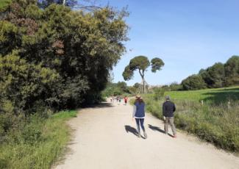
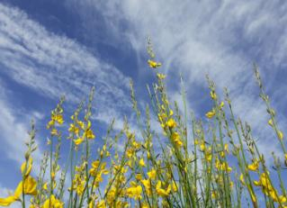
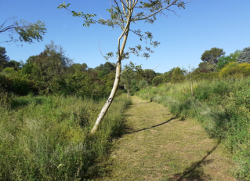
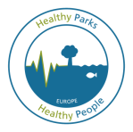
Nature and Health in the COVID-19 world – an environmental perspective
Carles Castell
Conservation Manager, Natural Areas Department, Provincial Council of Barcelona
Member of EF Health and Protected Areas Commission
HPHP Europe launch webinar, June 29th 2020

Slide 2
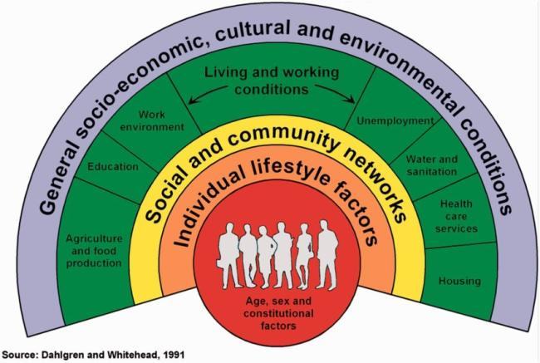
Definition of Health (WHO, 1948)
A state of complete physical, mental and social well-being and not merely the absence of disease or infirmity
Determinants of Health

Slide 3
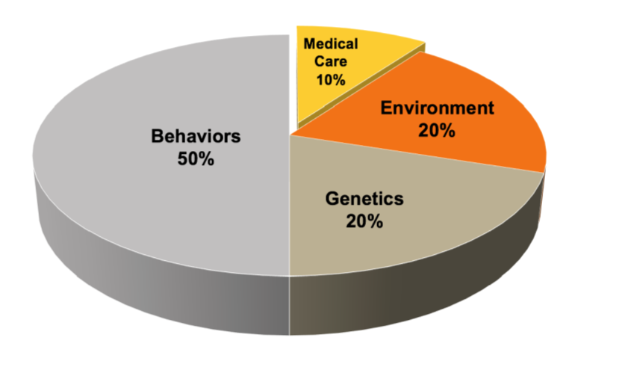
Relative Determinants of Overall Health
Source: “The Relative Contribution of Multiple Determinants to Health Outcomes”. Health Affairs, August 2014.

Slide 4
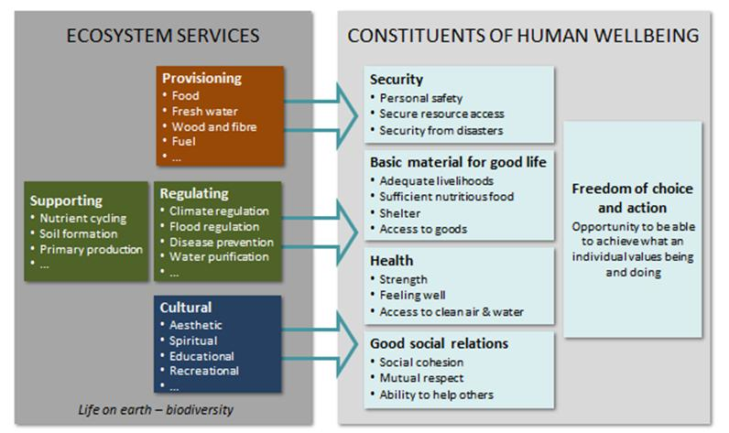
Conceptual Framework of Ecosystem Services
Pressures & Impacts
Source: Modified from “The Millenium Ecosystem Assessment, 2005”

Slide 5
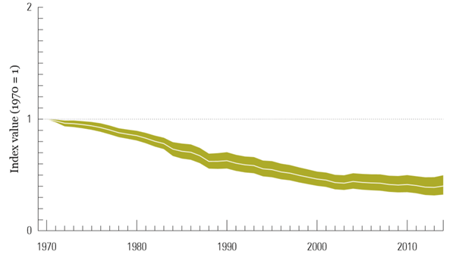
The Living Planet Index
The Living Planet Index (LPI) is a measure of the state of global biological diversity based on population trends of vertebrate species from around the world.
-60%
Source: Living Planet Report, 2018

Slide 6
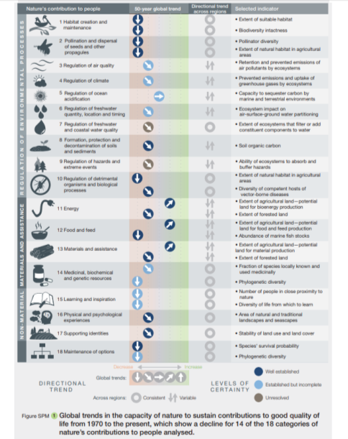
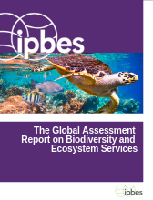
ASSESSMENT REPORT ON BIODIVERSITY AND ECOSYSTEM SERVICES
Source: The Global Assessment Report on Biodiversity and Ecosytem Services. IPBES, 2019

Slide 7
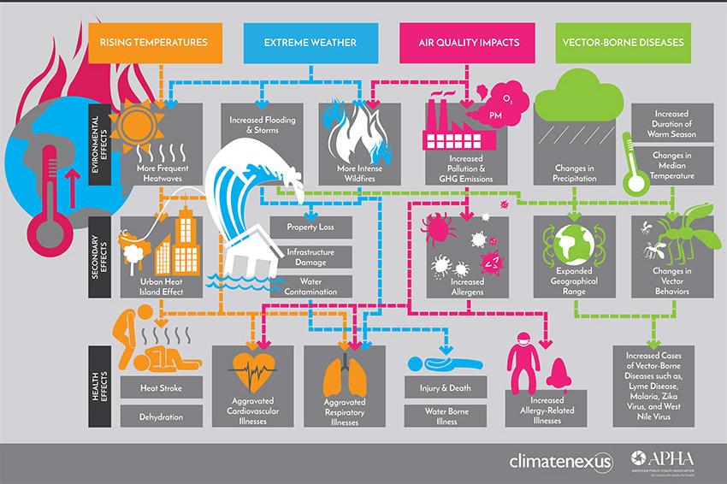
Effects of Climate Change on Human Health

Slide 8
The example of zoonosis control
Well-preserved natural ecosystems
Biodiversity controls viral load:
  Population control (interspecific relationships)
  Dilution effect (interspecific Biodiversity)
  Buffer effect (intraspecific Biodiversity)
Altered and simplified natural systems
Loss of biodiversity and weakening of ecological processes
  A high viral load passes to the vector species
  Direct contact of wildlife with humans
  Passage from pathogens to humans (zoonosis)
  Quick dispersal due to globalization
  Exponential contagion by concentration in large metropolis

Slide 9
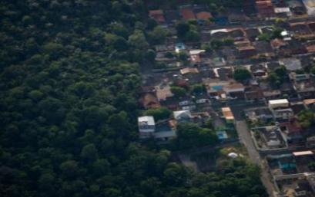
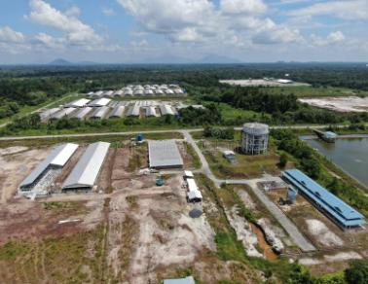
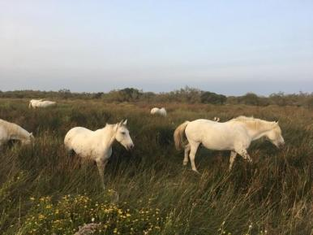
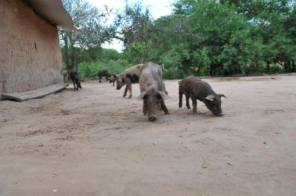
Virus Hendra, Australia (1994)
Virus Nipah, Malaysia (1999)
Photo: Greenpeace
Photo: Dreamstime
Source & Photo: WHO
Source & Photo: WHO

Slide 10
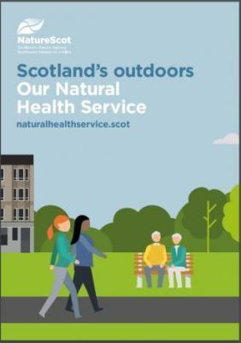
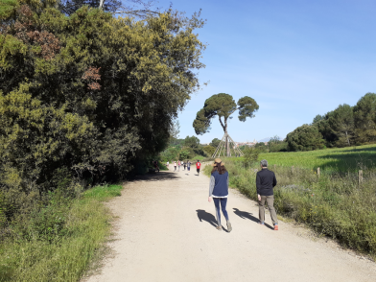
Benefits of contact with nature
Better physical and mental health
Guarding against future illness
Therapeutic and restorative qualities which enhance recovery
Reduced social isolation
Greater community cohesion
Opportunities to establish lifelong healthy behaviors.
Source: “EUROPARC Toolkit on Health and Well-being benefits of parks and Protected Areas”, 2018.

Slide 11
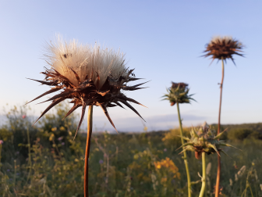
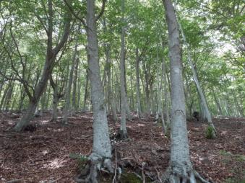
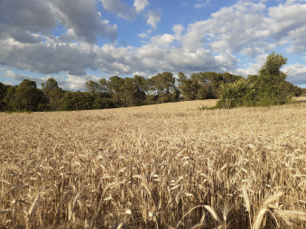
Parks & PA’s in the current post COVID-19 context
Growing social interest in nature during lock down.
Confinement emphasised inequalities in access to nature.
Parks & PA’s are strategic places to deliver health benefits.
Risk of overpressure by visitors.
Demand of specific activities for distinct groups and goals.
Need of resources, alliances and strategies for planning, developing and communicating programmes and projects.

Slide 12
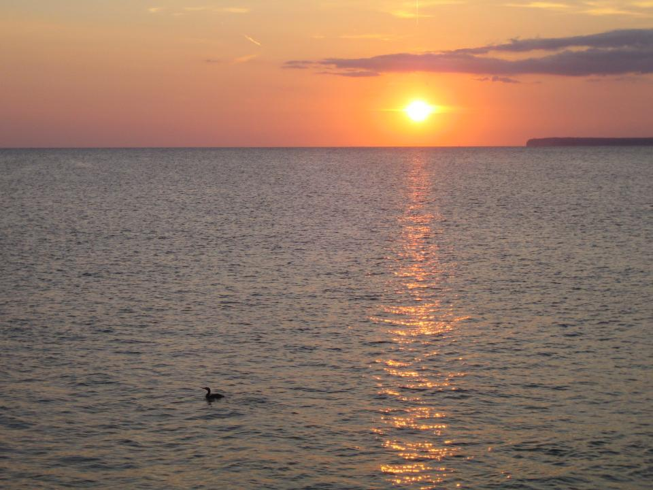

Many thanks

