Slide 1
Healthy Parks Healthy People Europe Connecting people and nature for a healthier and happier Europe
Trail to Nature
Joel Erkkonen
Parks & Wildlife Finland
Photo: Vastavalo / Mikko Karjalainen

Slide 2
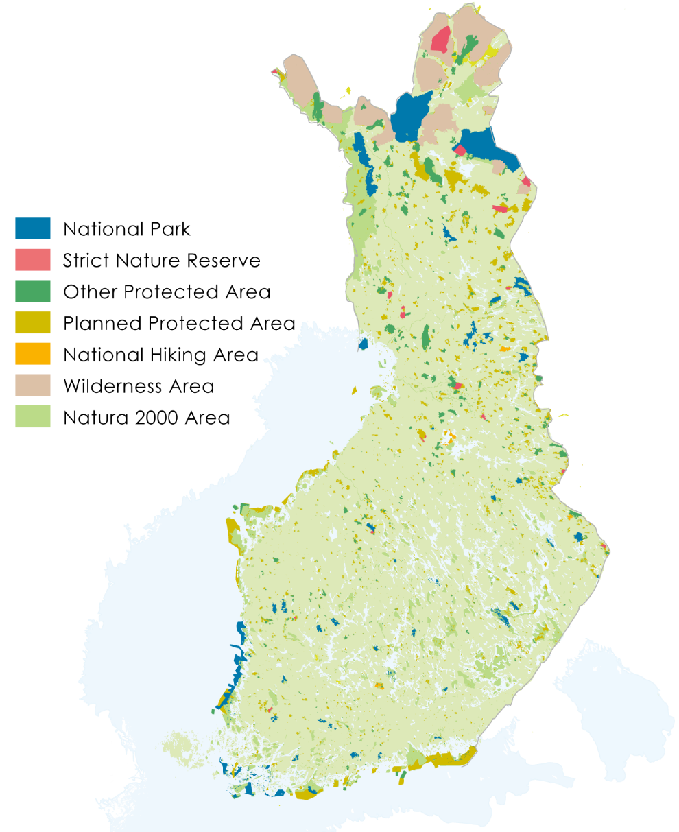
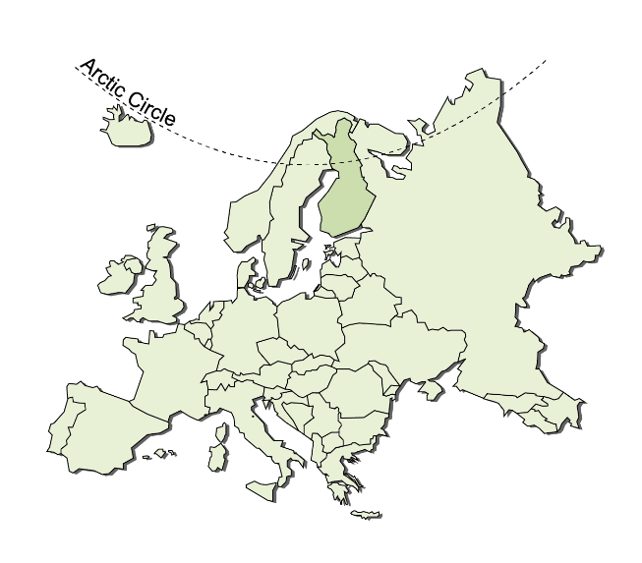
Parks & Wildlife Finland manages our most pristine nature and cultural heritage
One organization to manage all state-owned areas reserved for nature conservation and hiking:
40 national parks
19 strict nature reserves
5 national hiking areas
12 wilderness areas in Lapland
over 3,000 other protected areas
and cultural heritage sites

Slide 3
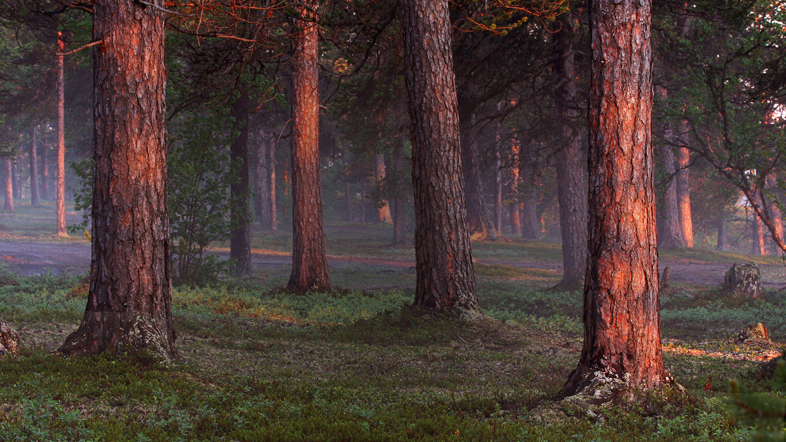

Slide 4
Case studies from Finland
Open Air (2012-2014) project focused on embedding nature in rehabilitation and integration services as well as improving access to urban and rural green space.
Moved by Nature project (2013-2015) aimed at developing nature-based health promotion interventions for groups classified as being high-risk groups.
Everyone Outdoors project aimed at improving access to nature in collaboration with the Finnish Federation of Adapted Physical Activity (2015-2016).
Moved by Nature II project (2017-2019) continues to develop nature-based health interventions, however children’s and adolescent’s increased physical activity levels as a target.
Trail to Nature project (2017-2019). Equal opportunities to reach nature are being developed further.
Nature Acces to All (NatAc) aims at facilitating access to nature tourism by developing a chain of accessible nature tourism sites in Latvia, Estonia and Finland.
Nature to Action
Photo: Maarit Vaahteranoksa

Slide 5
Trail to Nature
Accessibility project (5/2017−4/2019)
Metsähallitus Parks & Wildlife Finland (lead partner)
Finnish Federation of Adapted Physical Activity (main partner)
Budget 150 000 EUR (Ministry of Education and Culture)
Target groups
People with mobility aids
Professionals and experts
Public organizations and associations
Photo: Saša Dolinšek

Slide 6
Main objectives
Accessible Trail to Nature
More outdoor activities in Nature
Communications and networks
Photo: Petri Jauhiainen

Slide 7
Main actions
Service design events
Creating co-operation networks
Modelling and creating new types of adapted nature activities
Photo: Pertti Turunen

Slide 8
Key outcomes
Cross-sectoral cooperation networks
Planning tools
Service Trail to Nature - a planning tool for designing nature activities
Moving Nature - a planning tool for encouraging and motivating
https://julkaisut.metsa.fi/assets/pdf/lp/Muut/polkuluontoon-palvelupolkuluontoon.pdf
https://julkaisut.metsa.fi/assets/pdf/lp/Muut/polkuluontoon-liikuttavaluonto.pdf

Slide 9
Photo: Joel Erkkonen

