Slide 1
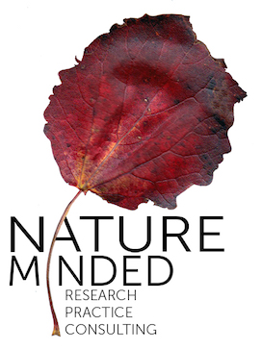
Healthy Parks Healthy People
Katriina Kilpi
NatureMinded, BOS+
Notes:
Concept
Being physically active in nature for 30 min for 30 days.
Online diary:
3 surveys (pre – during – post)
4 years of campaigning, reach across Flanders

Slide 2
Duration & frequency of outings increased
Changes in outdoor activities
Strong correlation between naturalness, energy levels and mood of active participants (participated >20 days).
At lockdown time used to travel to nearby nature dropped
Dependence on car & losing company caused many to dropout
Effect of too little green space:
”At the beginning of the lockdown it was really nice to go for a walk in the forest. Now I'm waiting for my mask to arrive to go back for a walk ".
Photo: Unsplash

Slide 3
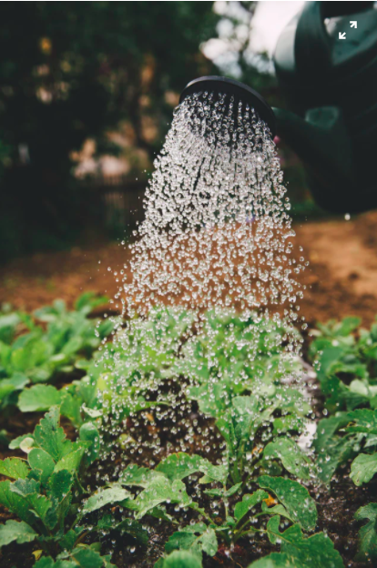
Effect of lockdown on perception of naturalness
More than just “green space” - it is a sensory experience. More relaxed time in same green space might support noticing nature.
Importance of green space:
Freedom, nothing better to do..
Physical movement
Time to be on my own, a break from work, peace and quiet..
Access to nearby nature for overall health is ESSENTIAL.
Photo: Unsplash
Notes:
Also important the nearby green : grope who stoppped after first week – we saw the was a link between the time they needed to travel to nearby nature and wheter they stayed active in the campaign. However, numbers are low, and differences are not statistically significant.
Naturalness

Slide 4
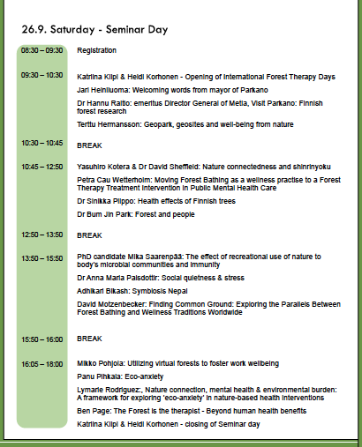
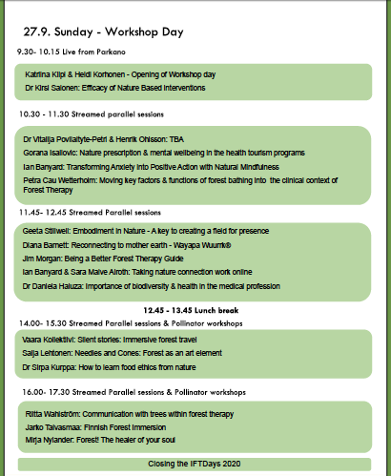
www.foresttherapydays.com

