Slide 1

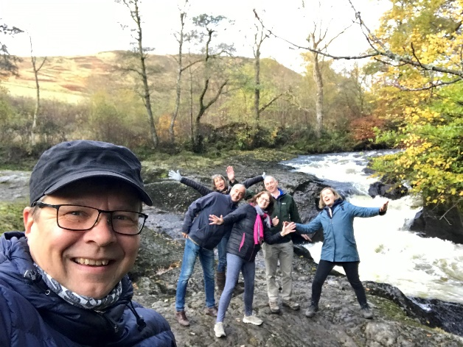

Healthy Parks, Healthy People Europe – introducing the strategy
Pete Rawcliffe – Head of People and Places for SNH and EUROPARC Federation Council member

Slide 2
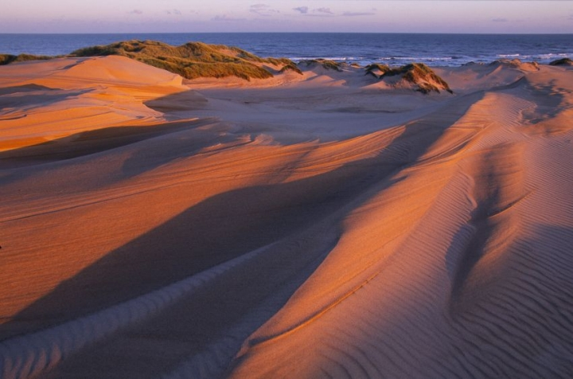
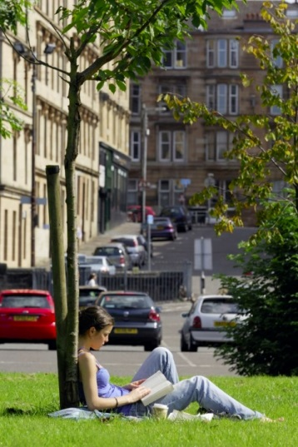
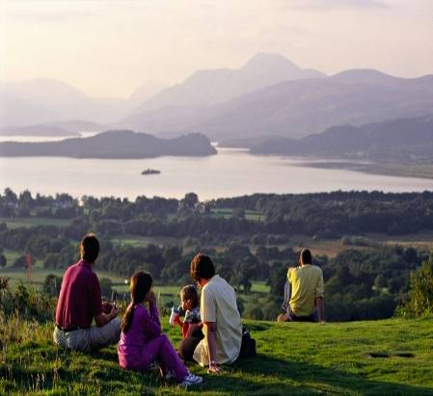
Title for this page
Text
“Everybody needs beauty as well as bread, places to play in and pray in, where nature may heal and give strength to body and soul”

Slide 3
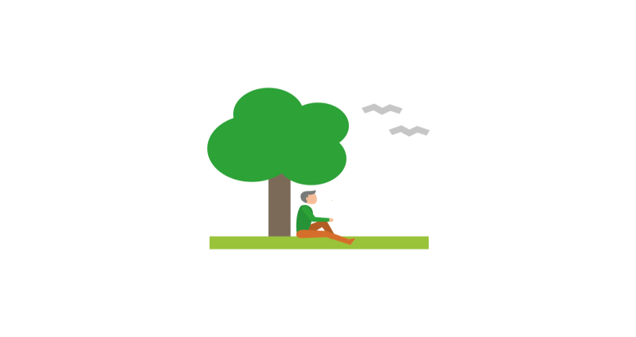
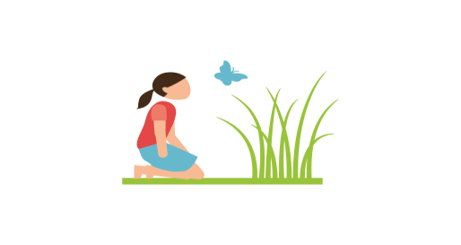
Nature is good medicine
For: improved mental and physical health,
lower stress and blood pressure, reduced risk of illness
Dosage: Take at least one dose a day with fresh air
Side effects: Improved mood, sleep, attention,
creativity, social contact, energy and happiness
Warning: Keep in reach of children (and adults)
How ? – recreation, environmental volunteering, bush craft, forest bathing, outdoor learning, gardening, active travel etc
Ways to well-being
Be active
Take Notice
Keep leaning
Connect
Give back

Slide 4
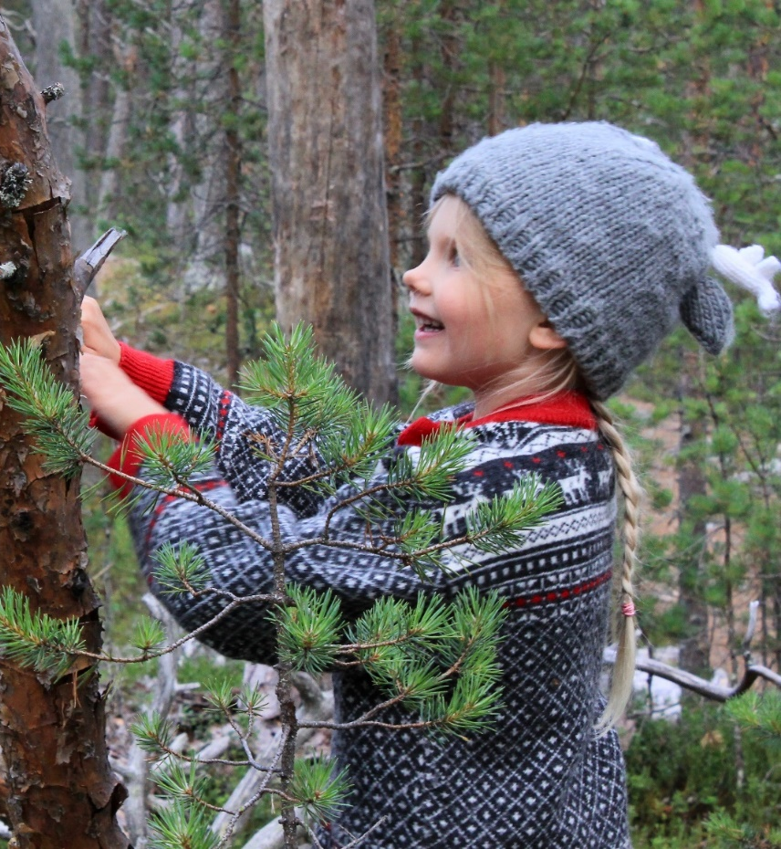
The role of Parks and Protected Areas
Europe’s parks and protected areas are well placed to support health outcomes for people.
Europe’s parks and protected areas are on the door step
There is a lot of good practice already happening in parks and protected areas
There are challenges - relevance; funding; developing new partnerships with new sector/stakeholders
There are opportunities to demonstrate the benefits of nature for people and makethe case for investment

Slide 5
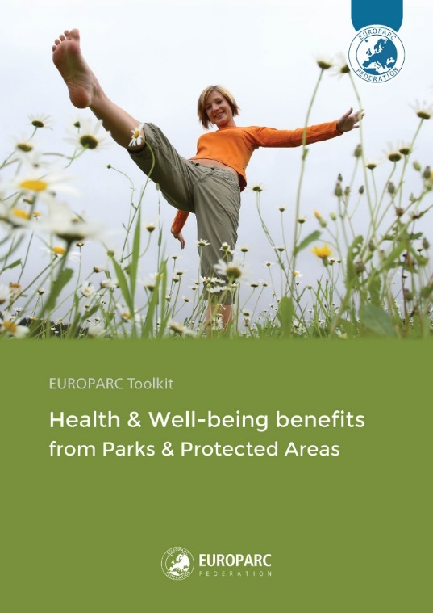
Key elements of good practice
Strategic planning
Site management
Communications
Staff training
Outreach to new audiences
Partnerships with health sector
Green exercise programmes
Monitoring & evaluation

Slide 6
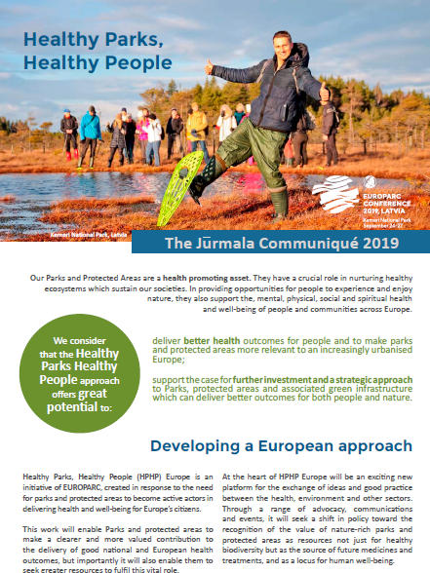
Jūrmala Communiqué
deliver better health outcomes for people and to make Parks and Protected Areas more relevant to an increasingly urbanised Europe; and
support the case for further investment and a strategic approach to Parks, Protected Areas and associated green infrastructure
See https://www.europarc.org/wp-content/uploads/2019/10/Jurmala-communique_EUROPARC2019.pdf

Slide 7
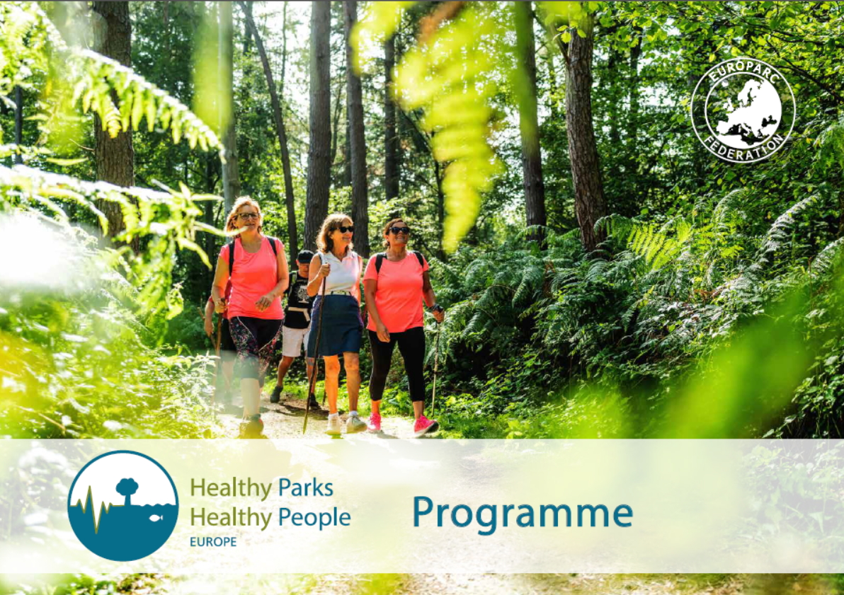

Slide 8

What?
A Europe-wide programme developed by the EUROPARC Federation to support parks and protected areas at the national/regional and local level to deliver better outcomes for the health of people and nature.

Slide 9
Why?
To maximise the contribution of Europe’s parks and protected areas to key policy priorities on:
Improving public health and well-being and reducing health inequalities
Protecting, restoring and investing in biodiversity,
Responding to the climate emergency
An essential part of the green recovery from COVID-19.

Slide 10
How?
Better provision of well managed, accessible facilities and engaging target groups in health-promoting activities.
Stronger policy, practice and partnership working to improve public health and well-being and reducing health inequalities.
More people from all backgrounds enjoying the health benefits of connecting with nature and supporting the case for better protection, restoration and further investment in Europe’s parks and protected areas.

Slide 11
Our vision
Happier and healthier people more connected to nature-rich parks and protected areas
The four pillars
Making the case
Building partnerships
Developing capacity and practice
Connecting people and nature

Slide 12
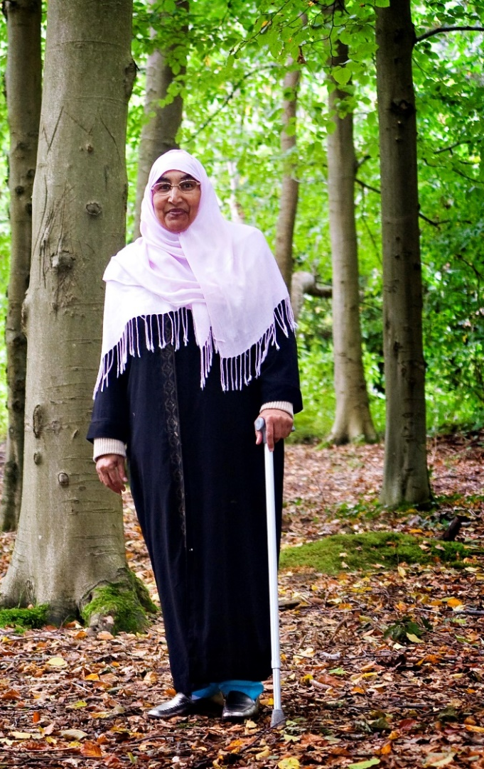
Key outputs
Establish a HPHP Europe platform of health and protected areas experts
Publish and promote a HPHP Europe toolkit and case studies for parks and protected area staff
Deliver HPHP Europe workshops, online seminars and study visits to build knowledge and capacity
Develop key messages to promote HPHPe Europe and promote a “nature for all” approach
Establish a HPHP Europe project to develop and share good practice in the use of “five ways to well-being”“5 ways to well-being” in parks and protected areas

Slide 13

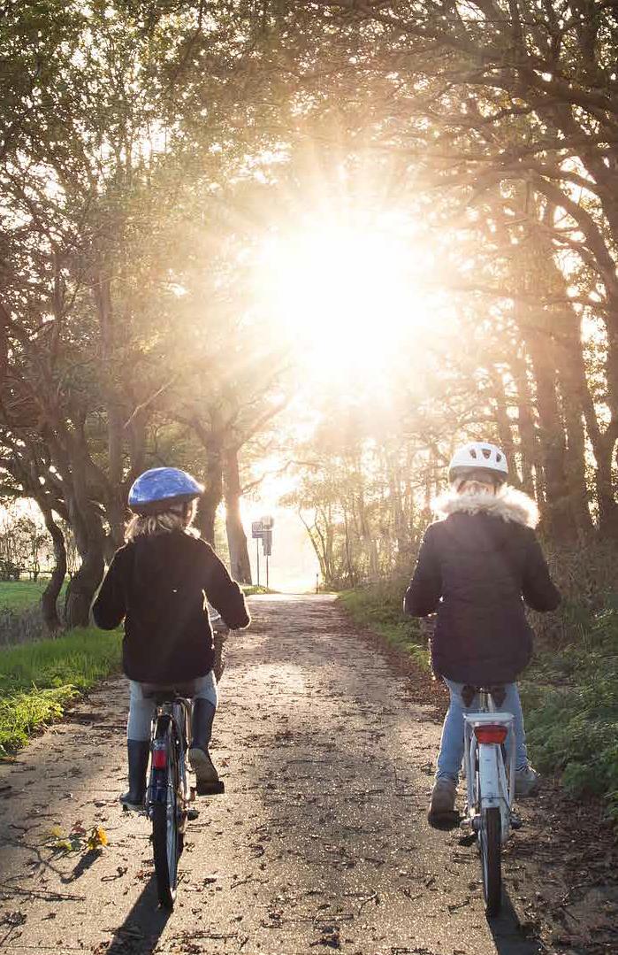
Join us
Join us in helping make Europe a healthier and happier place by
Champion HPHP Europe in regional, national and European policy and practice
Promote a “nature for all” approach to help attract new audiences to parks and protected areas and help reduce health inequalities
Invest in programmes and projects in parks and protected areas that support public health outcomes
Work together and stay in touch

