Slide 1


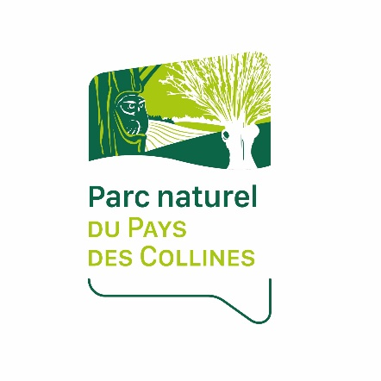

Conference EUROPARC 2020 – 8th/9th september
Workshop 2
Agriculture in Parks : how can we communicate to farmers,
with farmers, for farmers?
Study case in the Walloon Nature Parks (Belgium)
Baptiste HOTTEKIET – Director NP Pays des Collines
b.hottekiet@pnpc.be

Slide 2

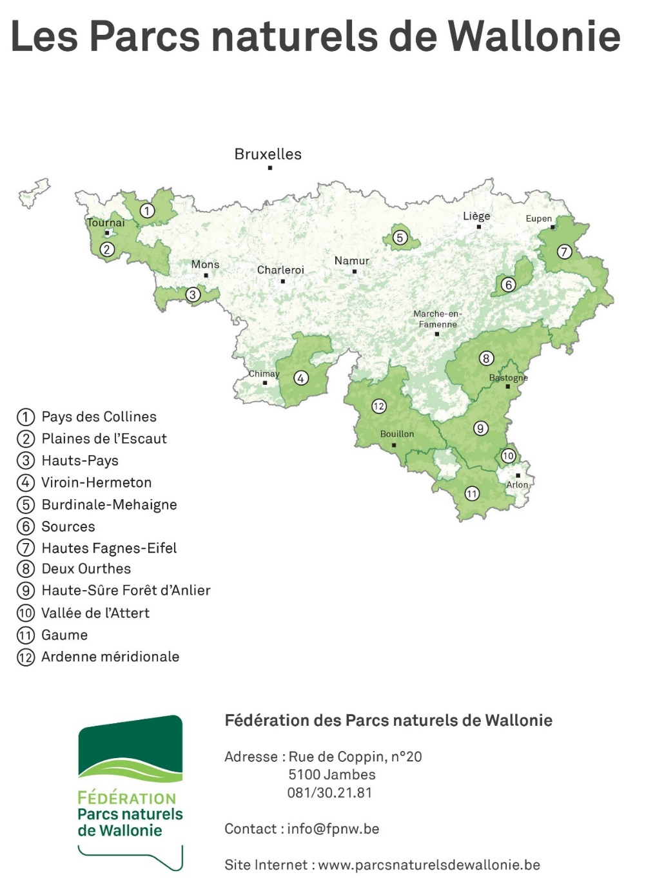
Nature Parks in Wallonia :
12 Nature Parks – 9 near 3 borders (FR, GE, LU)
1 near Flanders
Same missions (walloon Decree) but differentiated according to the challenges of the territories
Natural resources and the environment
Rural and economic development
Landscape and territory development
Education
Innovation
Cooperations
= a living and preserved territory with economic activity and
inhabitants. Not a territory under a bell. Not a Nature Reserve
= work with and for the inhabitants in order to preserve
the territory together
1 Federation of the walloon Nature Parks

Slide 3
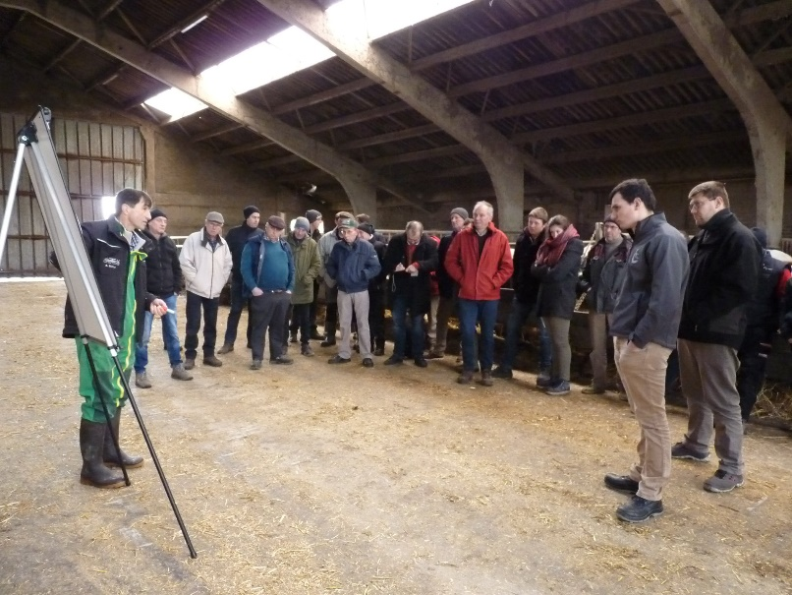
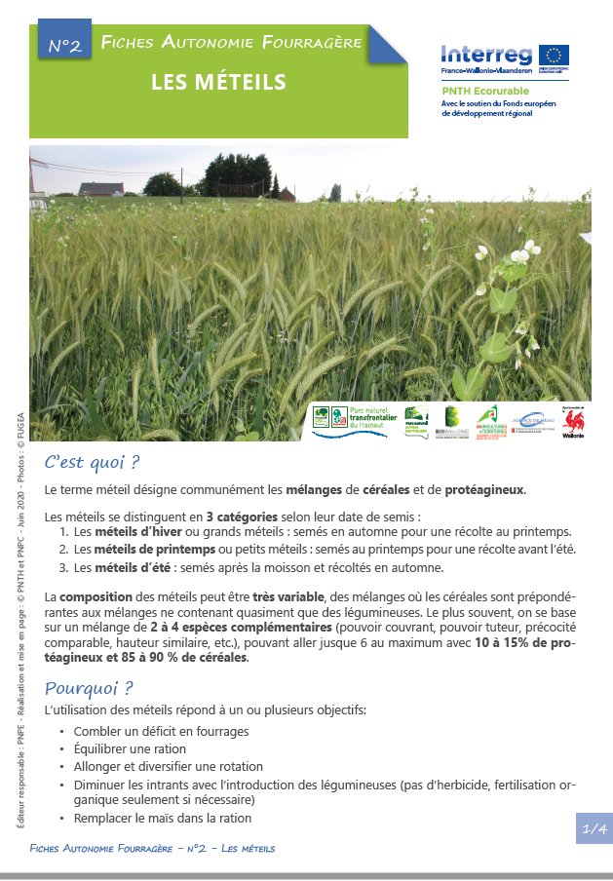
How Walloon Nature Parks promote a better communication
with farmers ?
Using the same language
First step: use an agronomic language
Second step: use a biological language after the implementation
of a trust relation
Often organizing meetings and especially keeping in touch
over the long term
Agricultural events
Studies meeting about sustainable and profitable agriculture
Following them in the transition
Be an administrative support, and give to them tools
Offer them a service, advices and lend equipment
Demonstrate that combining ecology and economy is possible
Knowing their work, understanding their
difficulties and listening to them
Target the right times to contact and to visit them
Have empathy and be able to identify quickly the obstacles to changes
Be up to date on agriculture
Be formed and informed

Slide 4
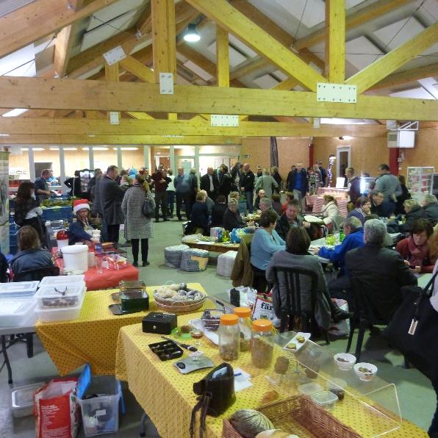
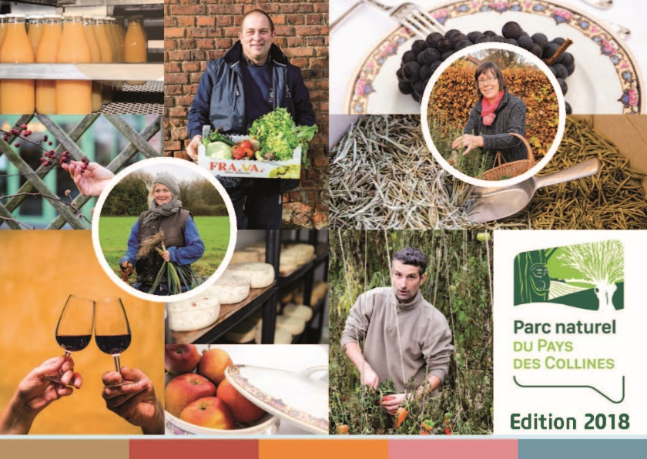
How Walloon Nature Parks improve the image of
farmers towards the public and consumers ?
Organizing and promoting events which facilitate the
meetings and the understanding between citizens and
farmers
Inform (new) inhabitants that they live in a rural
area and that an agricultural reality goes with it
Support and promote open days, opening of a farm store
Organize farmer’s markets with local food
Organize internships on farms with children
Implementation of social agriculture in the farms, with the
farmers and for people with social stall or for a public
with a mental handicap
multifunctional roles of agriculture
more links with public and not just produce food
Promoting the projects of farmers
Use our communication supports (website, Facebook
page, leaflets, flyers), or other communication
supports (television report, video capsule, radio,… )
Installation of banners on the fields with messages.
For example: “here, the farmer has planted hedges or
produces local food”, or “here the farmer has restored a
meadow with high biological
value”
Including the farmers in the decision-making process and in the projects of the Nature Parks
In the board of directors or general assembly
In working groups

Slide 5
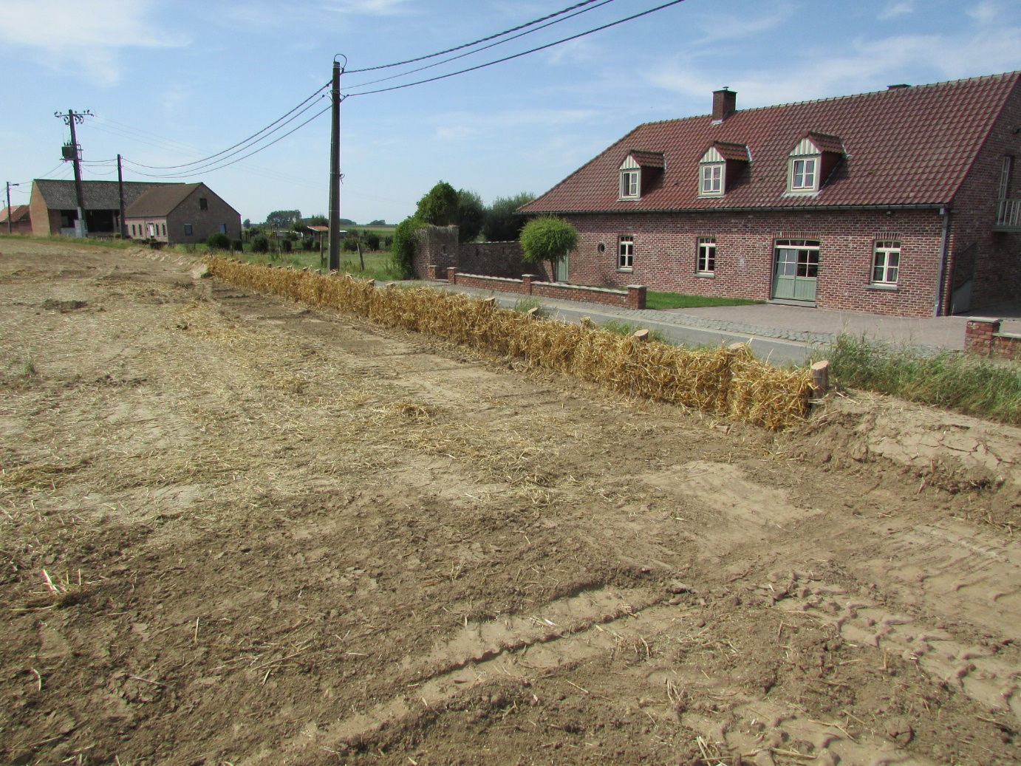
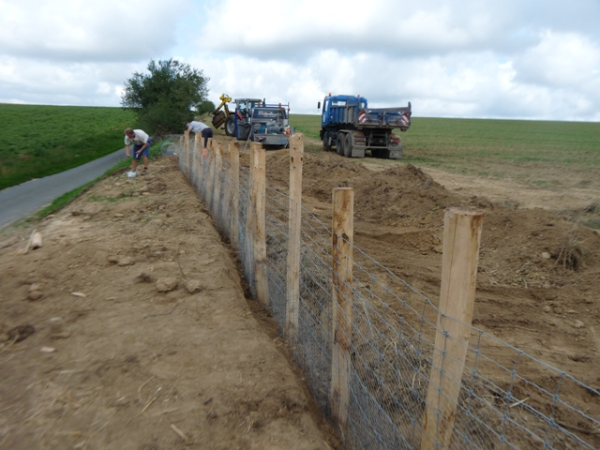
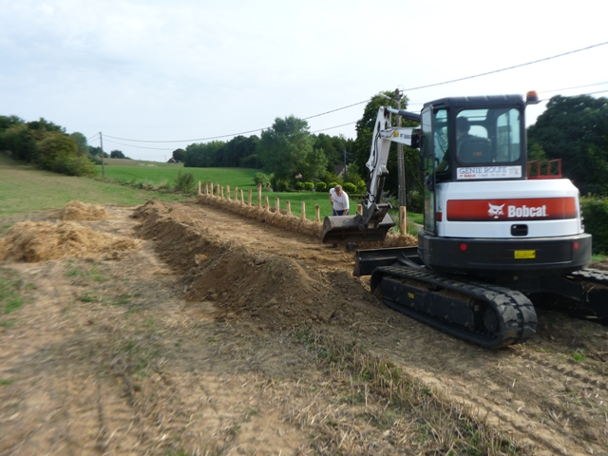
How Walloon Nature Parks support the relation
between farmers and public authorities ?
Being an intermediary, a relationship facilitator
about some problems
NP = place for exchanges and debates
Global view to solve some problems (erosion, …)
Co-organizing events with the involvement and
the support of public authorities
Organize farmer’s markets with local food
Festival with and for farmers => help of municipal
workers and with a specific municipal budget
Being a partner, an expert, to implement the
municipal rural development strategy
Animate debates or working groups

Slide 6
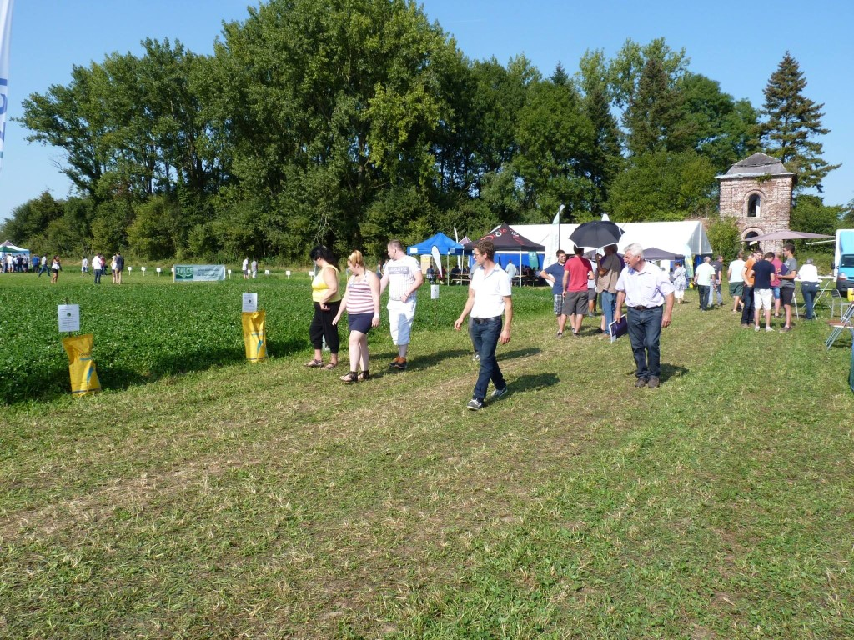
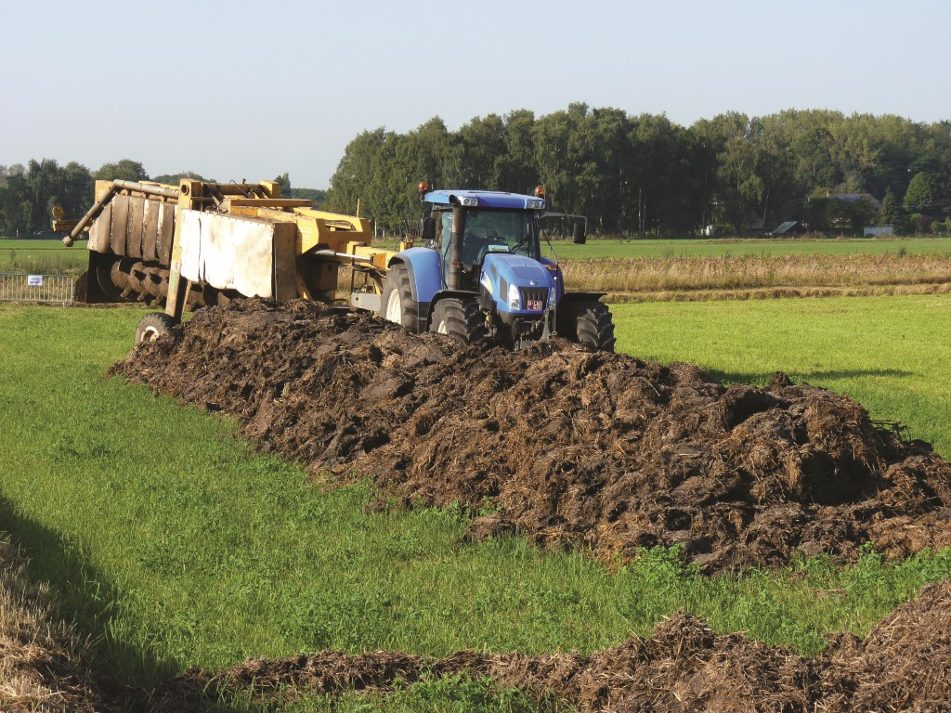
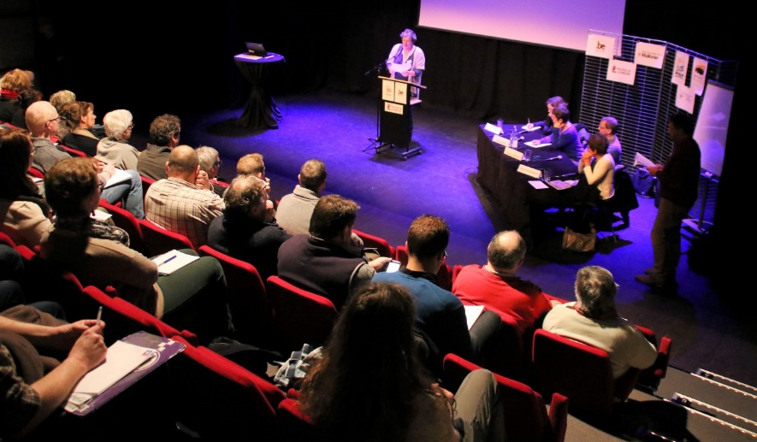
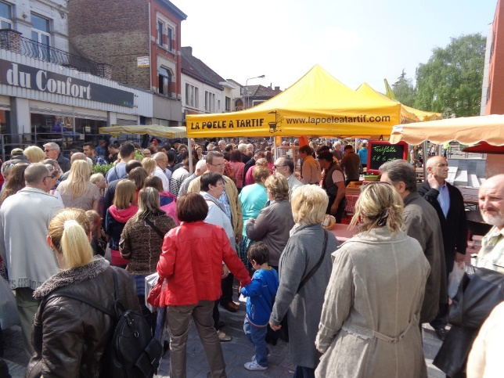
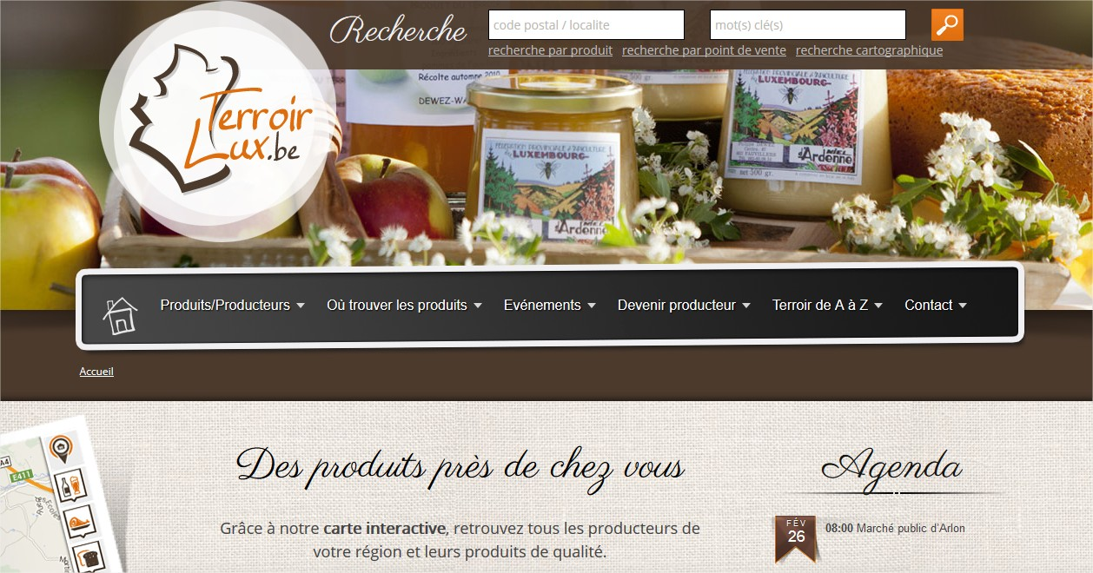

Slide 7
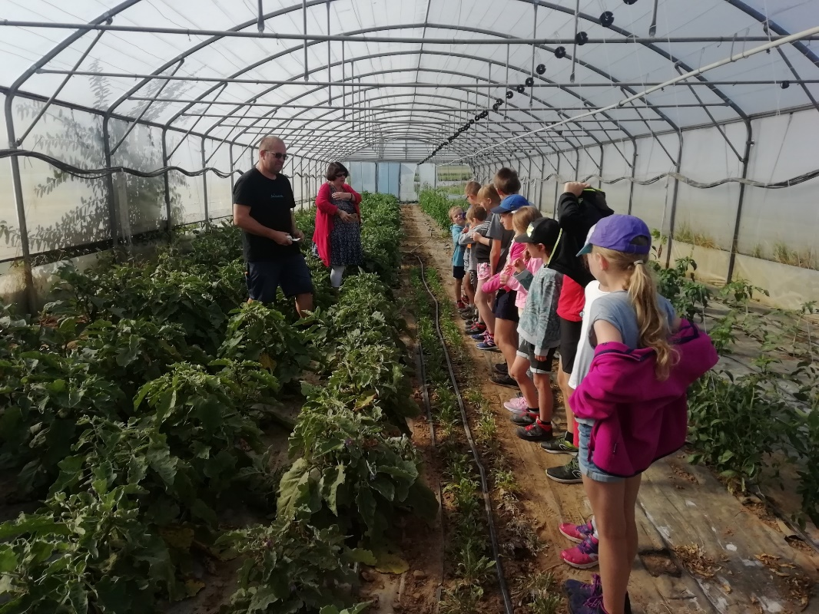
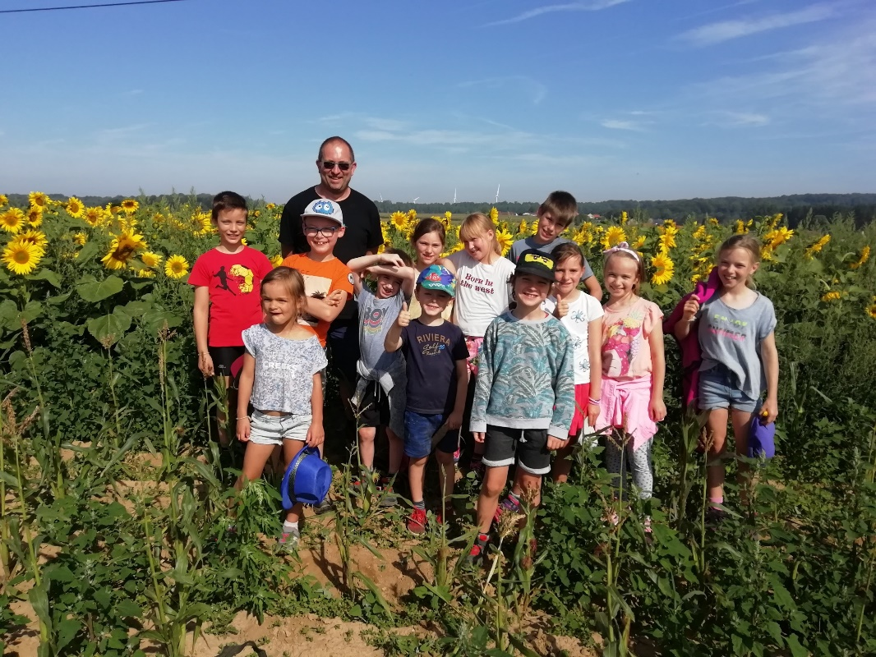
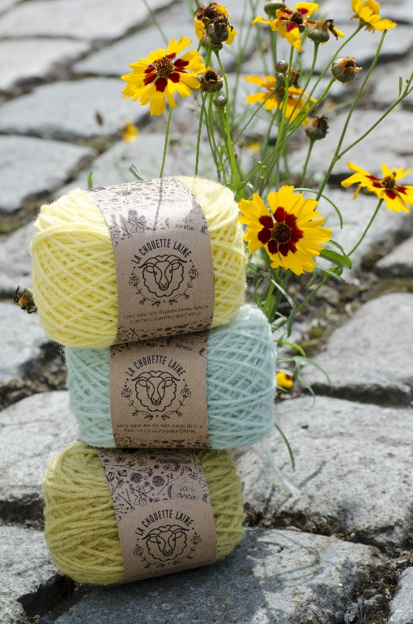
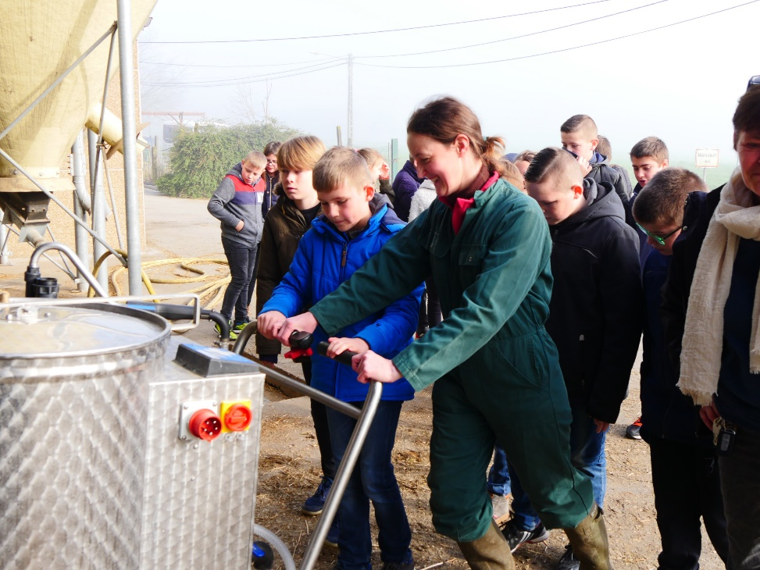
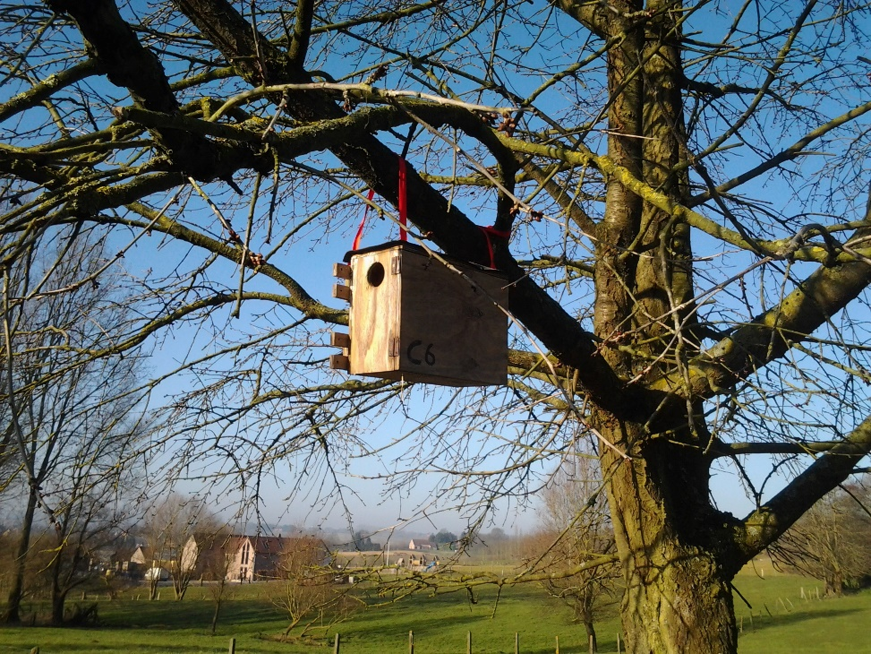
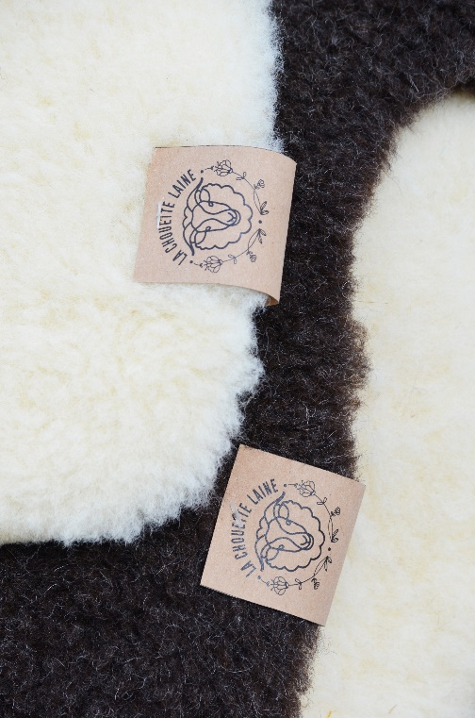

Slide 8
Thank you for your attention
Coordinator: Nicolas Nederlandt – nicolas.nederlandt@fpnw.be
Director: Baptiste Hottekiet – b.hottekiet@pnpc.be

