Slide 1
EUROPARC Conference 2020
Youth Advisory Board: a way to youth inclusion
Carolina Chinese & Nicola Ceschia
Spokenperson, spokenperson deputy of MAB Reserve Italian Julian Alps
carolinachinese@gmail.com
ceschia.nic@gmail.com

Slide 2
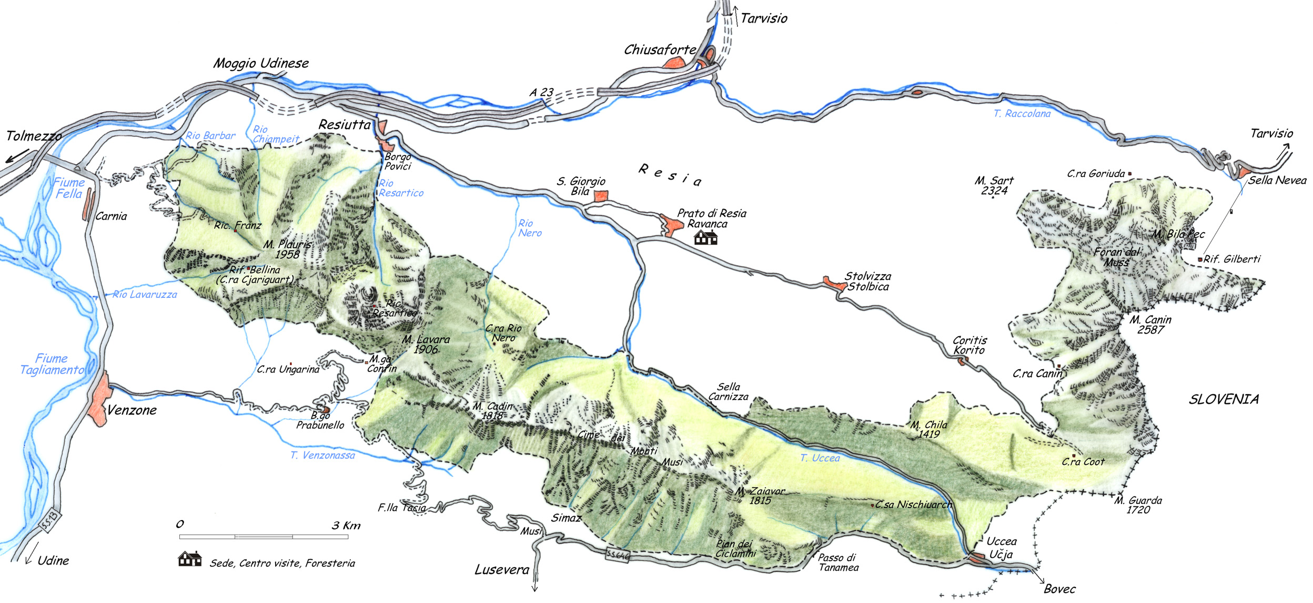

A little piece of Heaven:
Julian Prealps Nature Park
Located in Friuli Venezia Giulia region, north-east Italy;
Born in 1996;
Six municipalities

Slide 3
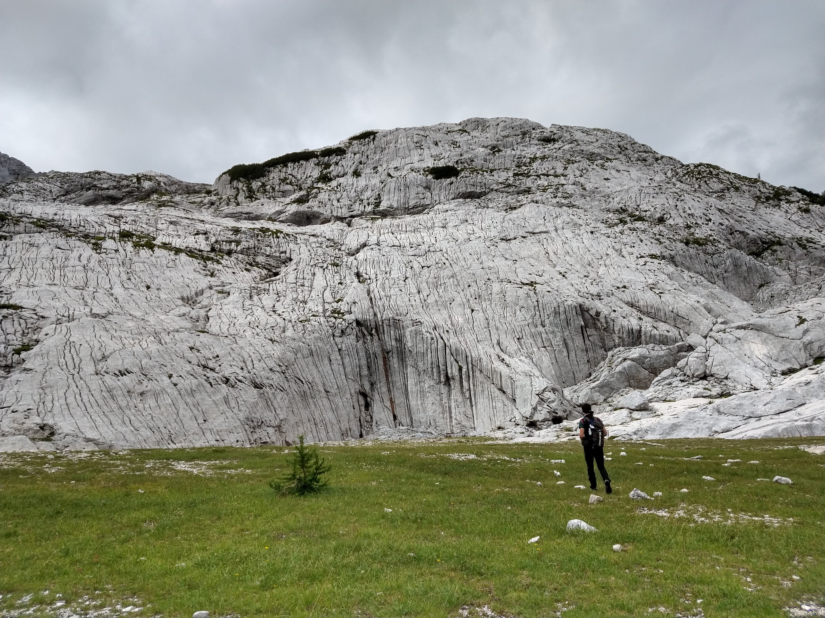
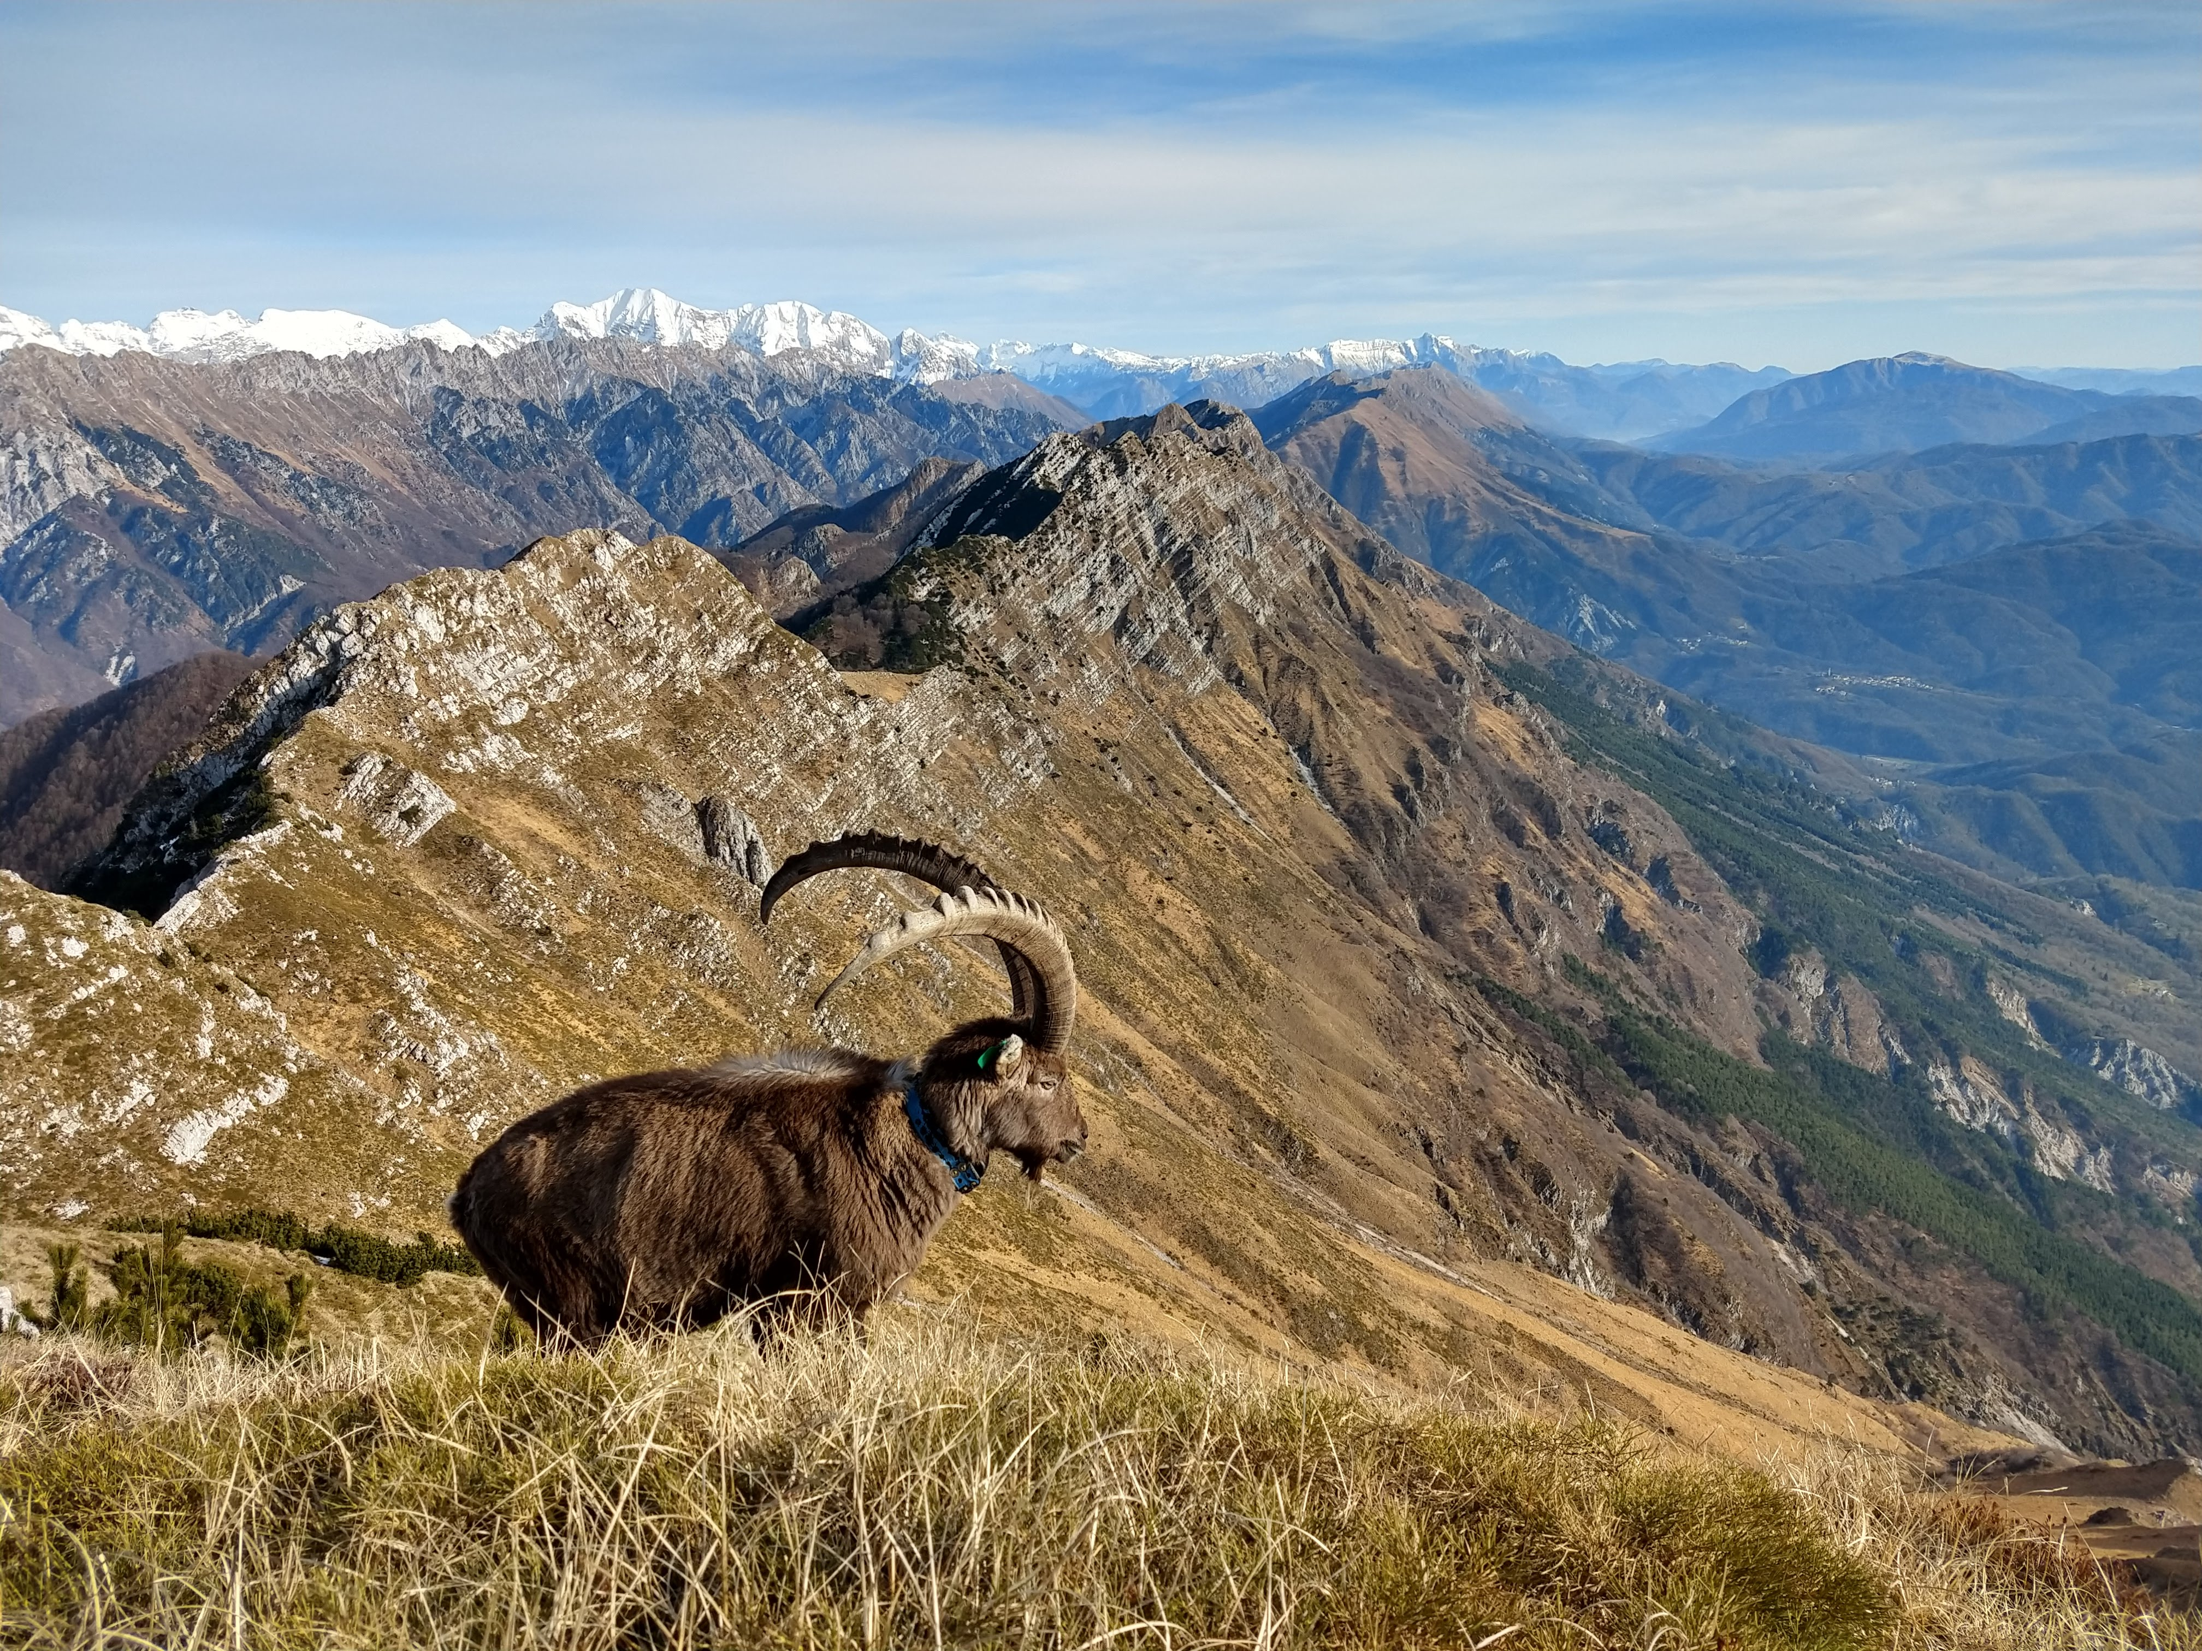
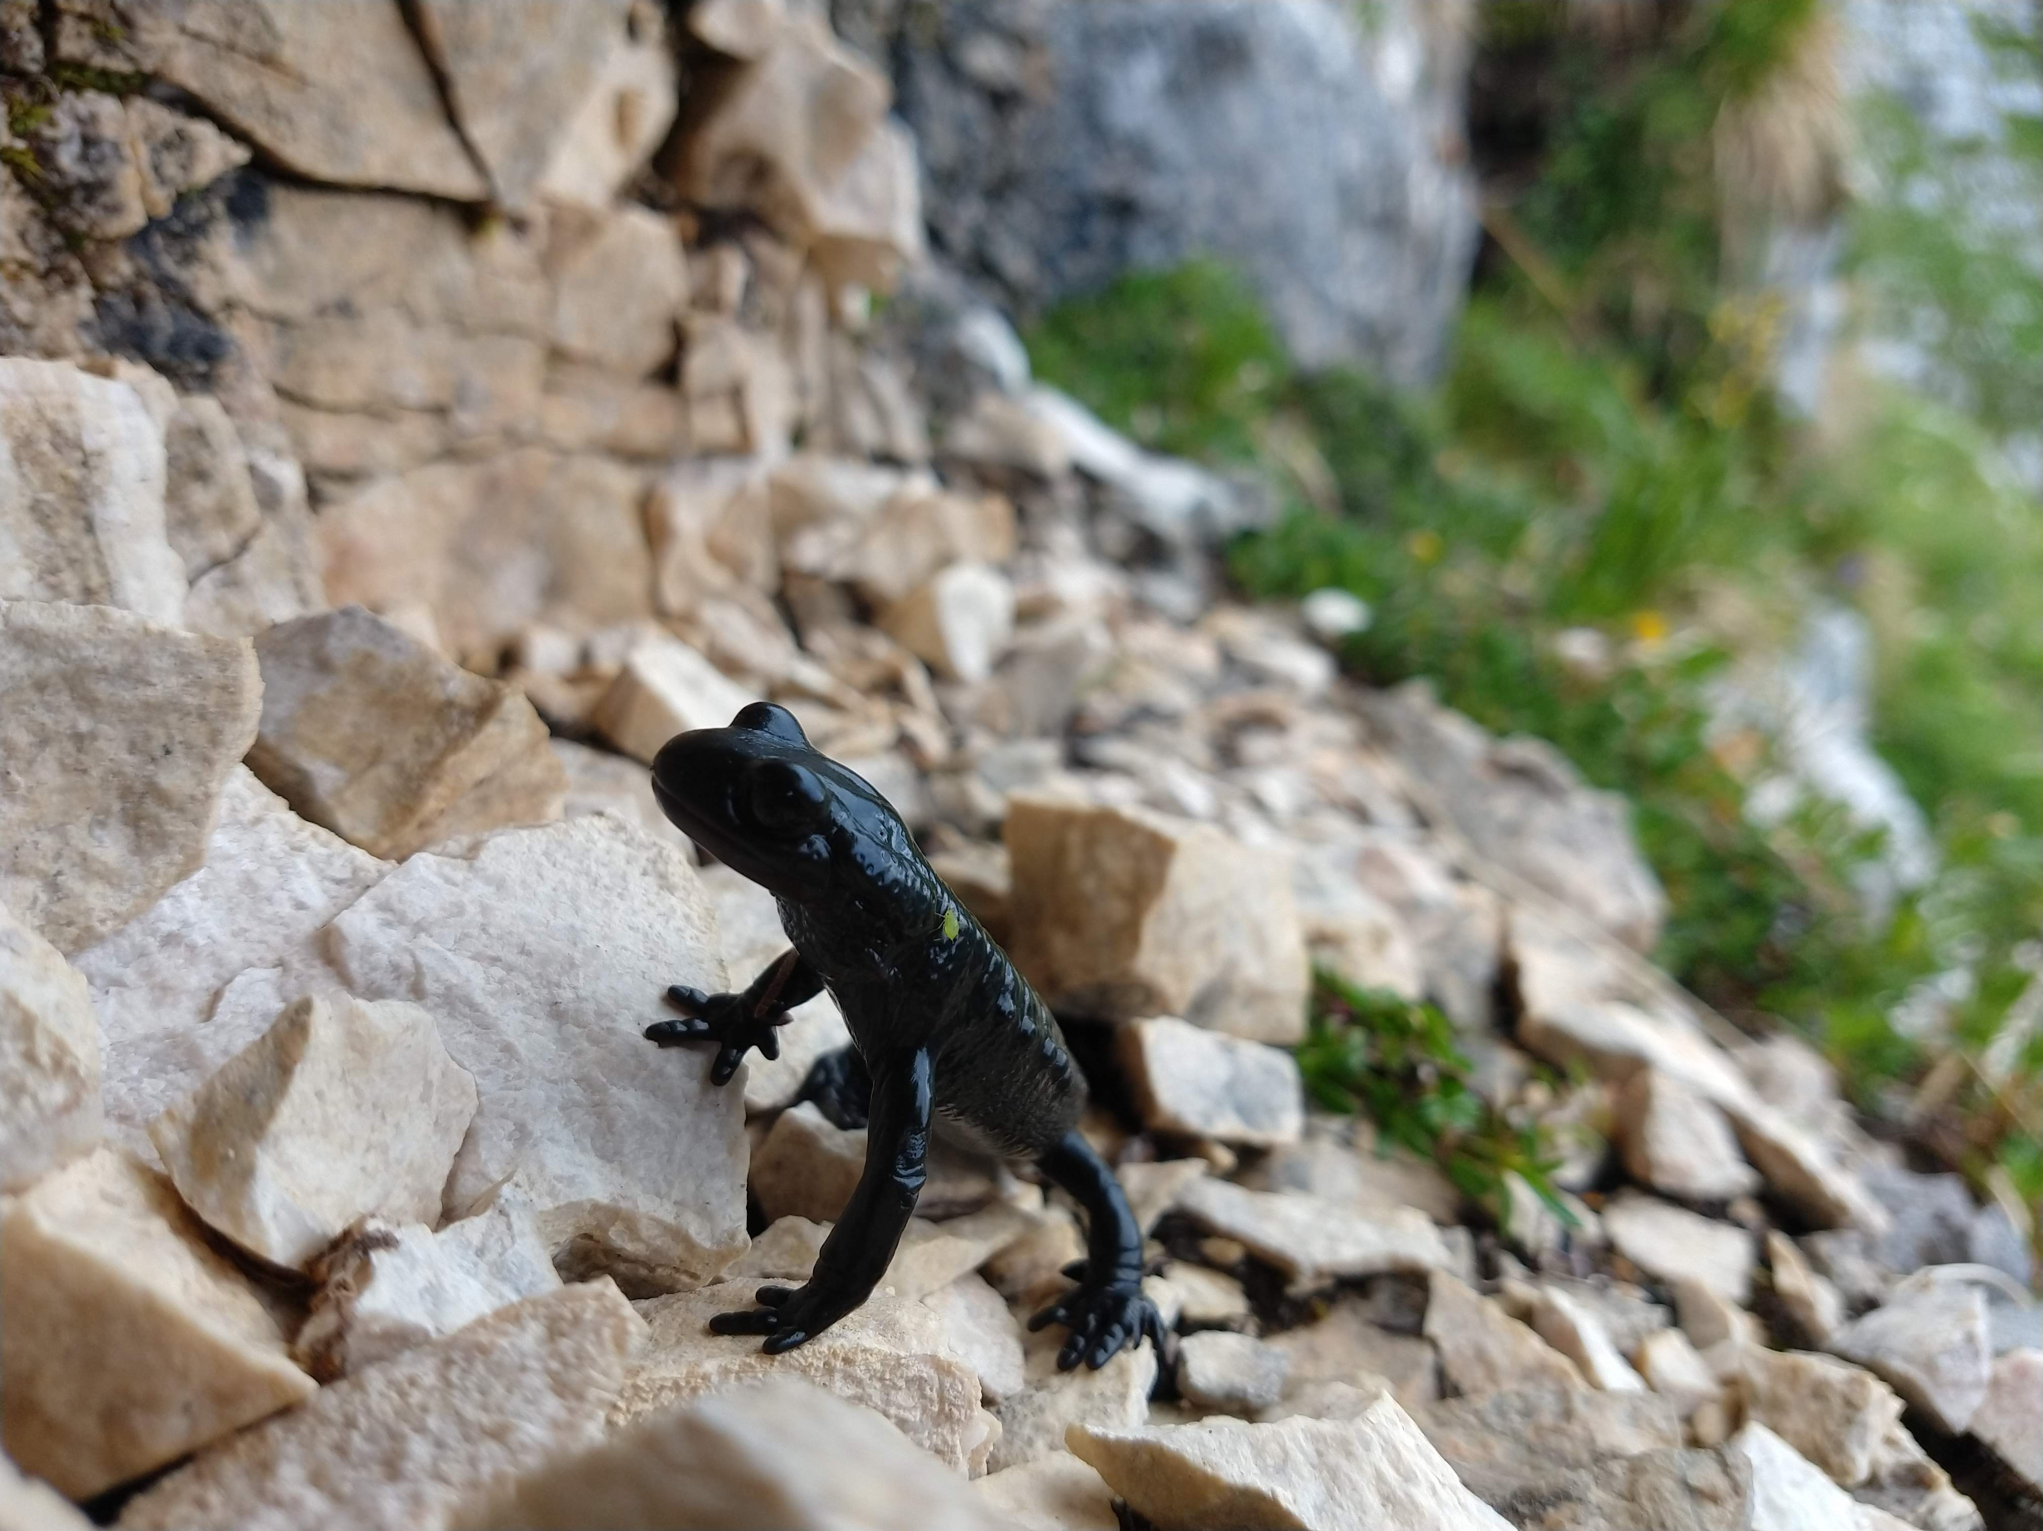
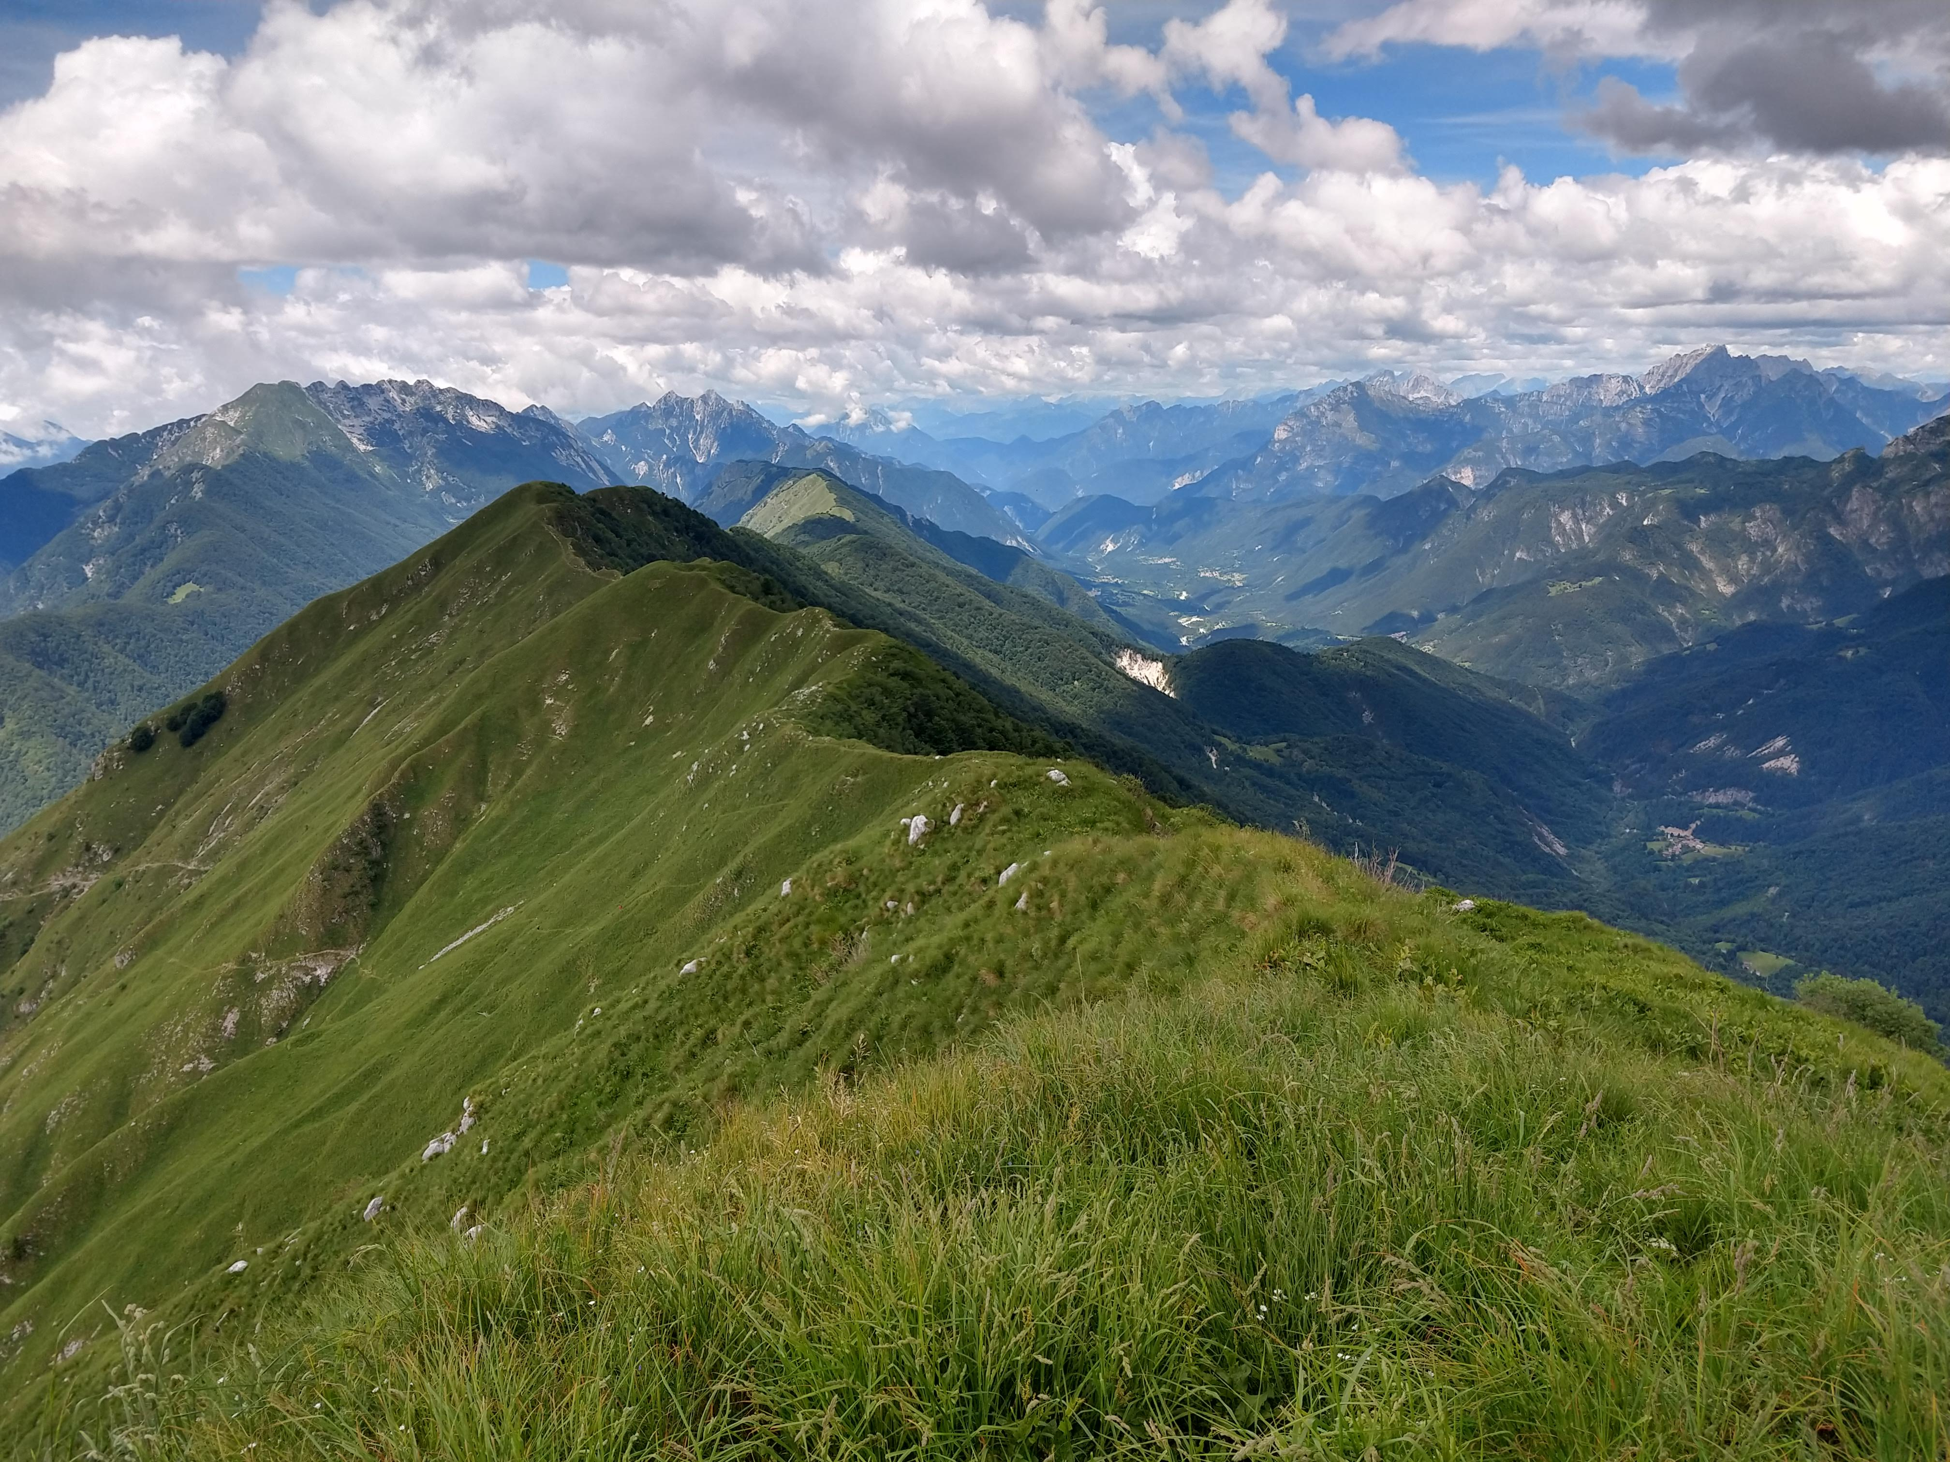
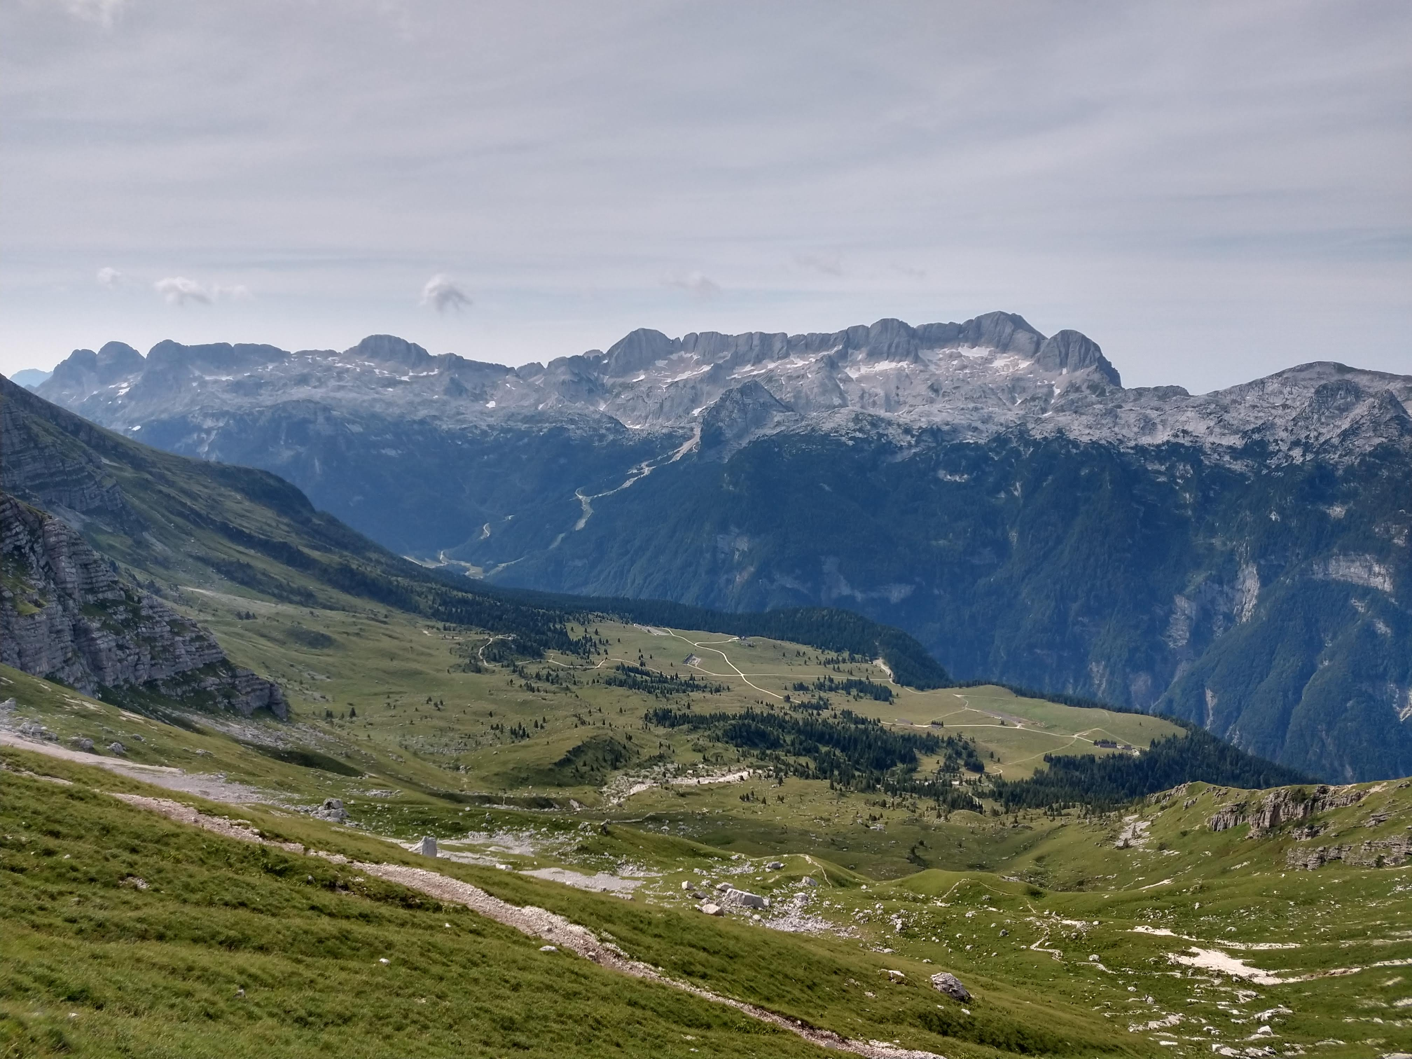
Snaps from our Land
Julian Prealps Nature Park is a land full of biodiversity. It’s part of Alpe Adria region, an ideal transboundary area between Friuli, Slovenia and Carinzia (Austria).

Slide 4
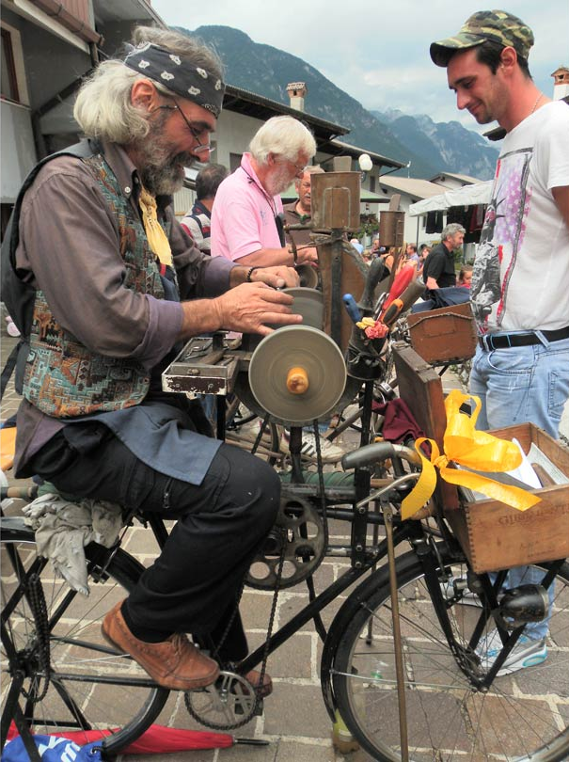
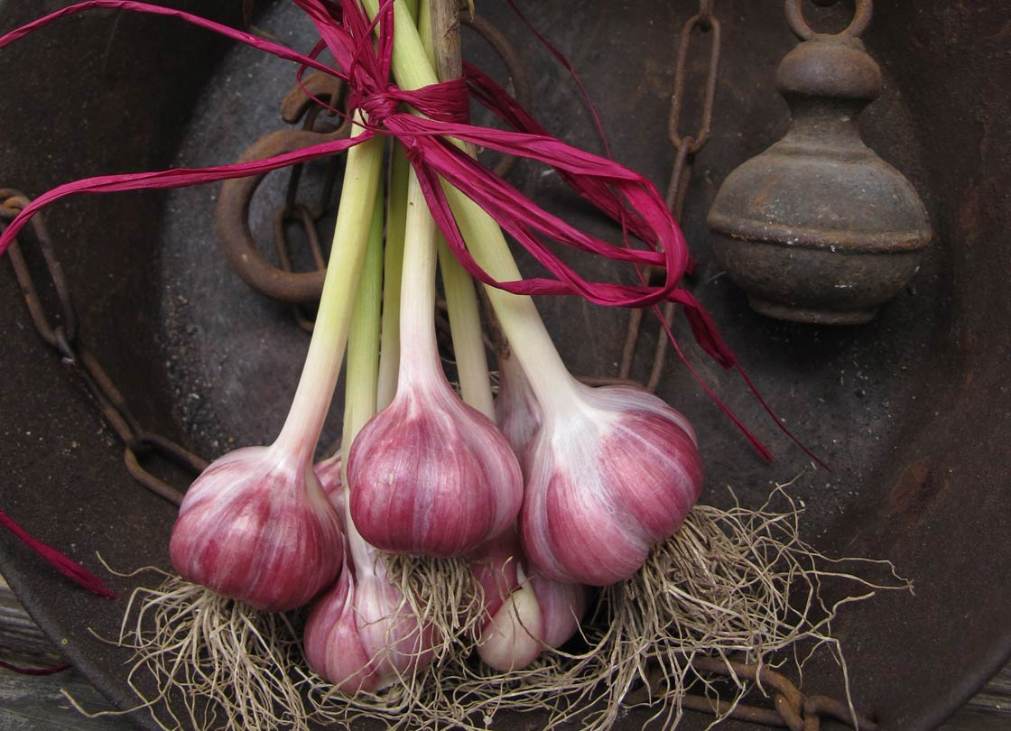
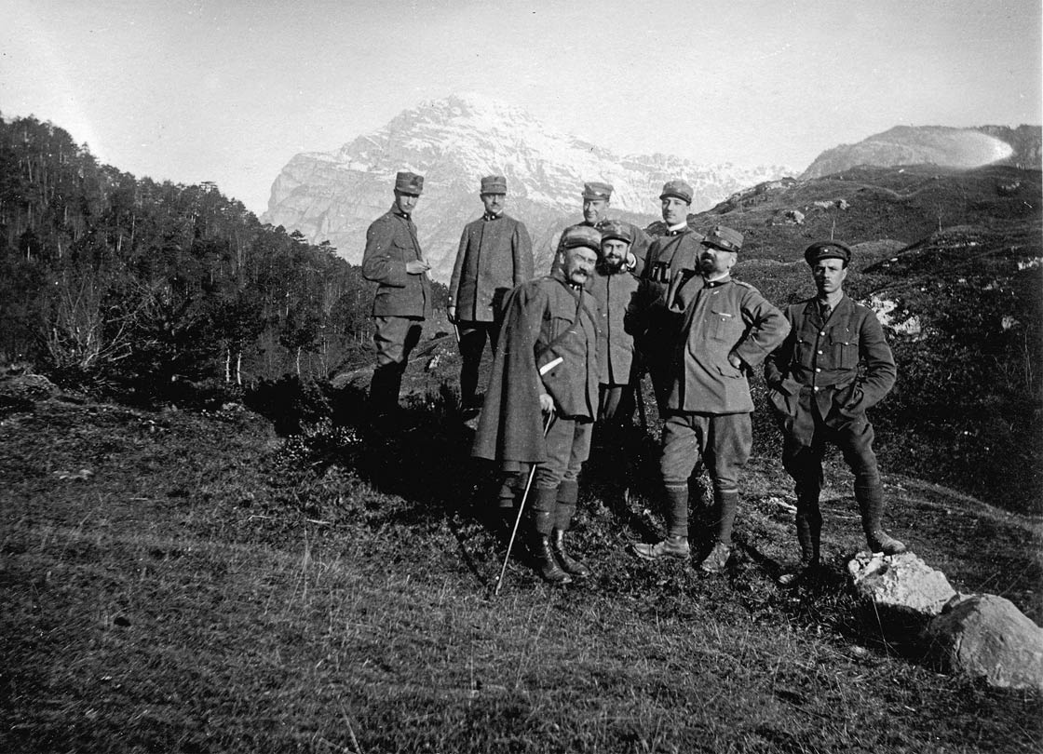
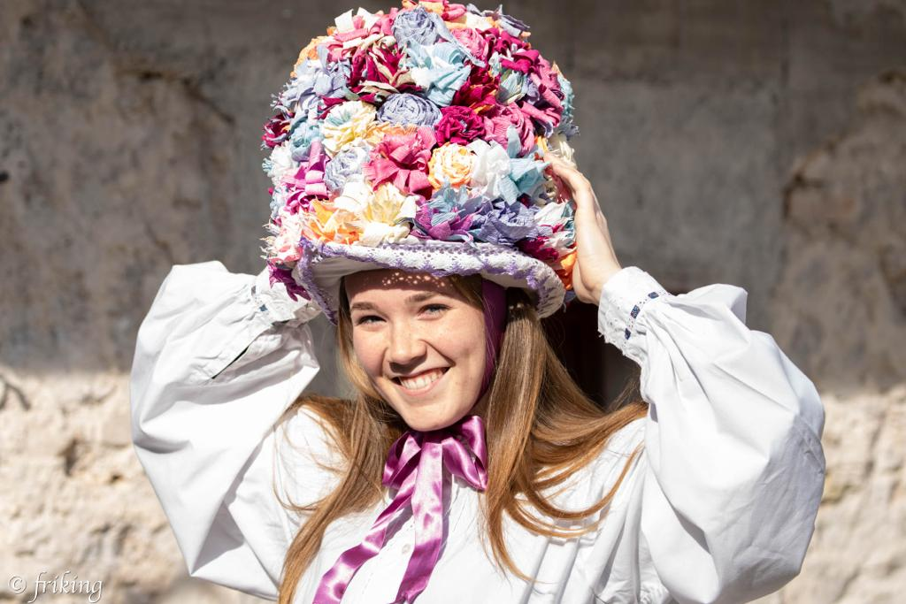
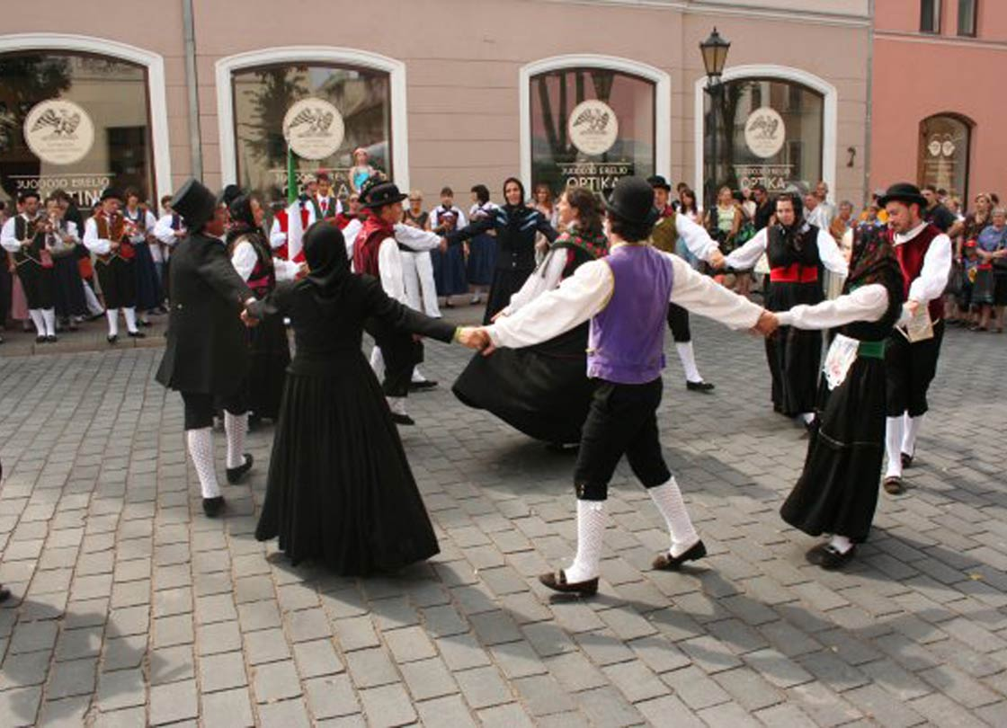
Snaps from our Land
Not only biodiversity, but also «human» diversity:
Two minority languages and other different dialects;
Each valley has its own culture and traditions;
Local products such garlic from Resia (strok), SlowFood brand product.

Slide 5
From Nature Park to MAB Reserve
Thanks to all this diversity, to the commitment and will of the Park and the municipalities, MAB Reserve Italian Julian Alps born in 2018/19.
The purpose of the MAB project is to promote a balaced relationship between human beings and the environment through the protection of biodiversity and good practices of Sustain Development.

Slide 6
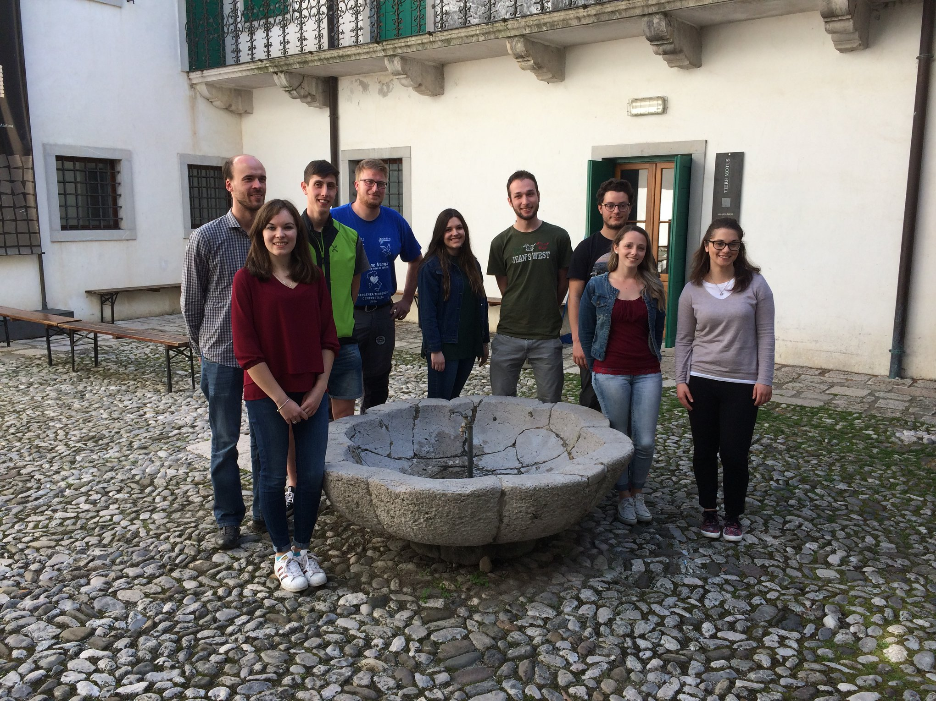

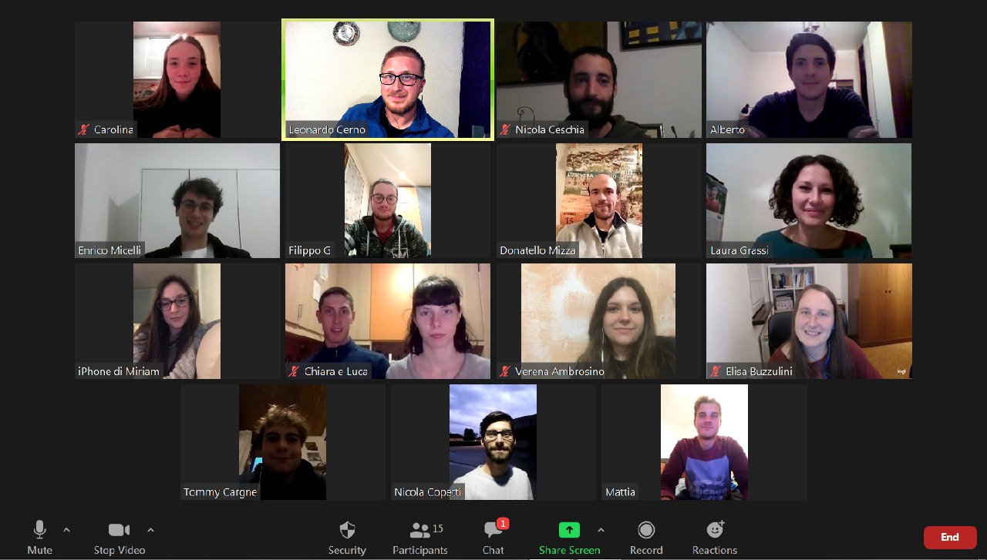
Youth Advisory Board
“The active participation of young people in decisions and actions at local and regional level is essential if we are to build more democratic, inclusive and prosperous societies.” From “Revised European Charter of the Participation of Young People in Local and Regional Life, 2013
Who are we?
Young people from 16 to 30 years old;
Young people from the 11 municipalities of the MAB Reserve;
Cross skills and passions to be active citizens for our territory;
An official part of the MAB Reserve management authority

Slide 7
Values
Awareness and active partecipation
Learning, as a process of continuous improvement of knowledge and abilities
Promotion of our cultural heritage in all its meaning
To actively contribute to the writing of youth projects
To promote cultural exchanges with people from other protected areas
International, national and local cooperation
Comunications as useful tool of exchange
Responsibility of today's generations towards the future ones

Slide 8
To play a consultive and proactive role into the MAB Reserve’s decision-making process
To promote the active partecipation of young people into territorial activities
To widen the local knowledge of young people
Purposes
Encourage the relation between youth living withins the Reserve’s municipalities
To plan activities that could bring young people close to the reality of the Reserve
To widen the local knowledge of young people

Slide 9
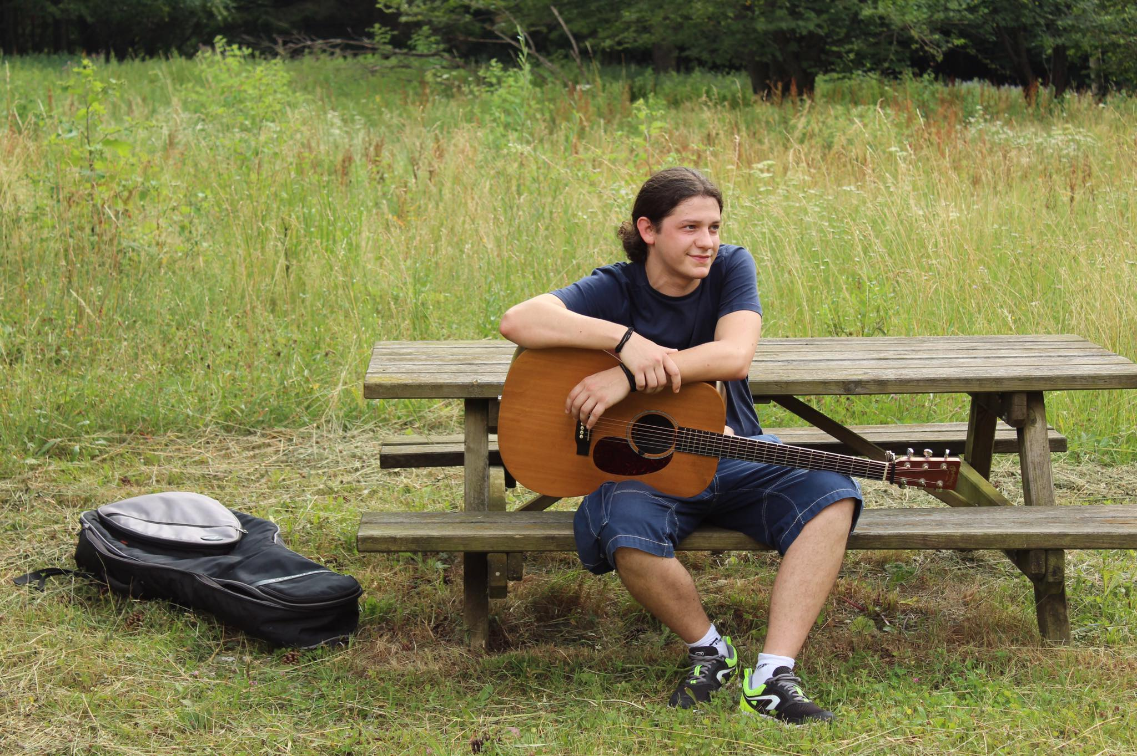
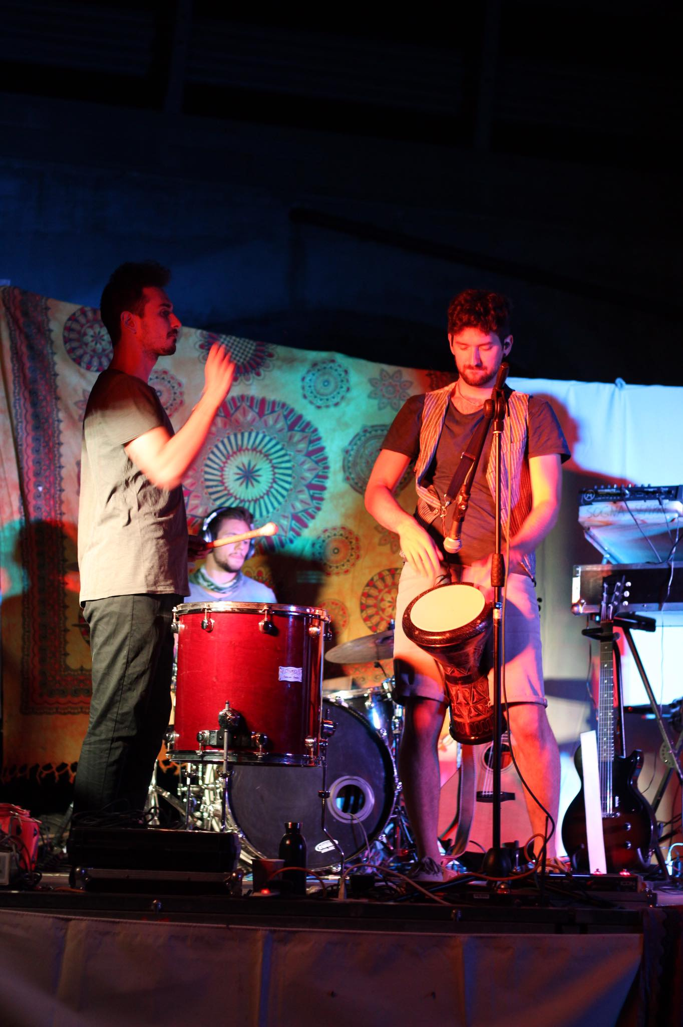

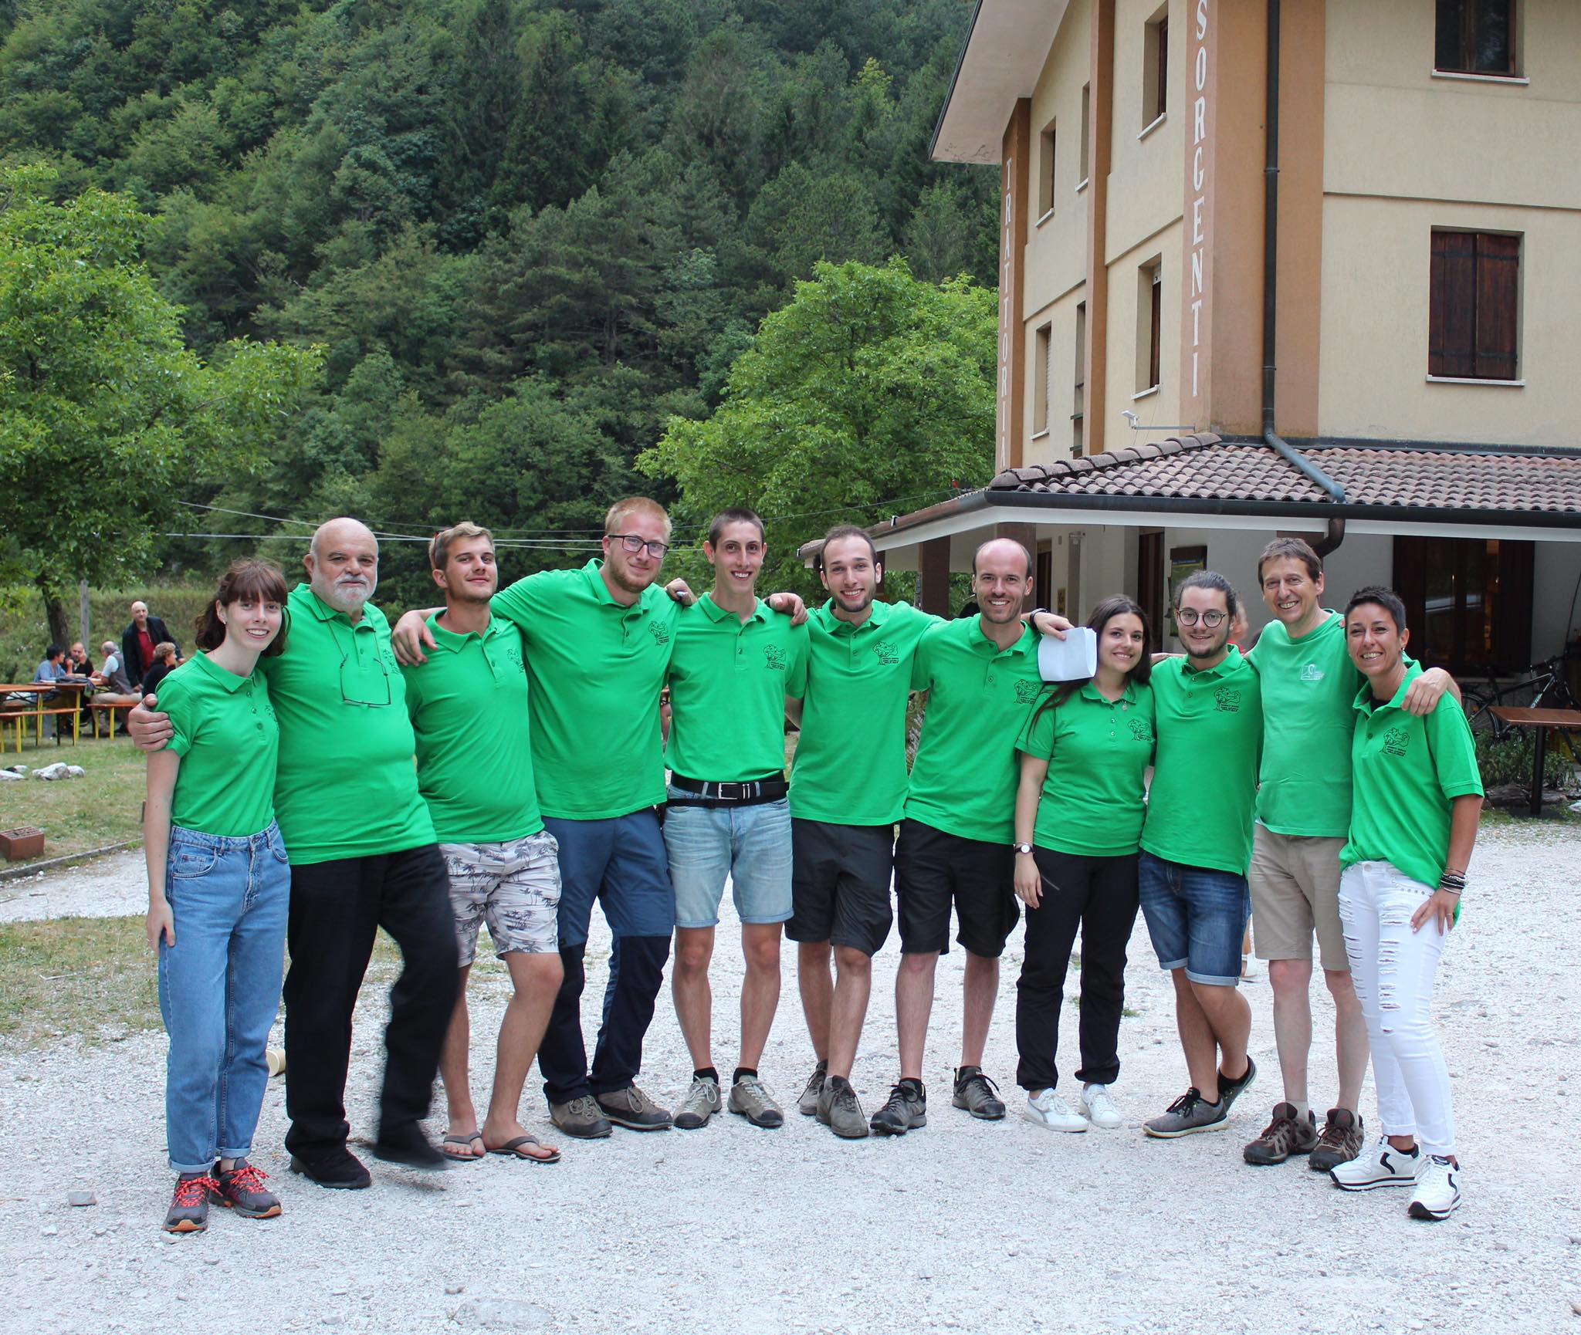



Nature Beats
Ecofriendly
Informal context
A day for youth people, the bond between music, fun and active citizenship.
Setting in rarely frequented area
Sharing of feelings and ideas

Slide 10
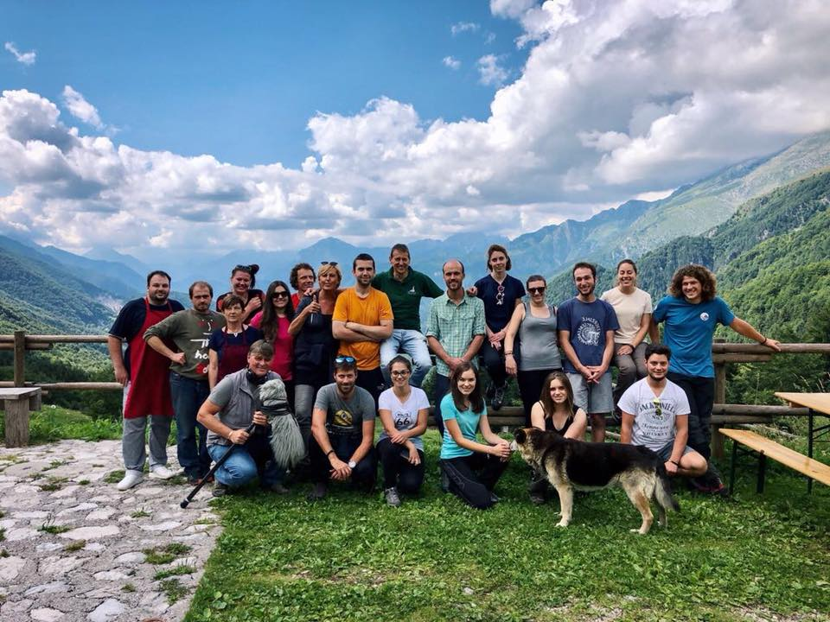


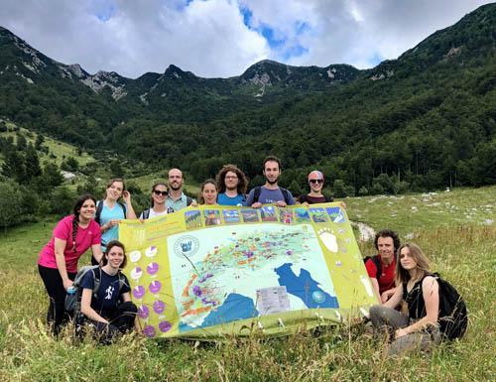
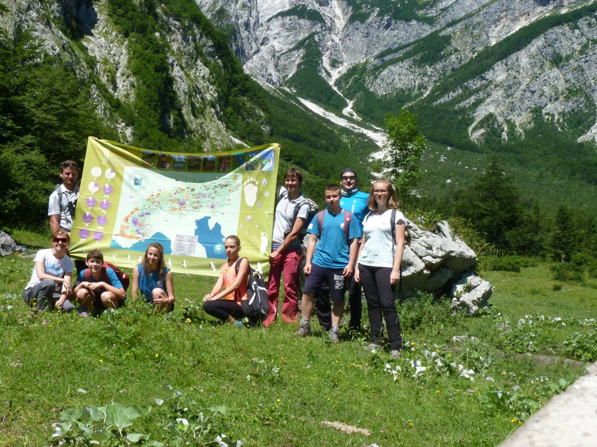
Youth at the Top
To share with other youngsters an experience of the power of being a group and the values of citizenship and solidarity
Six countries (Austria, France, Germany, Italy, Slovenia and Switzerland), as a sole alpine region
To reach the top «together» and re-discover the beauties of the territory

Slide 11
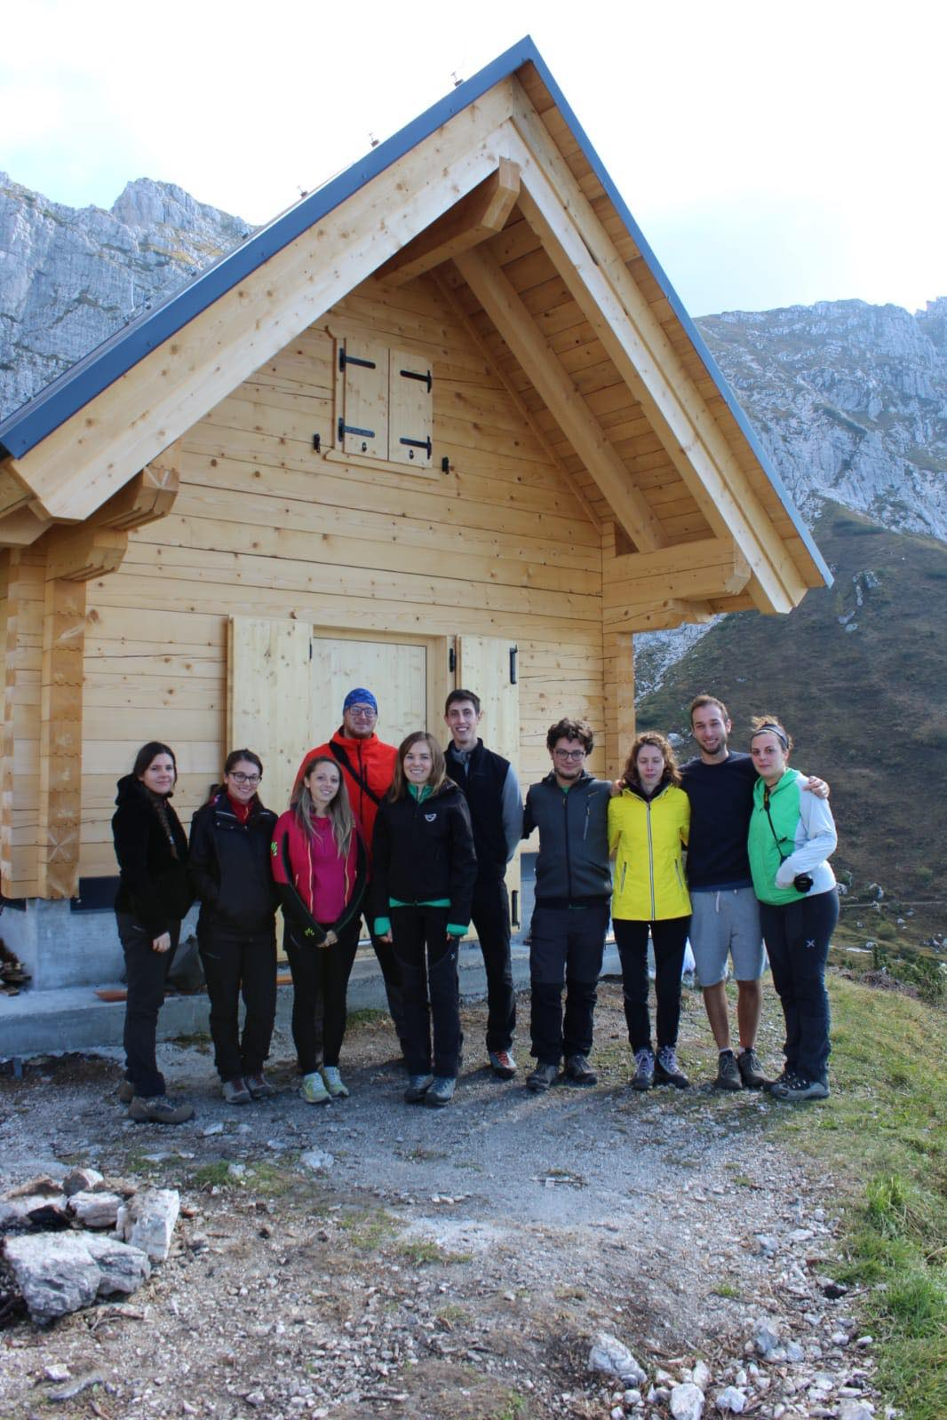
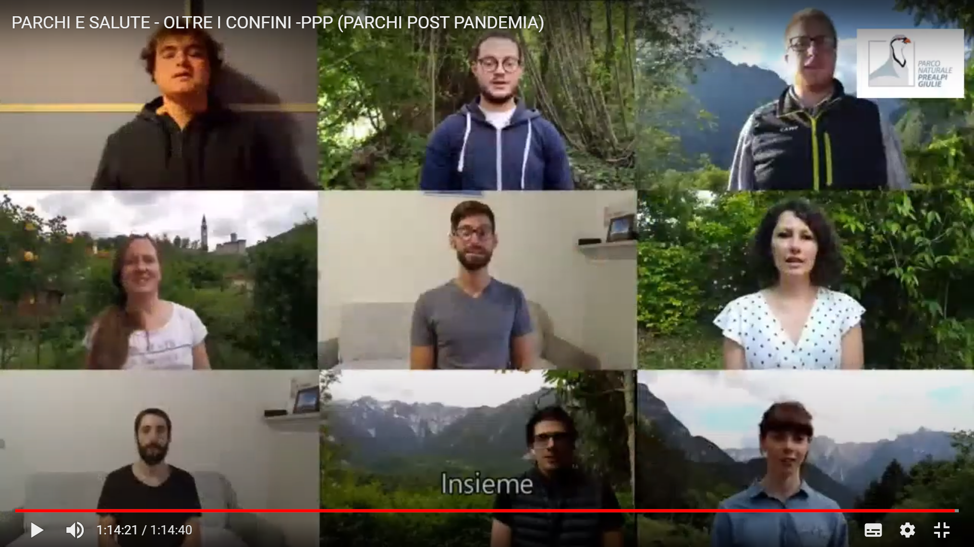
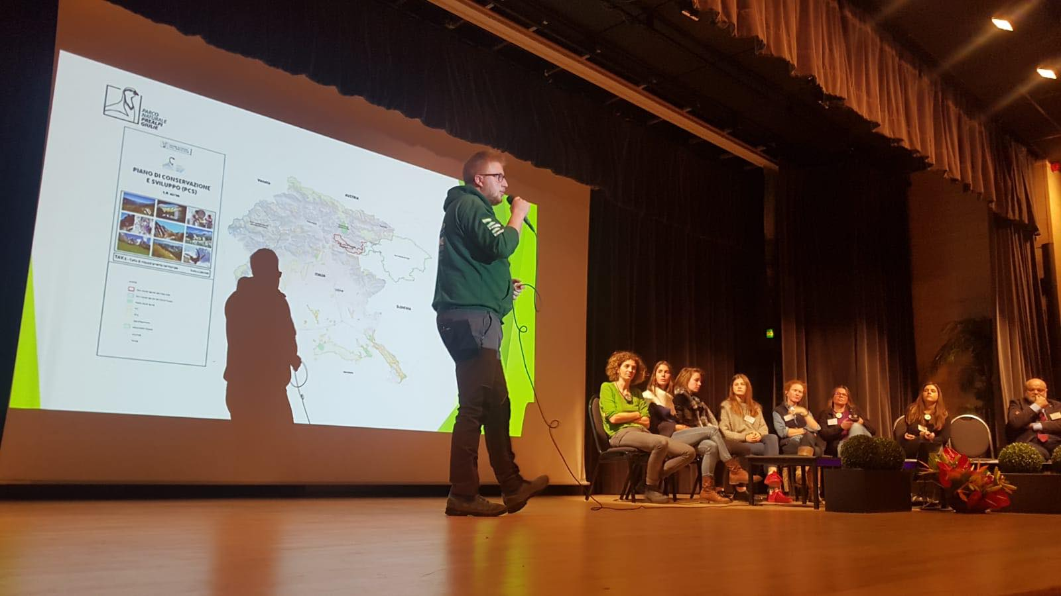
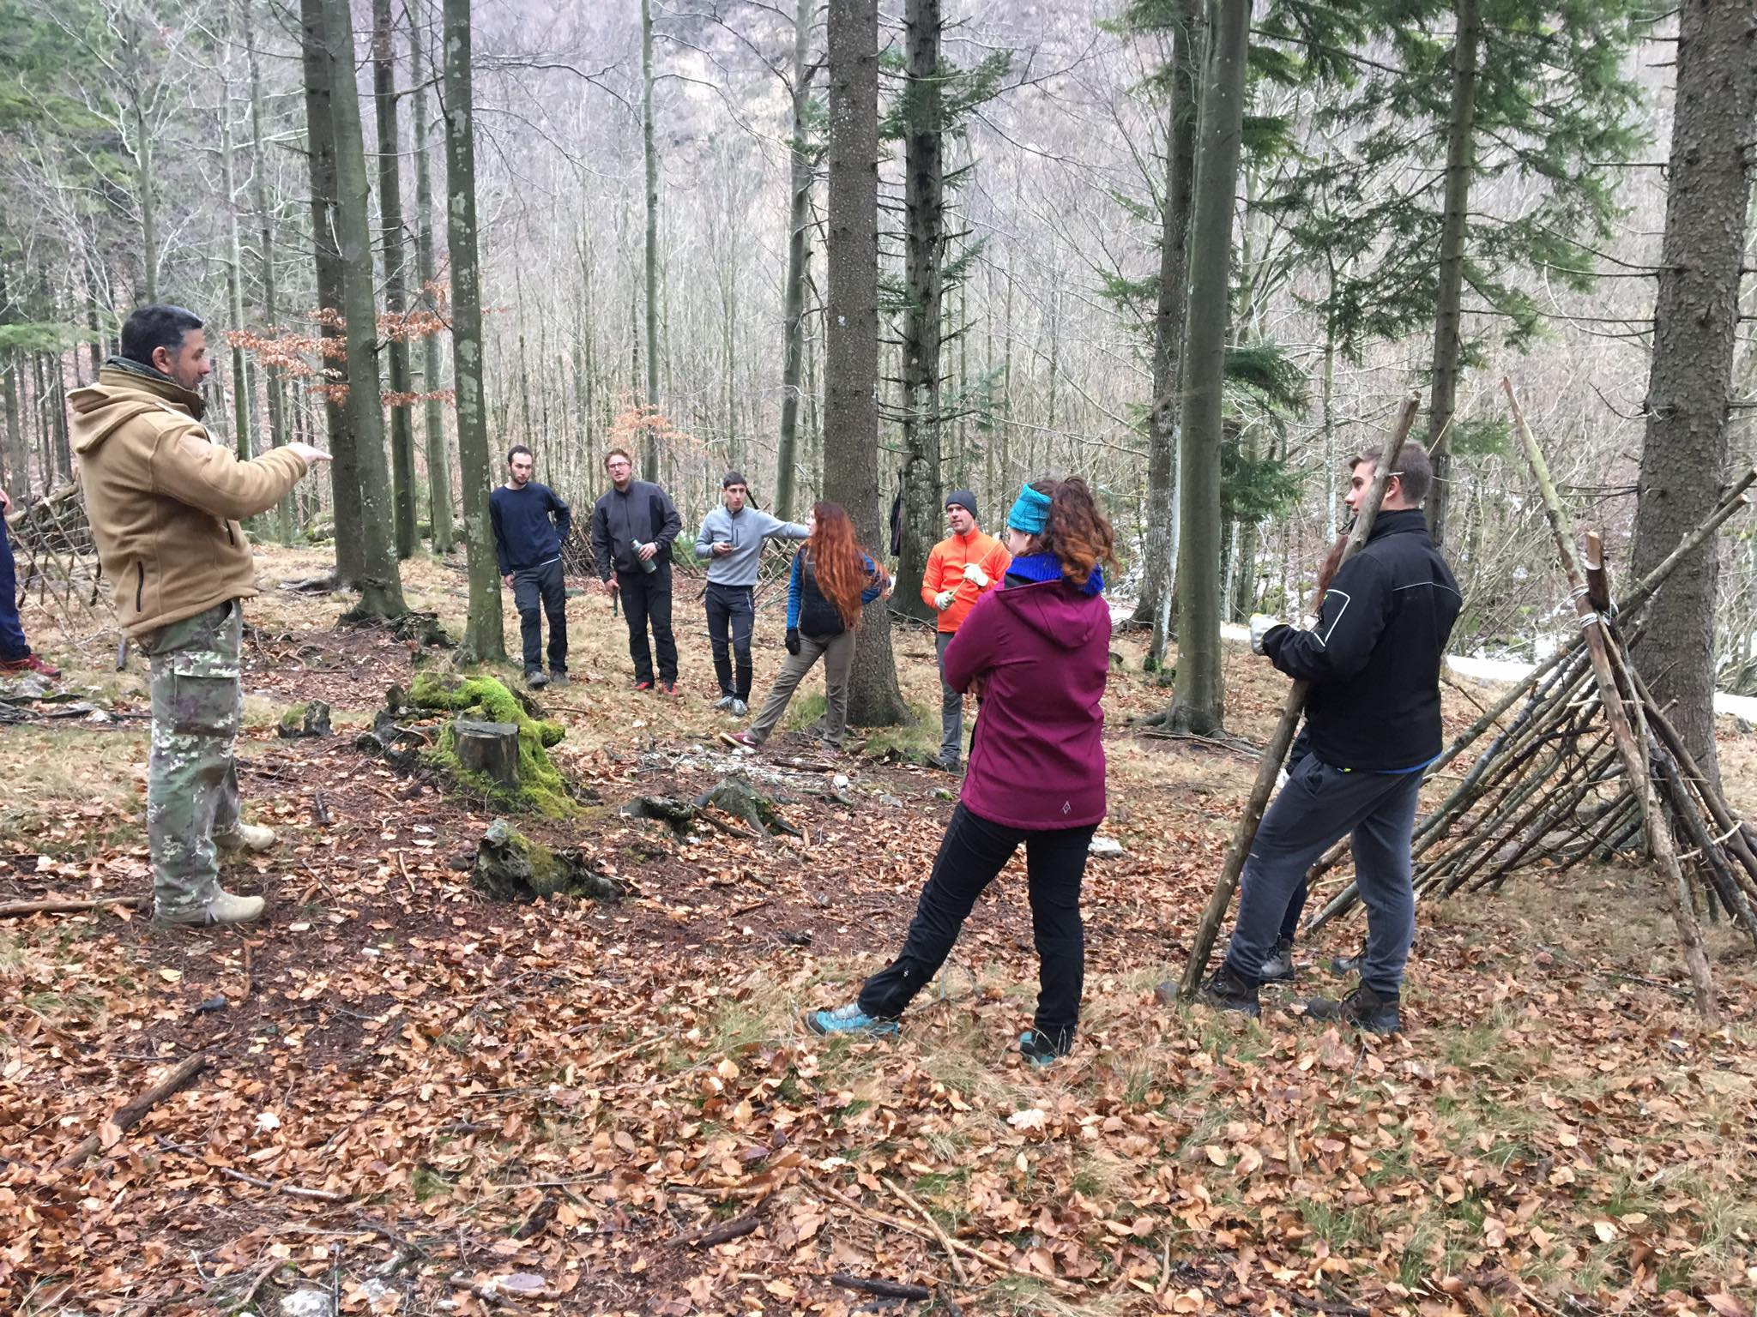
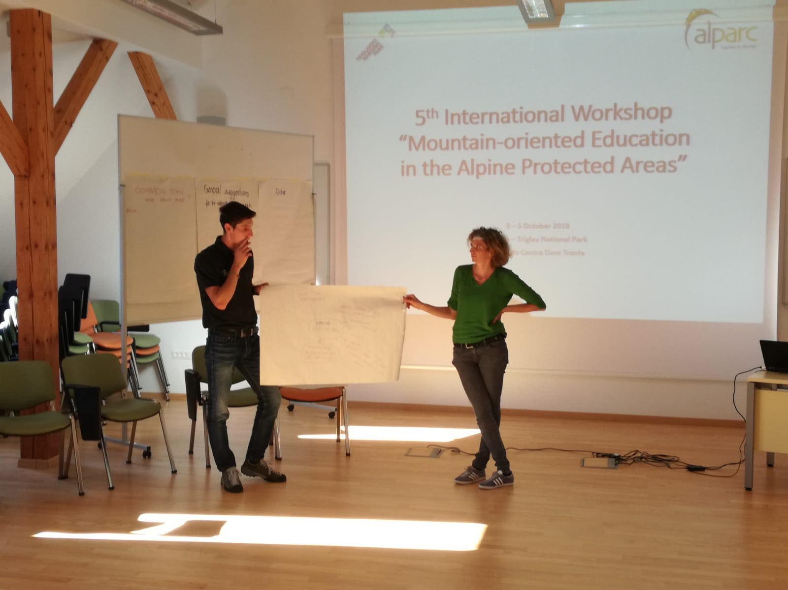
From local activities...
... to international meetings and workshops

Slide 12




Plans for the future
Create Youth Advisory Board of Transboundary Biosphere Reserve Julian Alps with the young people of Triglav National Park;
Create projects for youth inclusion and outdoor educational (Erasmus+ and local announcement);
Cooperate with other association and groups for build a network of active citizen where cooperation and solitarity are the key

Slide 13
Thanks for your attention!
Carolina Chinese & Nicola Ceschia
Spokenperson, spokenperson deputy of MAB Reserve Italian Julian Alps
carolinachinese@gmail.com
ceschia.nic@gmail.com

