Slide 1
EUROPARC Conference 2020
AGRICULTURE AND PROTECTED AREAS
THE EU NEW STRATEGIES: BIODIVERSITY 2030 and FARM TO FORK
Stefania Petrosillo
EUROPARC Policy Officer
stefania.petrosillo@europarc.org

Slide 2
THE CONTEXT : THE EU GREEN DEAL
a new vision of Europe: a fair and prosperous society, with a modern resource-efficient and competitive economy
achieve carbon neutrality by 2050 and to position the European continent as a leader
a transition in all sectors, with the underlying idea being "mainstream environment”
interconnection of challenges
https://ec.europa.eu/info/sites/info/files/european-green-deal-communication_en.pdf

Slide 3
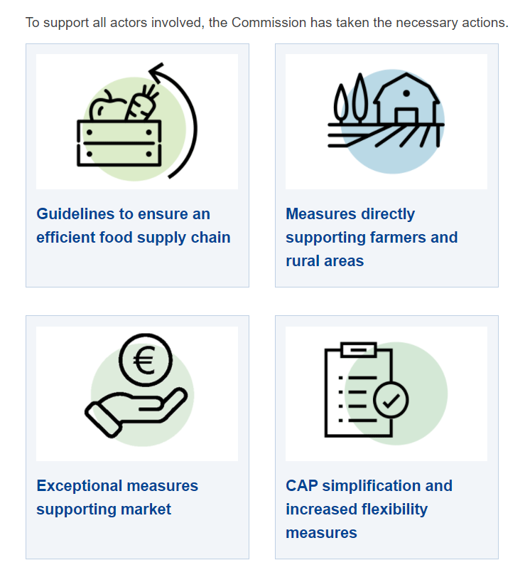
THE CONTEXT : COVID-19
COVID-19 impacts to the the agri-food sector
EU’s special support to the agriculture and food sectors amid COVID-19 time
Debate about the economic sustainability of green new obligations for farmers in COVID-19 time
https://ec.europa.eu/info/food-farming-fisheries/farming/coronavirus-response_en

Slide 4
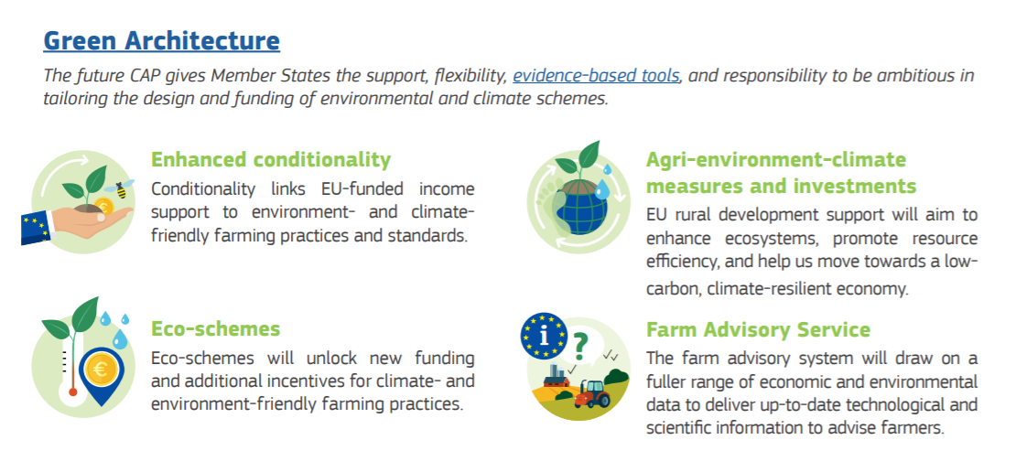
THE CONTEXT : THE COMMON AGRICULTURE POLICY
https://ec.europa.eu/info/sites/info/files/food-farming-fisheries/sustainability_and_natural_resources/documents/analysis-of-links-between-cap-and-green-deal_en.pdf

Slide 5
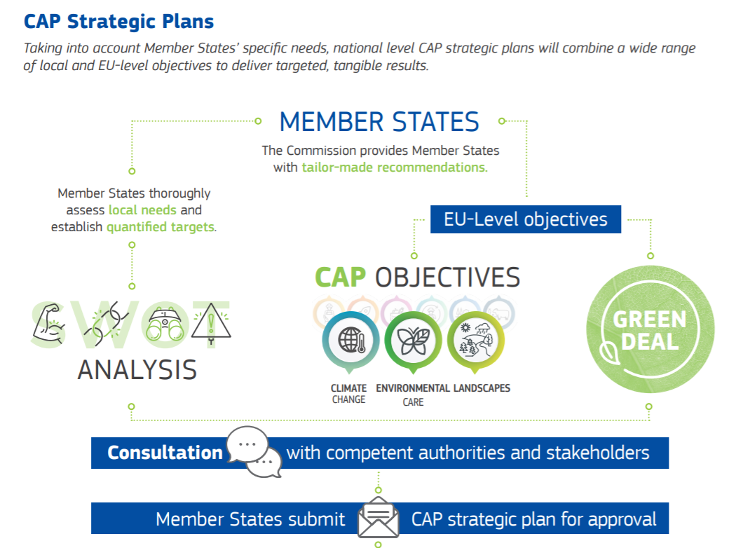
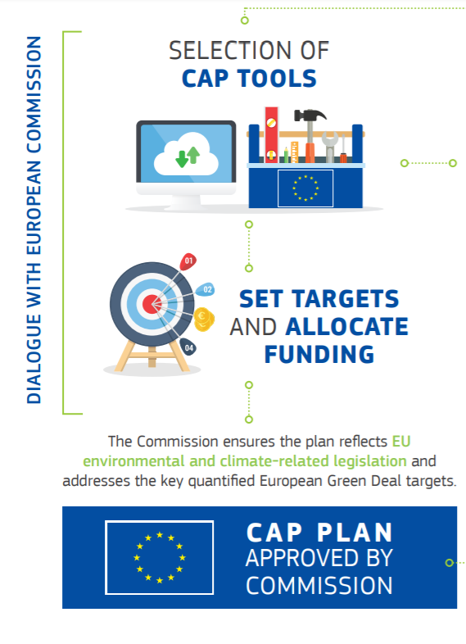
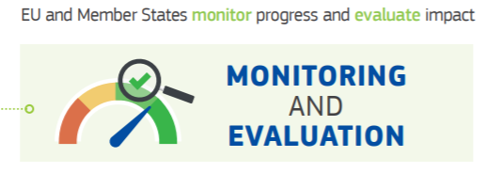
https://ec.europa.eu/info/sites/info/files/food-farming-fisheries/sustainability_and_natural_resources/documents/factsheet-how-cap-contributes-to-green-deal_en.pdf

Slide 6
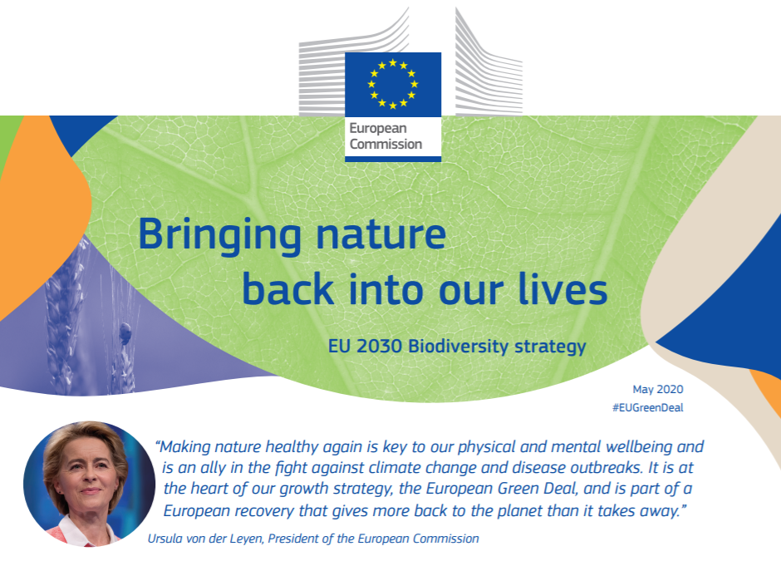
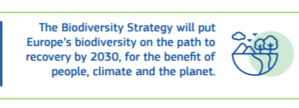
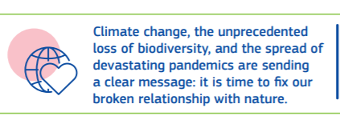
THE BIODIVERSITY STRATEGY 2030
IN ALL EU LANGUAGES:
https://eur-lex.europa.eu/legal-content/EN/TXT/?qid=1590574123338&uri=CELEX%3A52020DC0380

Slide 7
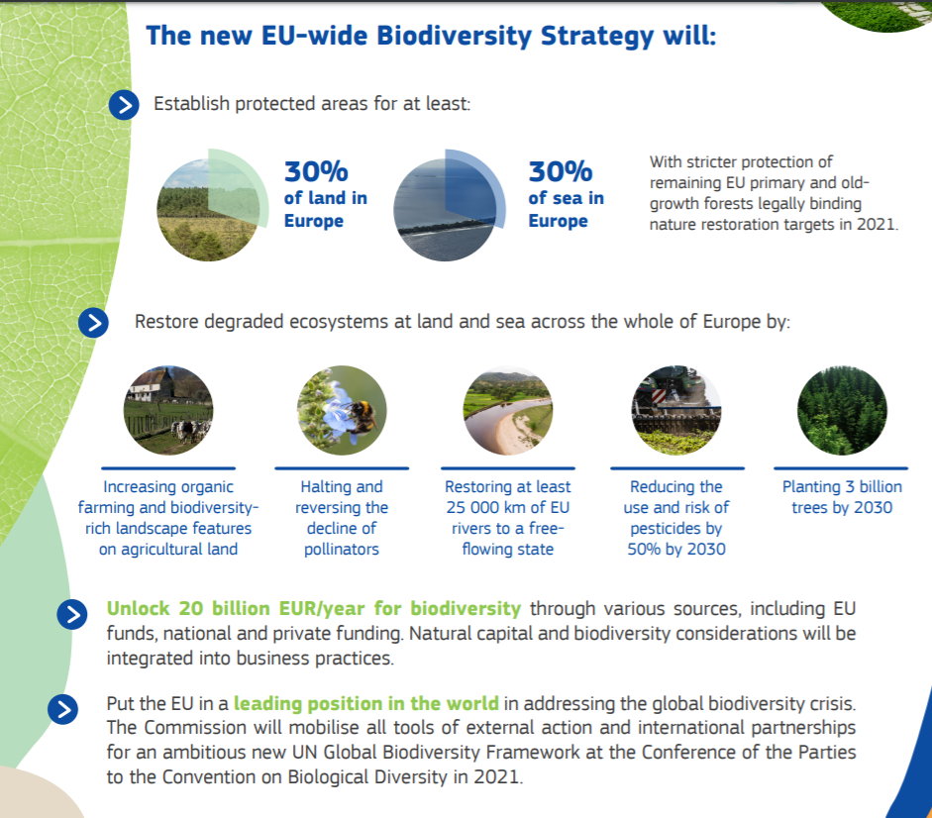
Questions and Answers: EU Biodiversity Strategy for 2030 - Bringing nature back into our lives
https://ec.europa.eu/commission/presscorner/detail/en/qanda_20_886

Slide 8
WHAT ROLE FOR PROTECTED AREAS
ABOUT THESE GOALS?

Slide 9
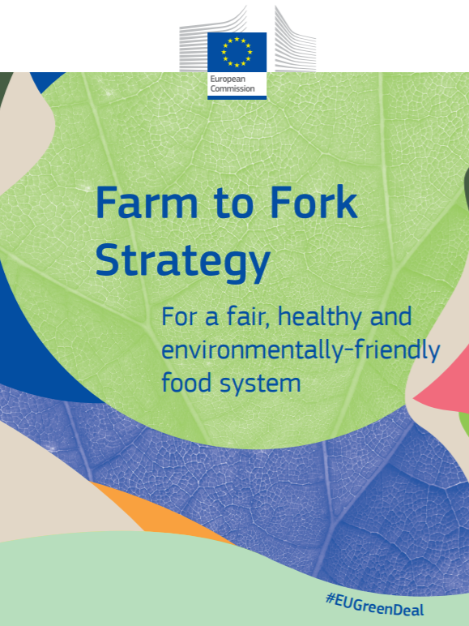
THE FARM TO FORK STRATEGY
Questions and Answers: Farm to Fork Strategy - building a healthy and fully sustainable food system
https://ec.europa.eu/commission/presscorner/detail/en/qanda_20_885
IN ALL EU LANGUAGES:
https://eur-lex.europa.eu/legal-content/EN/TXT/?uri=CELEX:52020DC0381

Slide 10
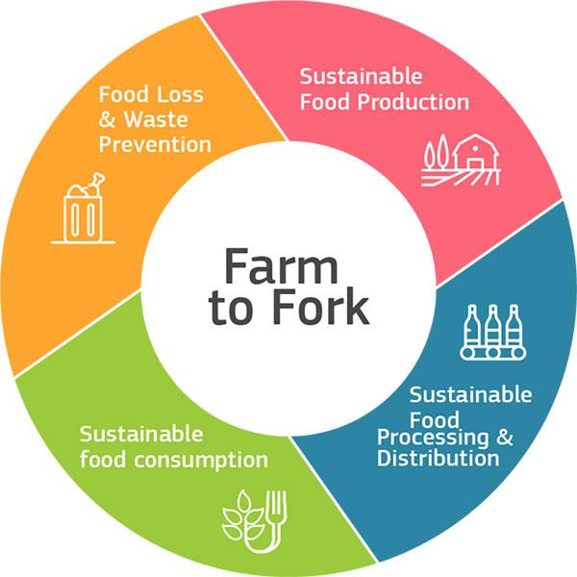
WHAT ROLE FOR PROTECTED AREAS
ABOUT THESE GOALS?
https://ec.europa.eu/food/sites/food/files/safety/docs/f2f_action-plan_2020_strategy-info_en.pdf

Slide 11
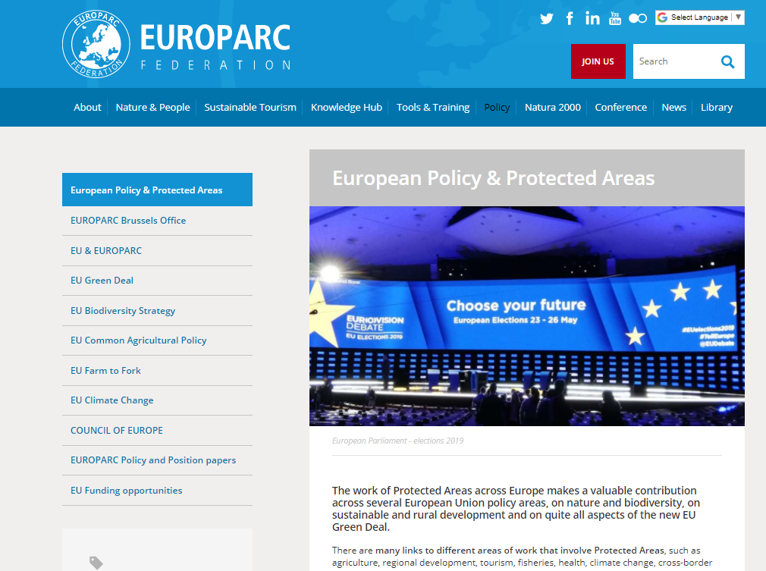
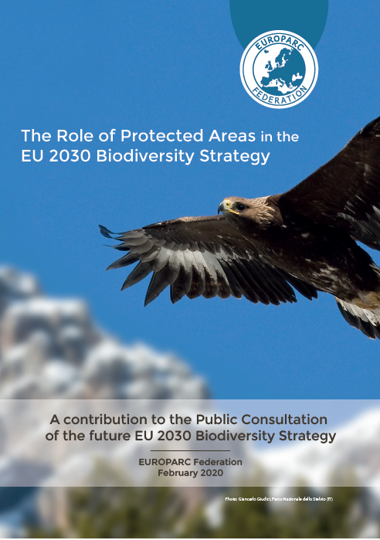

Slide 12
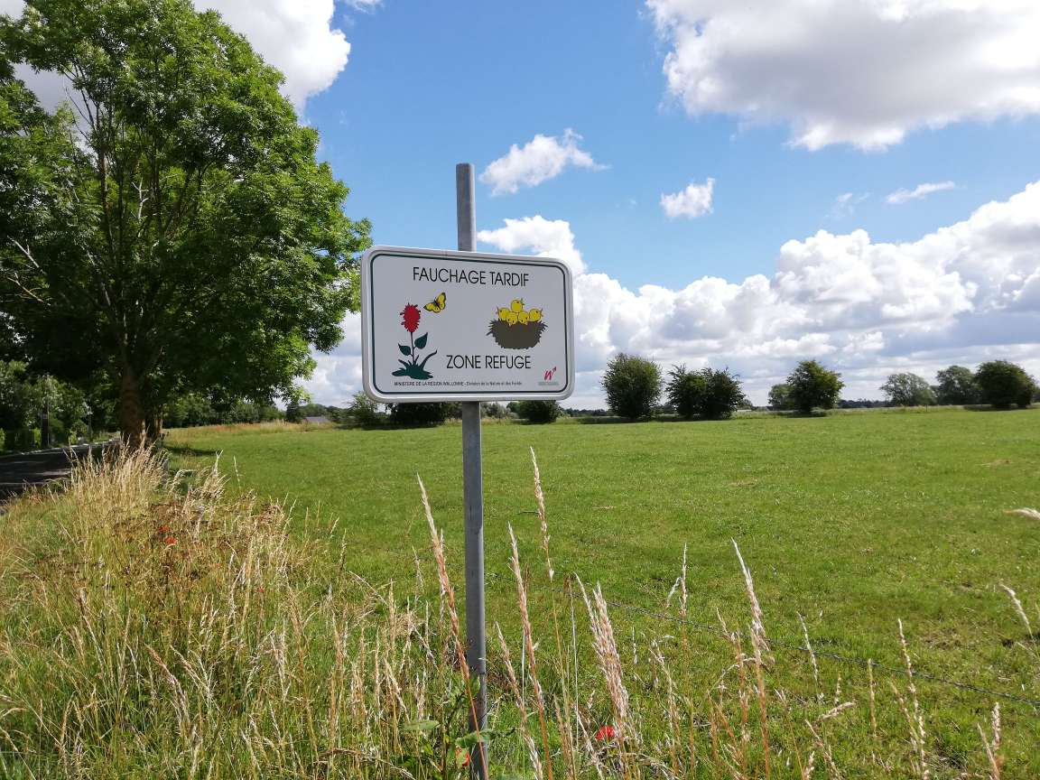
Thank you!
©S.Petrosillo

