Slide 1
Understanding and communicating with people
to instil change and enhance collaboration
Marie Micol, for the NAAONB
Notes:
My experience of the course and how it applies to my work

Slide 2
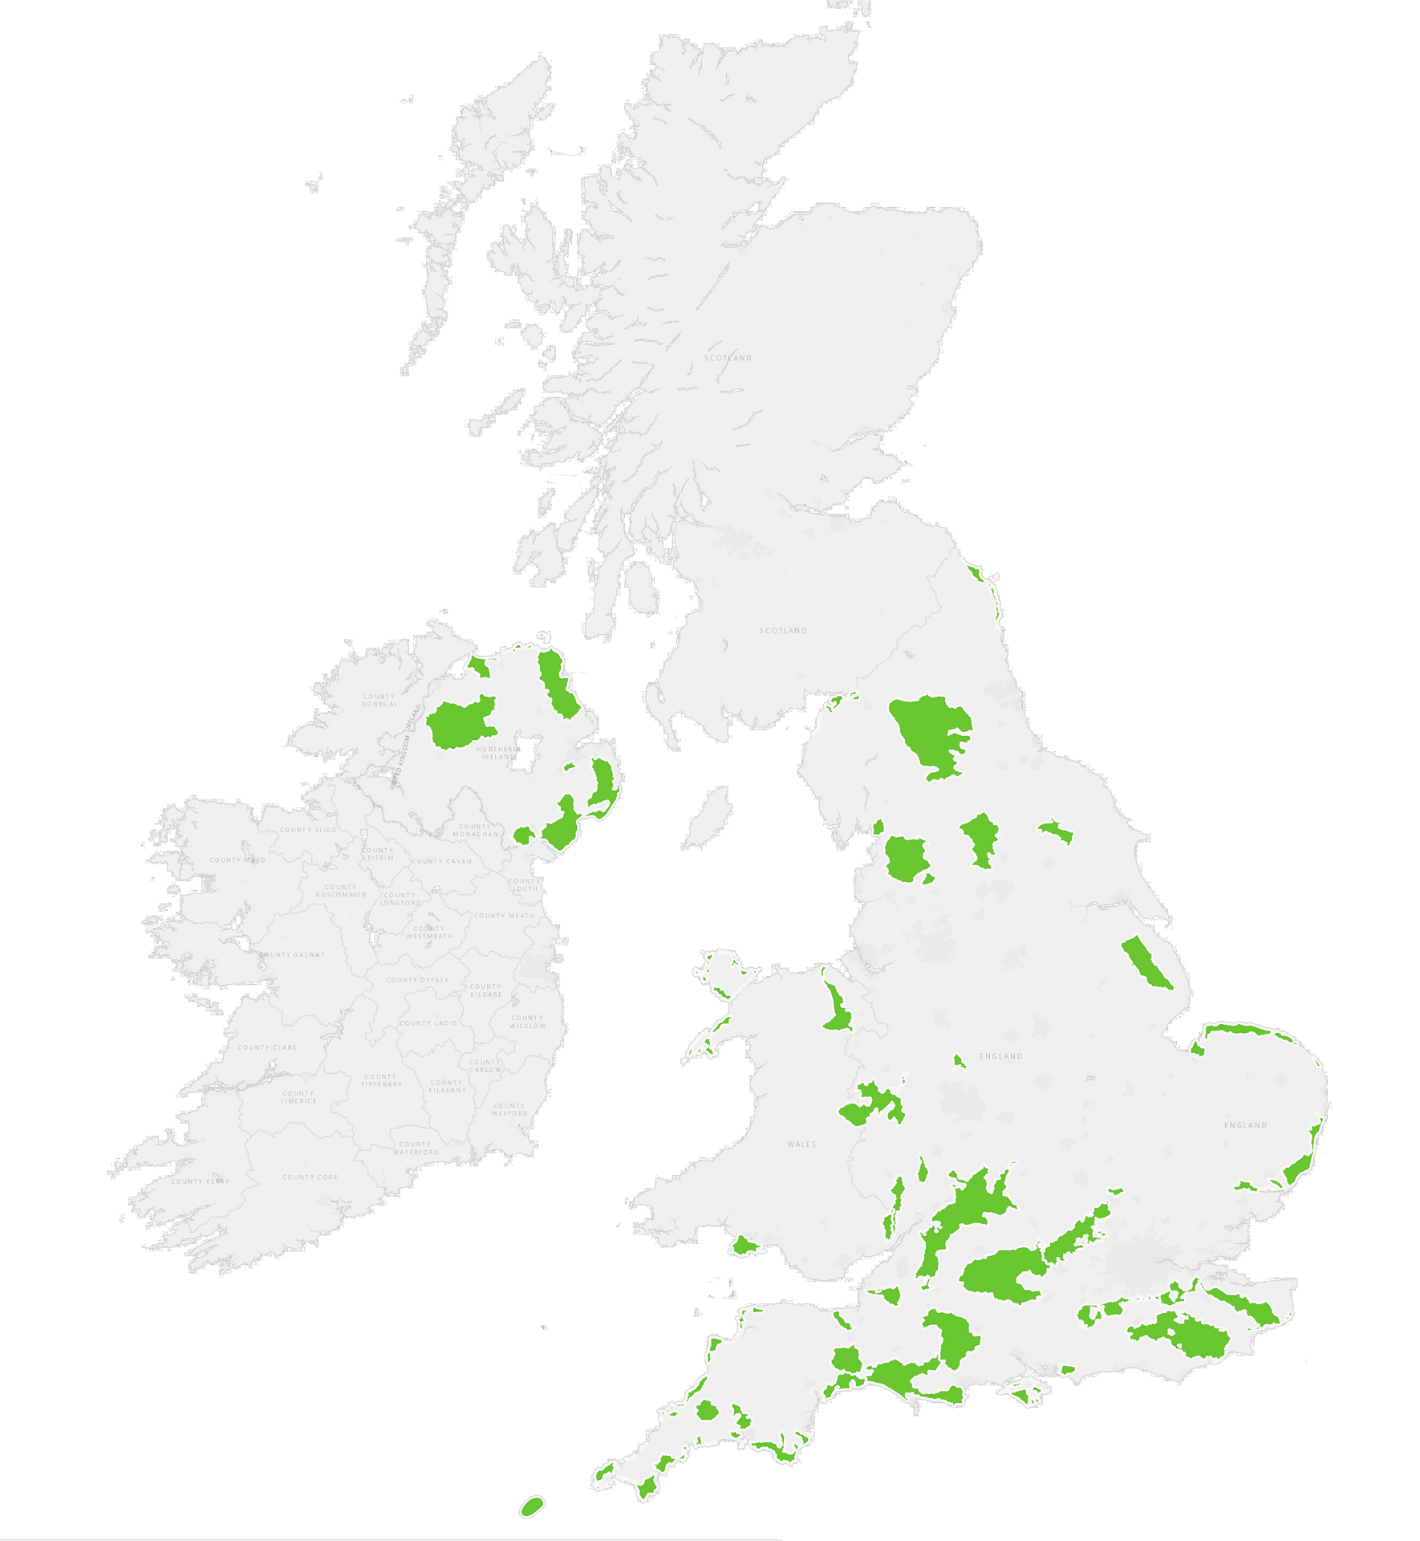
National Association for
Areas of Outstanding Natural Beauty
AONBs
≈
‘Regional Parks’
Notes:
Contracted by NAAONB
Exist along National Parks in the UK

Slide 3
The AONB Network: A network of organisations AND a network of people
Notes:
Enhancing collaboration between AONB teams, national level
Different shapes, sizes, etc.
Getting them to work together is complex. Don’t just put people in a room expect something to happen. Even telling them collaboration is good isn’t enough.

Slide 4
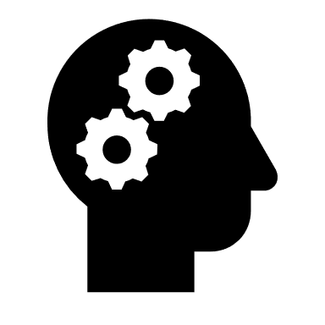
Notes:
What collab requires is mindset and attitude
People to believe in it, be motivated, be willing to change their normal behaviours, to scan for opportunities to work at a national level
Takes also the right tools and the right platform to make it happen

Slide 5
CLEAR message, goal and strategy
FRAME for more impact
Truly KNOW your audience
WHAT I LEARNED FROM THE COURSE
INSPIRE others and BE INSPIRED!
BLENDED Learning
Notes:
That’s why comms and interpersonal skills are such an important aspect of my work
Participating to course made real diff to how I approach the project I am running – using blended learning methods
CLEAR: it’s not enough to make a nice video, a nice Facebook post, if it’s not part of a well thought through communications plan, if you do not have a clear objective in mind
Not just ‘they work in AONBs’, but really what do they think, what do they believe in, what triggers them to act => consultation survey
How powerful communications can be depending on how you frame your topic. ‘Collaboration’ on it’s own it just a word. ‘Inclusive and effective collaboration’ is already more engaging, ‘creating synergies’ gives it a more businessy twist, … the list Is endless. The words we use, how we use them and the channels we use to communication => ways to increase impact of comms
Fantastic human experience. Part of something meaningful, that will make a difference to protected area management in the future

Slide 6
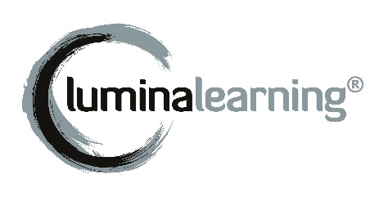
Lumina Spark
Individual development supports organisational change
Co-
Creating
Results
Building Rapport
Self Knowledge
Valuing Diversity
Psychometric profiling
Inclusive, non-judgemental
Research-based
Visual, provides common language
Notes:
Idea behind using LS is…
To go even further: LS practitioner qualification

Slide 7
Thank you!
Marie Micol, for the NAAONB
Notes:
Only the start.
My aspiration: enhance collaborative behaviours within and between protected areas in Europe, to get protected area staff and stakeholders to work together towards common goals, to share learning and to move forward in the same direction.
That’s why I think the team at Europarc are doing such an important job, with opportunities such as the course I attended, the app presented today and also this annual conference, they are really hitting the mark and putting things in practice, making international collaboration a reality.

