Slide 1
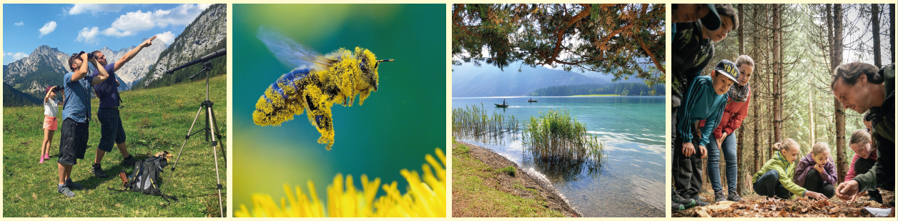
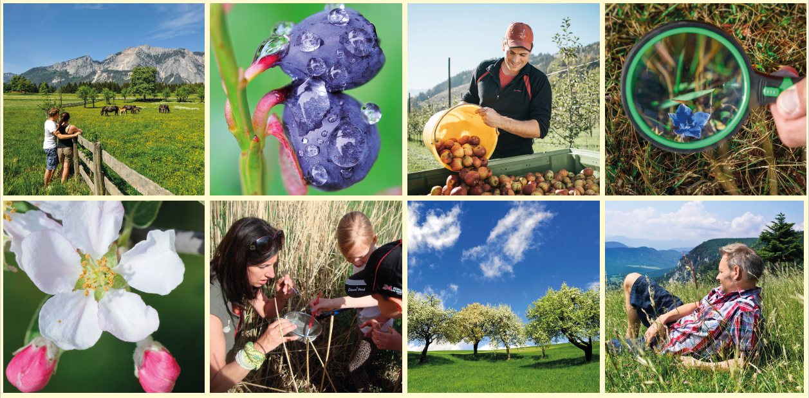
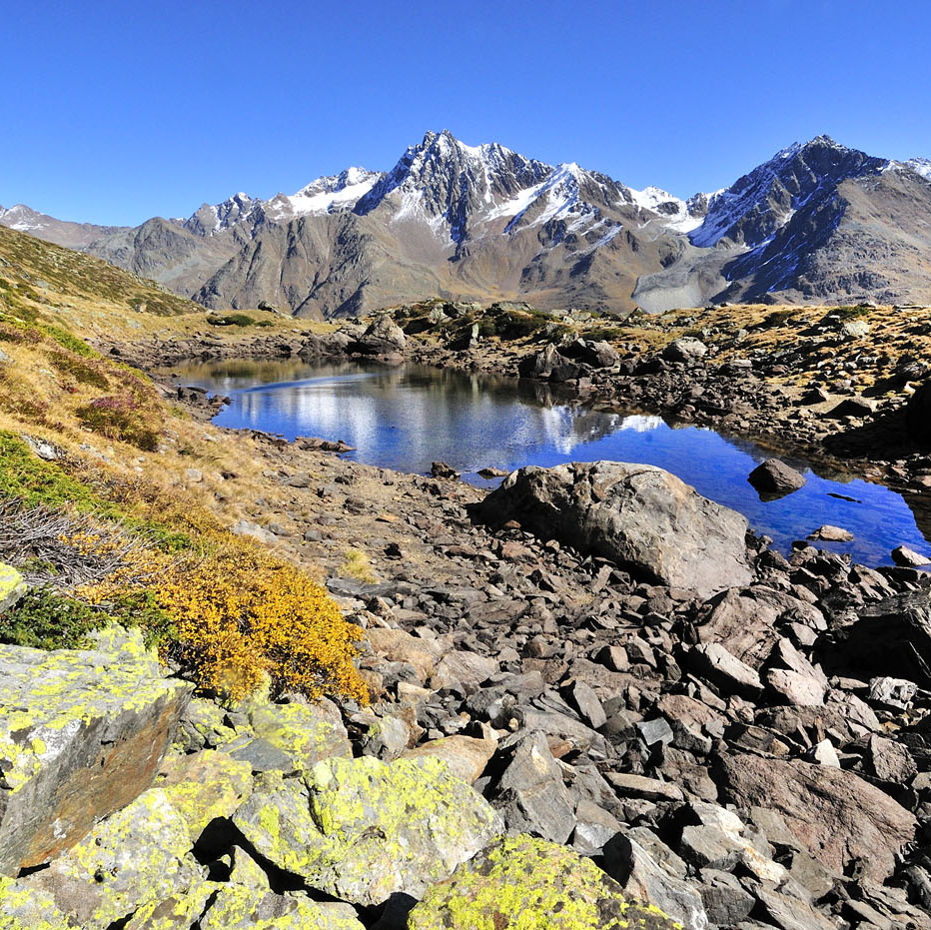
Europe’s Nature Regional
Landscape Parks
Climate Change Mitigation Strategies
^{Zoom Online-Workshop}
^{Oktober 22, 2020}
^{Nina Zitz}
^{Project Coordinator}
Association of Austrian Nature Parks
Fotos: Hannes Kohlmeier, Franz Kovacs, Herfried Marek, Naturpark Weißbach Archiv, Naturpark Weissensee, Ewald Neffe, TVB Naturpark Zirbitzkogel-Grebenzen Mediadome, Verein Naturparke NÖ/www.pov.at

Slide 2

Association of Austrian Nature Parks
Umbrella organisation of 47 nature parks
Statutory obligation in following fields:
Natural protection
Recreation
Education
Regional development
Foundation of climate change adaptation and mitigation strategies:
Create resilient landscapes
Healthy and well-connected ecosystems
© Pixabay

Slide 3
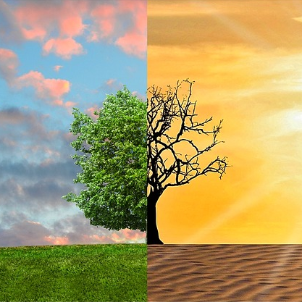
Climate Mitigation Actions
Active in climate protection:
Concrete measures in nature park areas
Awarness raising
Mobility solutions
Endeavours in the field of Circular Economy
Visitor guidance
Aim:
Development of common climate-strategy for nature parks
  Strategically processing existing efforts in a project
  Inclusion of essential stakeholders
  Embedment in the development strategy of nature parks
© Pixabay

Slide 4
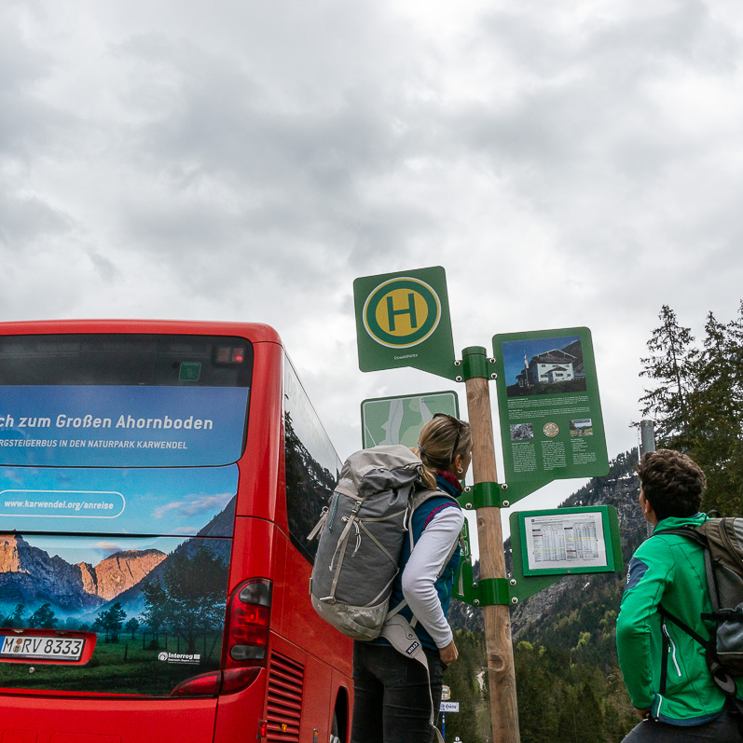
Best-practice examples
Wöffis – Hiking with public arrival
Broschure with hiking paths accessible with public transportation, timetables, touristic information
Concept for all Tyrolian nature parks
Arrival from Innsbruck and Munich
In cooperation:
  All transportation providers
  All 7 tourism association in Bavaria and Tyrol
  Several other institutions and organizations
© DAV_Hipp_medium

Slide 5
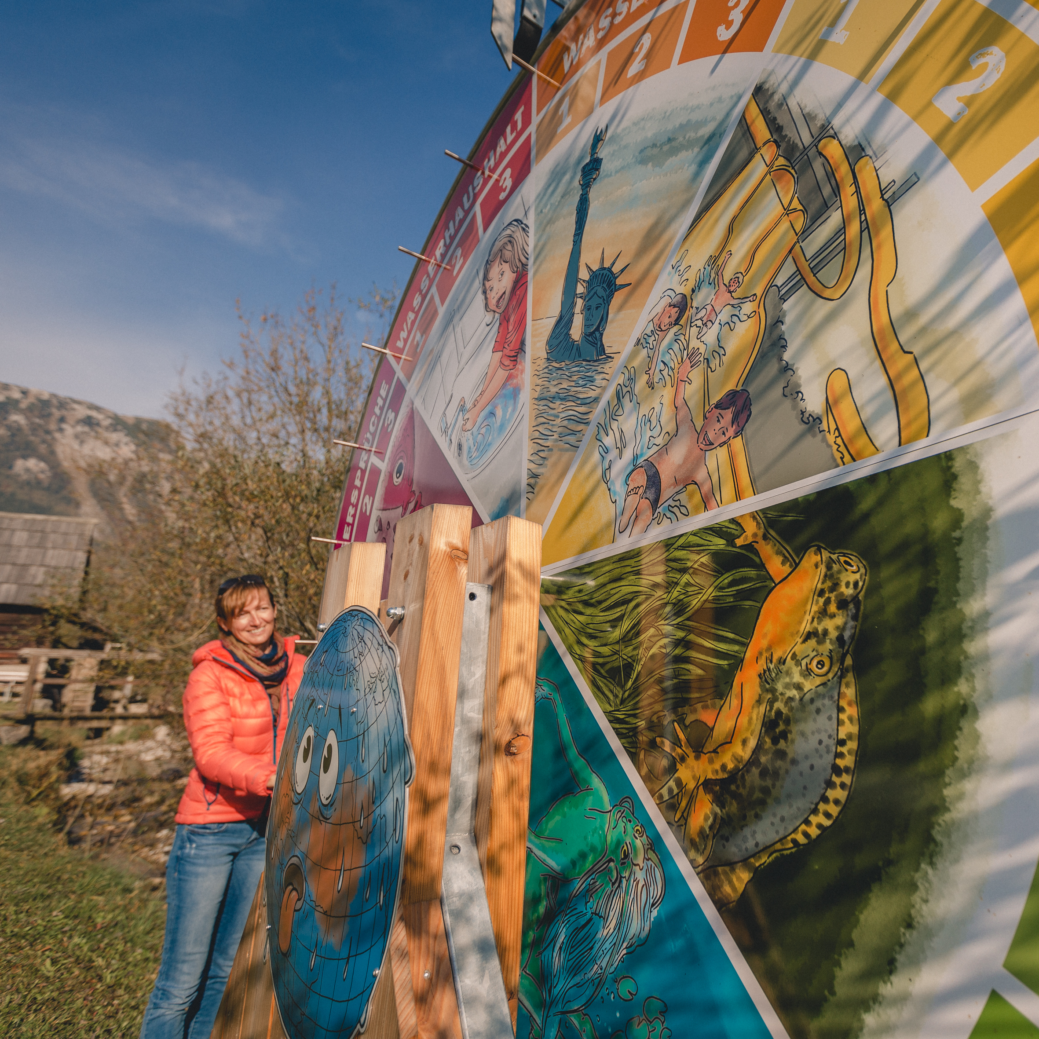
Best-practice examples
Klimawandeln - Climate walk
Experience trail
Awareness raising through interactive, sensoric, experience and team-oriented elements
14 stations
Topic:
  Influence of climate change on habitats and its endangered and protected species
Target group:
  Families, schools, tourists and day visitors, residents
© nixxipixx.com

Slide 6

Best-practice examples
KlimaAlps - Visualizing climate change
Transnational project of Nature Park Karwendel (Tyrol) and Bavaria
3 main instruments:
  Qualification measure „climate educator“
  Visualization of consequences of climate change in the landscape
  Development of a network of partners
Target group:
  children, adolescents and adults

Slide 7
Thank you for your attention!

