Slide 1
A health perspective: delivering triple-wins for health equity and nature in peri-urban Europe – key lessons from INHERIT
Europarc Conference
8 September 2020

Slide 2


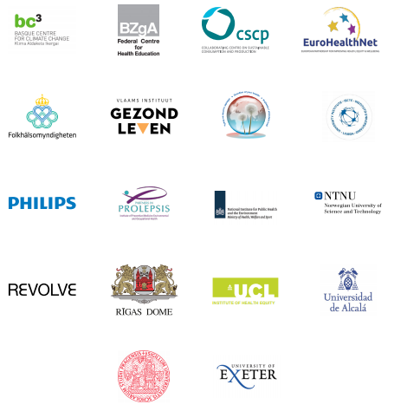
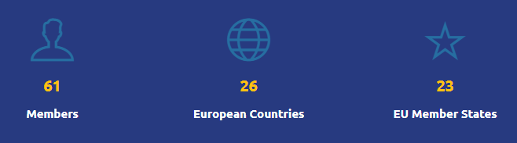
Who we are

Slide 3







INTERSECTORAL POLICIES AND INTERVENTIONS
THAT CHANGE BEHAVIOURS
FOR A ‘TRIPLE-WIN’
+
+

Slide 4
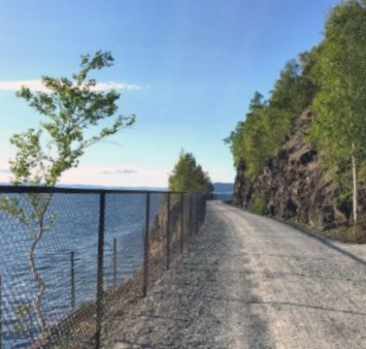
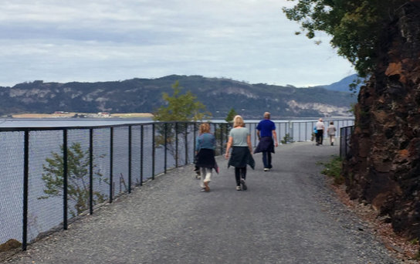
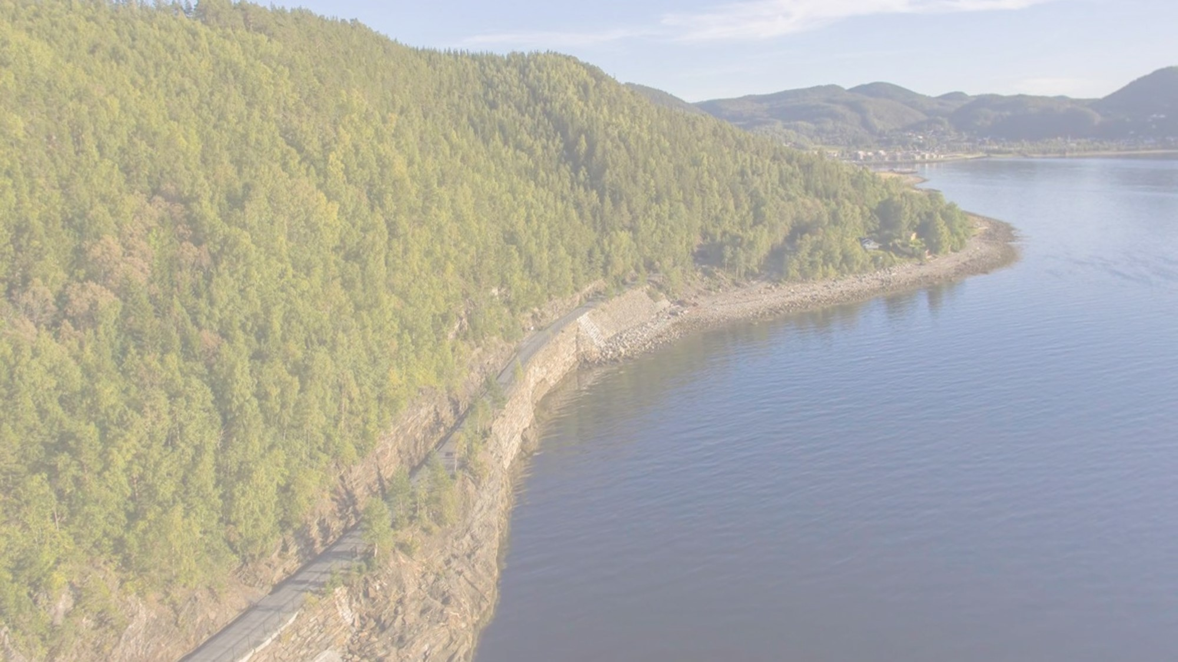
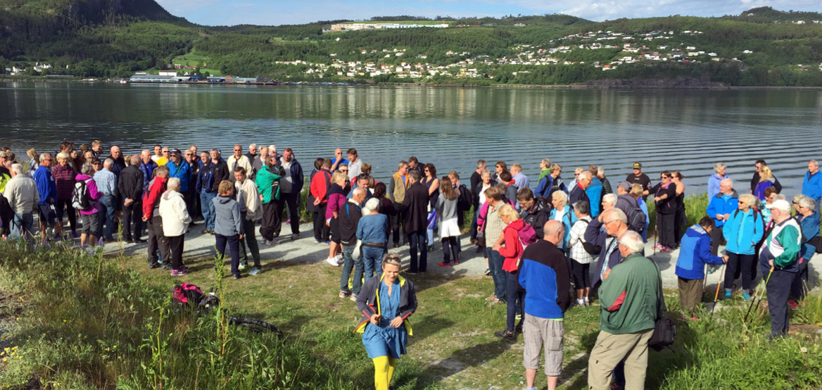
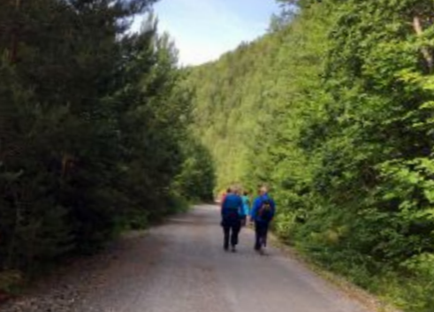
Case study: Malvik Path, Norway

Slide 5
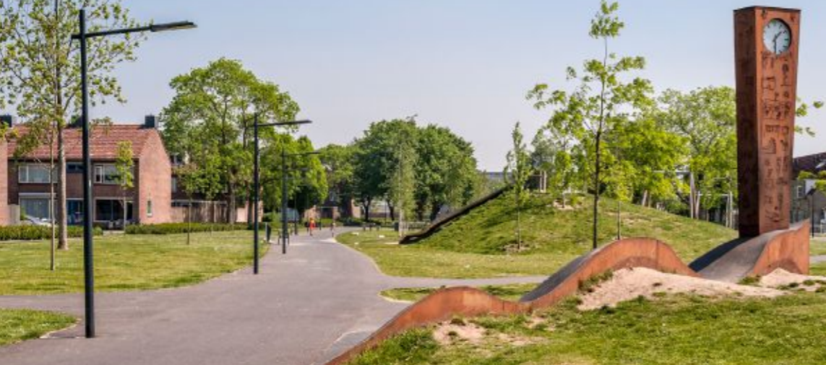
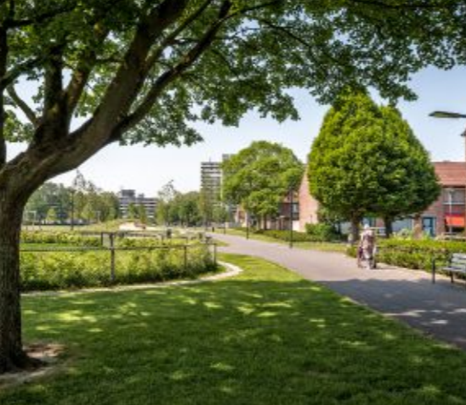
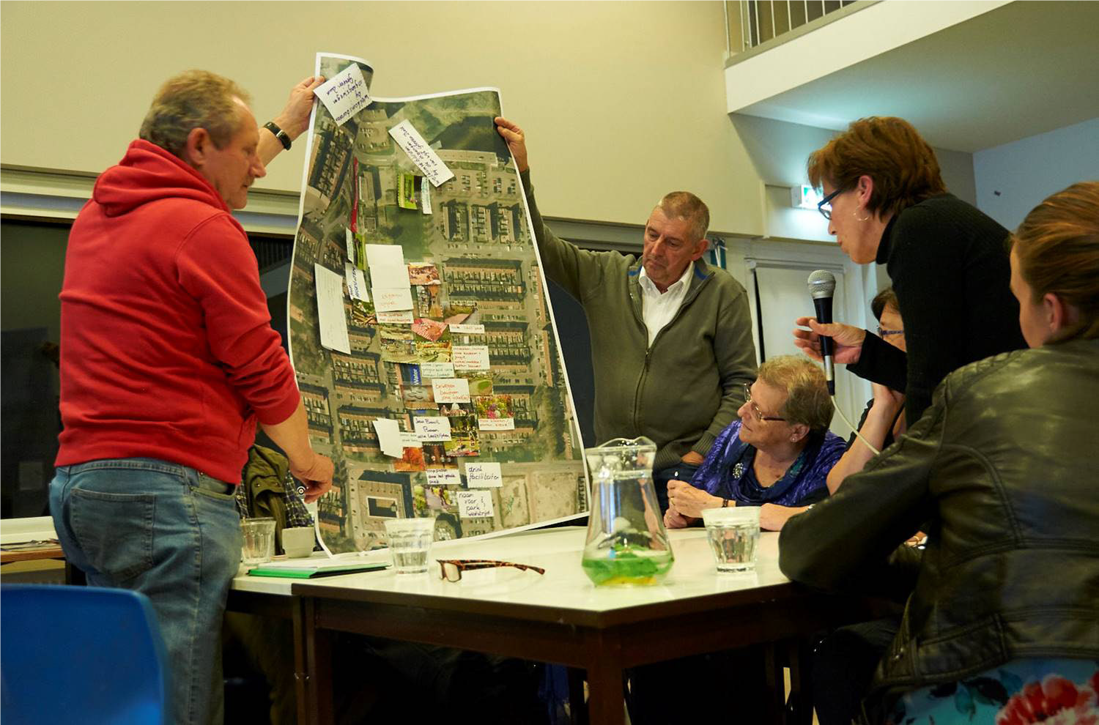
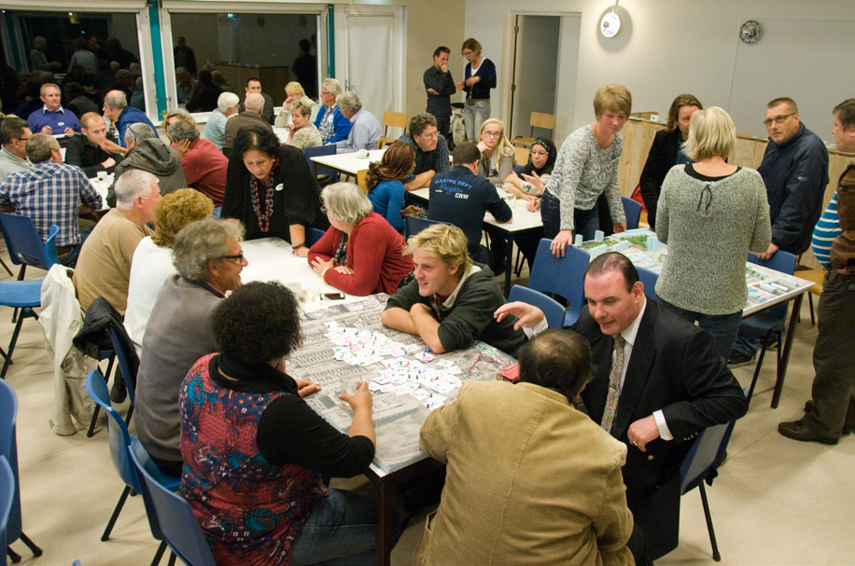
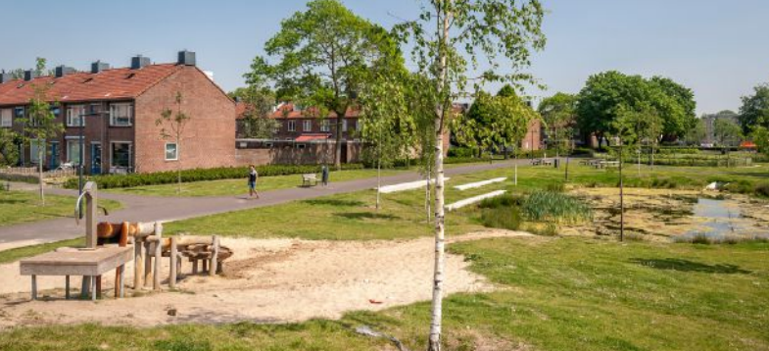
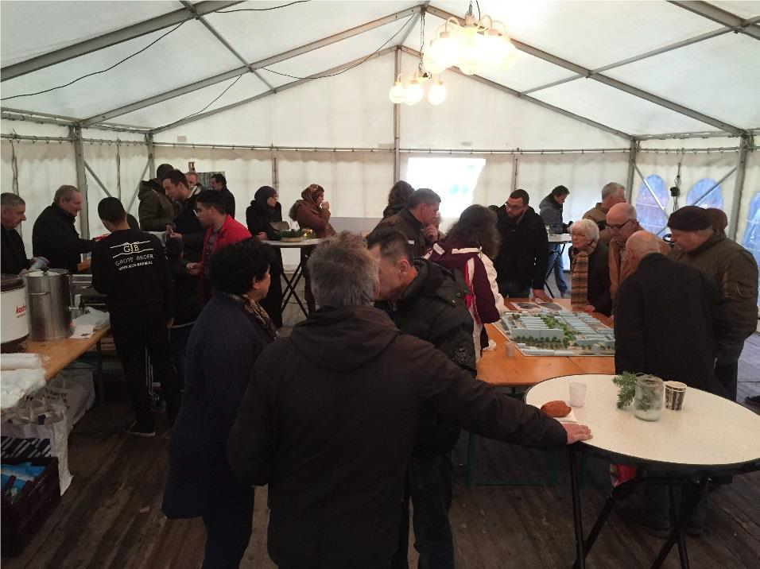
Case study: Restructuring Green Space, NL

Slide 6
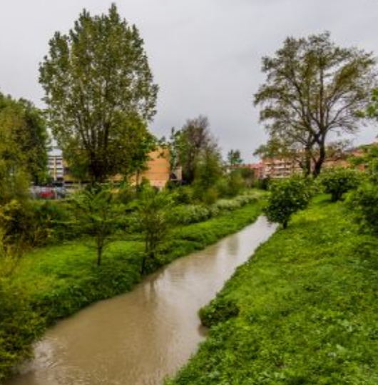
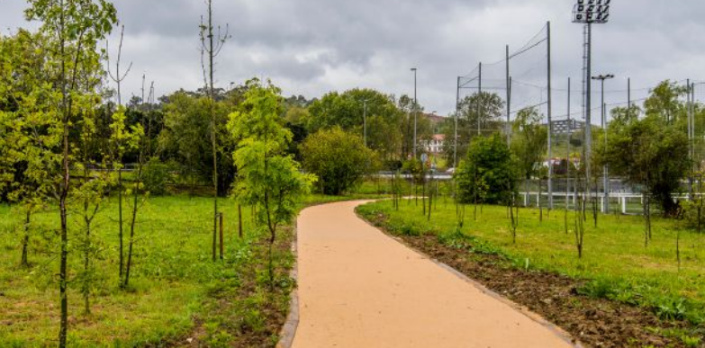
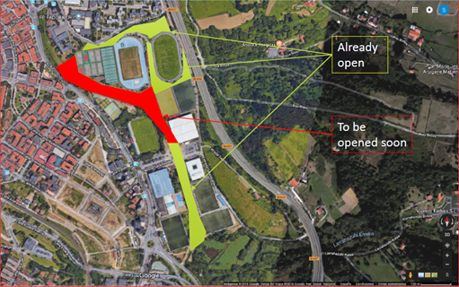
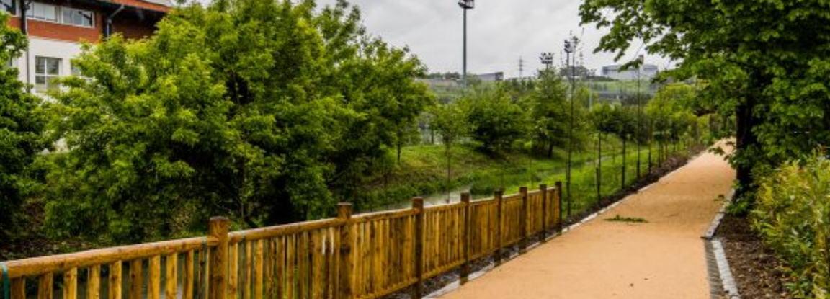
Case study: Thinking Fadura

Slide 7
“BUILDING BACK BETTER”
Quality, inclusive, accessible design
Meaningfully engage communities – work towards co-ownership
Collaborative cross-sectoral working
Social prescribing
Strengthen approaches to quantify value across the ‘triple-win’
Supportive EU context

Slide 8
RESOURCES
INHERIT: https://inherit.eu/
INHERIT Policy Toolkit: https://inherit.eu/policy-toolkit/
INHERIT key outcomes booklet: https://inherit.eu/Inherit-Conference-booklet-DIGITAL.pdf
Policy roundtable report: Urban Open Spaces: enabling activities to maximise positive impacts on environmental sustainability, health and equity: https://inherit.eu/wp-content/uploads/2019/11/Urban-Opens-Spaces-Roundtable-1.pdf
Urban Green Space: Creating a Triple Win for Environmental Sustainability, Health, and Health Equity through Behavior Change, Int. J. Environ. Res. Public Health 2019, 16(22), 4403; https://doi.org/10.3390/ijerph16224403
Contact: i.stegeman@eurohealthnet.eu

