Slide 1
Adventure Travel Guide Standard (ATGS)
Myles Farnbank,
Wilderness Foundation UK,
info@mylesfarnbank.com

Slide 2
Agenda
Background on the ATGS
ATGS Content
Spotlight on Sustainability
How to use it?
Governance Board
Notes:
GT

Slide 3
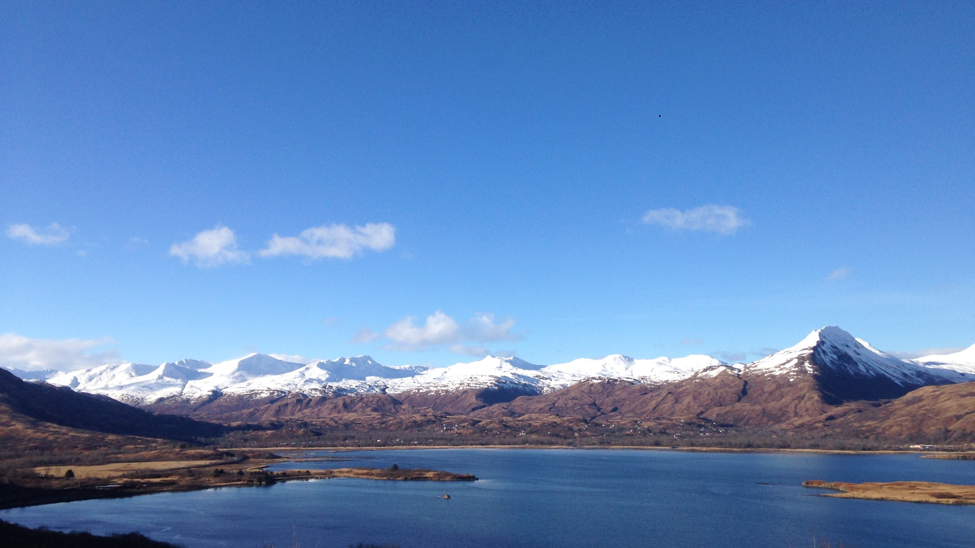
WHY?
Notes:
DM

Slide 4
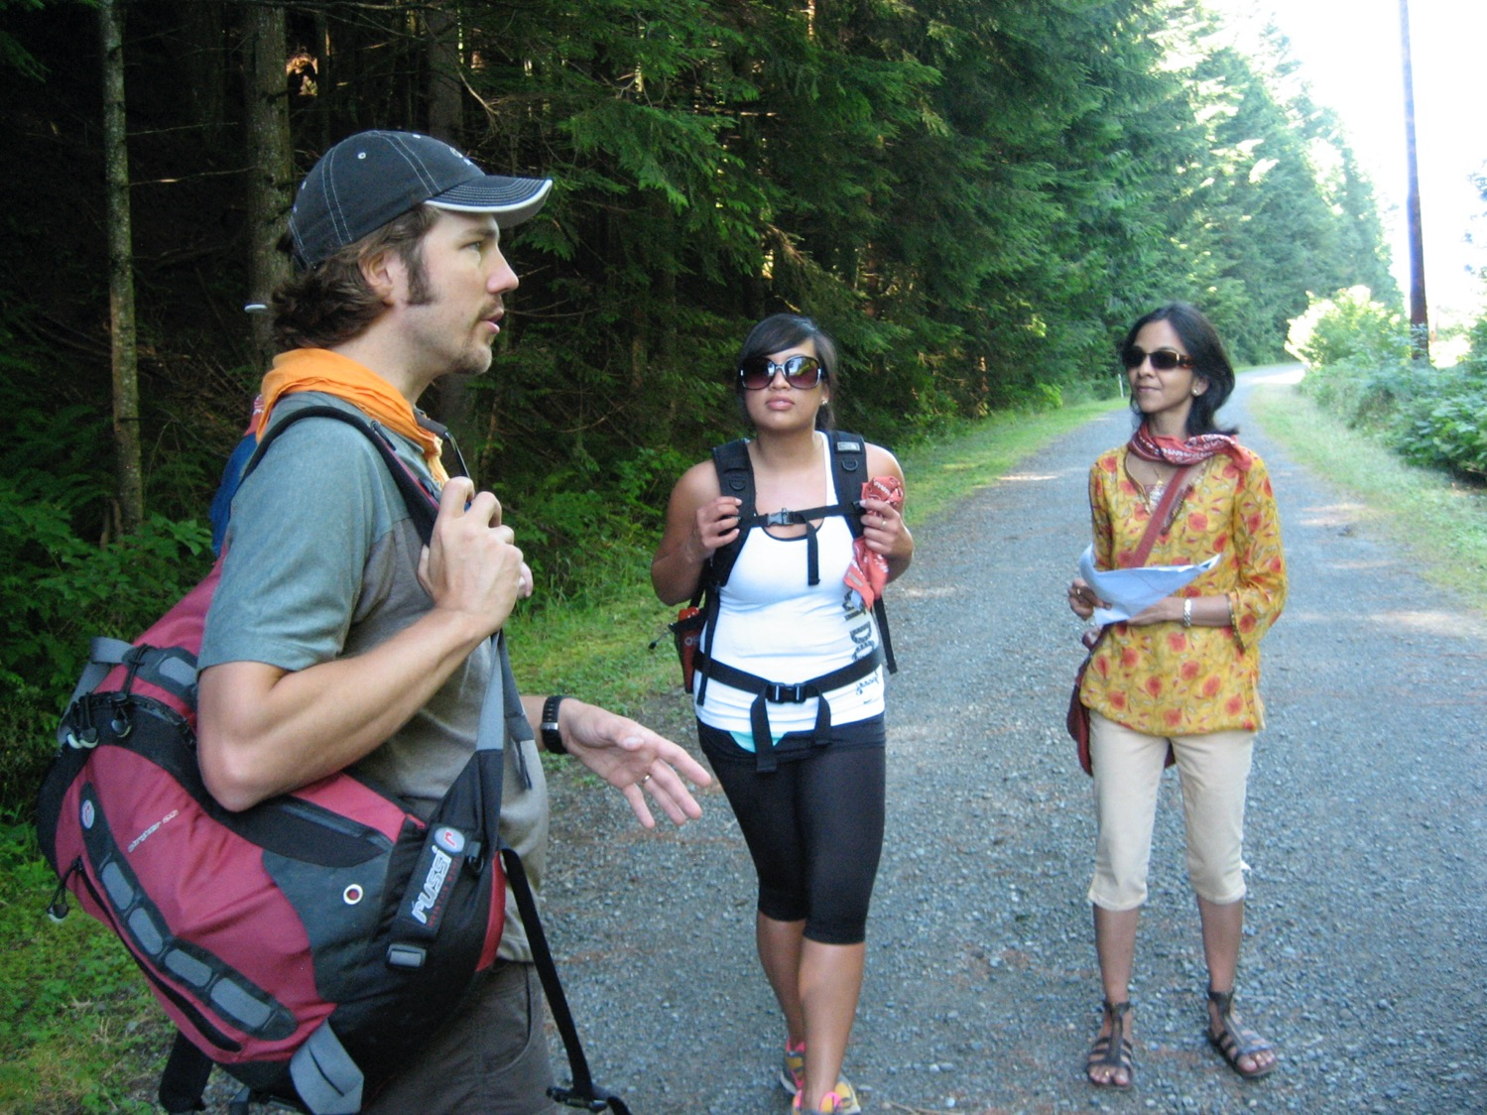
The role of a guide has evolved from just showing people the route from point ‘A’ to point ‘B’.
It is now helping people find the path to connect to the place and story of the destination and ultimately the traveler’s purpose.
Notes:
DM

Slide 5
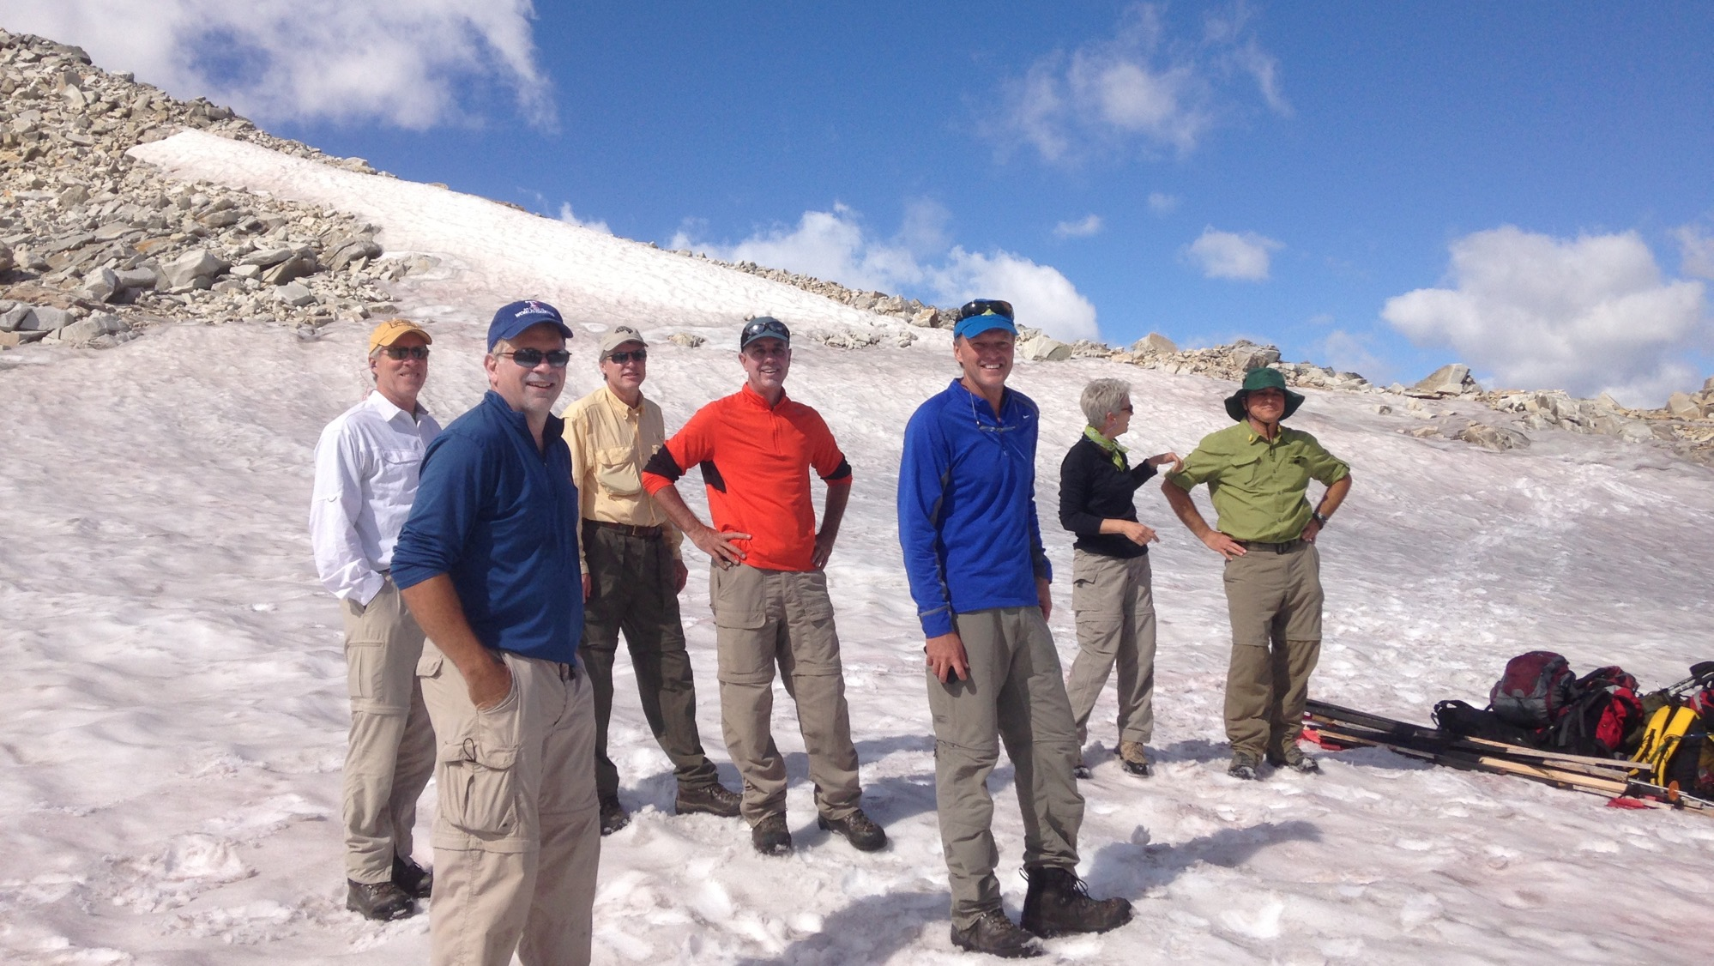
An excellent guide in one destination can raise the bar for all of us, while a less competent guide in another can just as easily hurt us all.
Notes:
DM

Slide 6
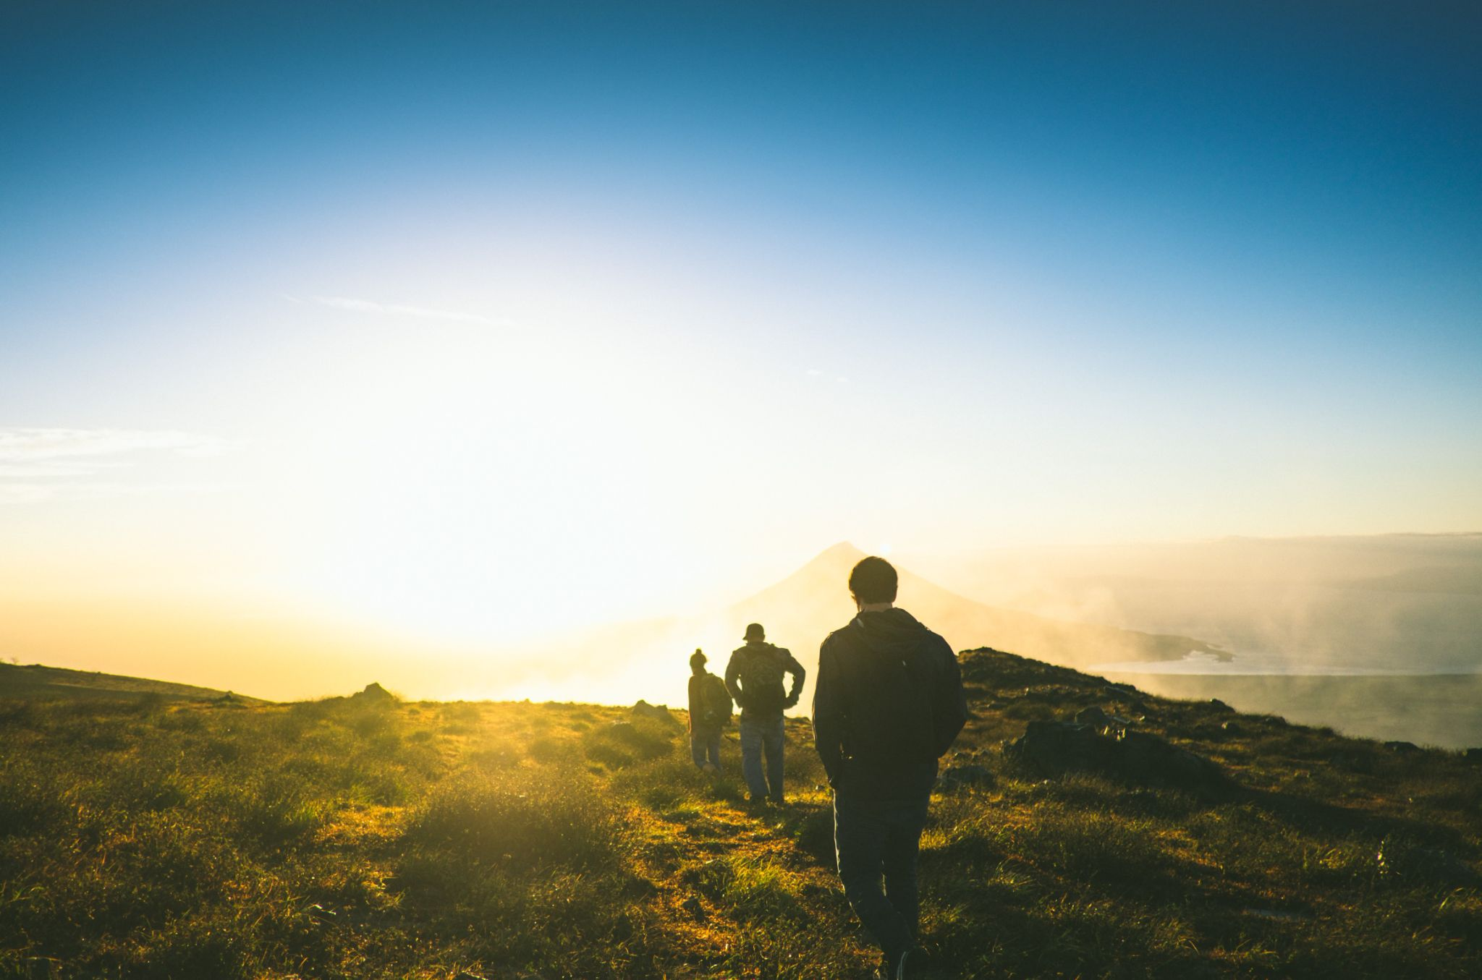
Adventure Guides encourage and inspire a love and connection to nature and nurture an adventurous spirit.
Notes:
DM

Slide 7
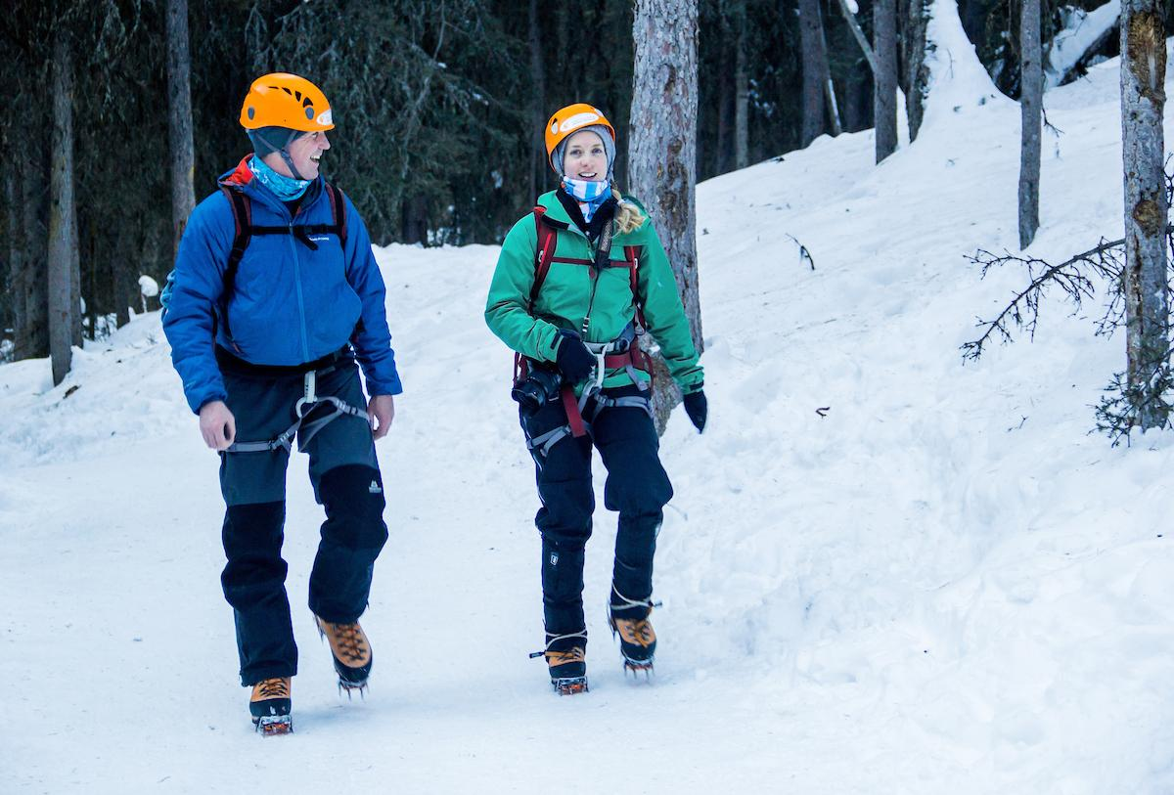
"These values are an antidote to some of the most vexing problems of the modern world.”
Jean-Claude Razel/ Alaya Expedições &
ATTA senior Educator
Notes:
DM

Slide 8
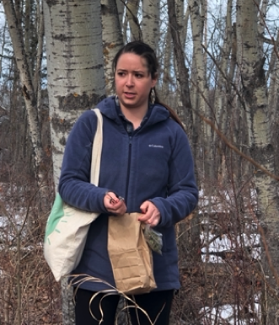
Why the Guides Standard Matter
Demand for Higher Quality
Adventure Travel rapidly growing
Increased competition locally and internationally
Higher customer expectations
Notes:
GT

Slide 9
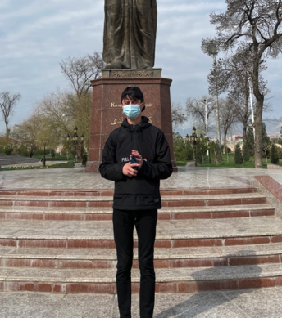
Why the Guides Standard Matter
Emphasis on Safety
Government regulations
Destinations more exposed in accidents
Insurance requisites
Notes:
GT

Slide 10
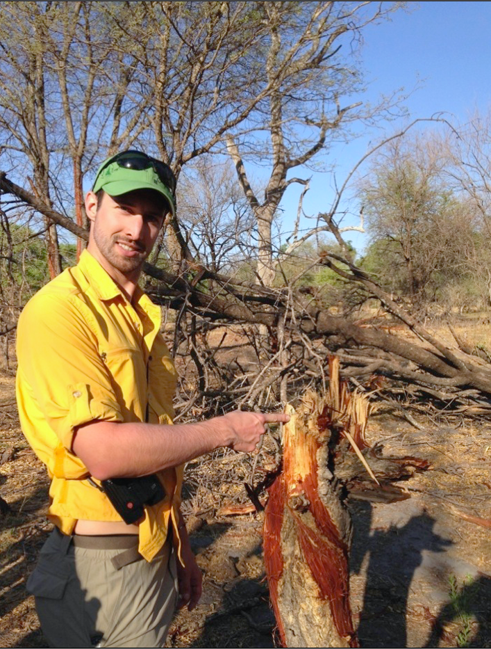
Why the Guides Standard Matter
Emphasis on Sustainability
Travel under scrutiny for impacts on communities and environment
Essential for future of adventure travel
Notes:
GT

Slide 11
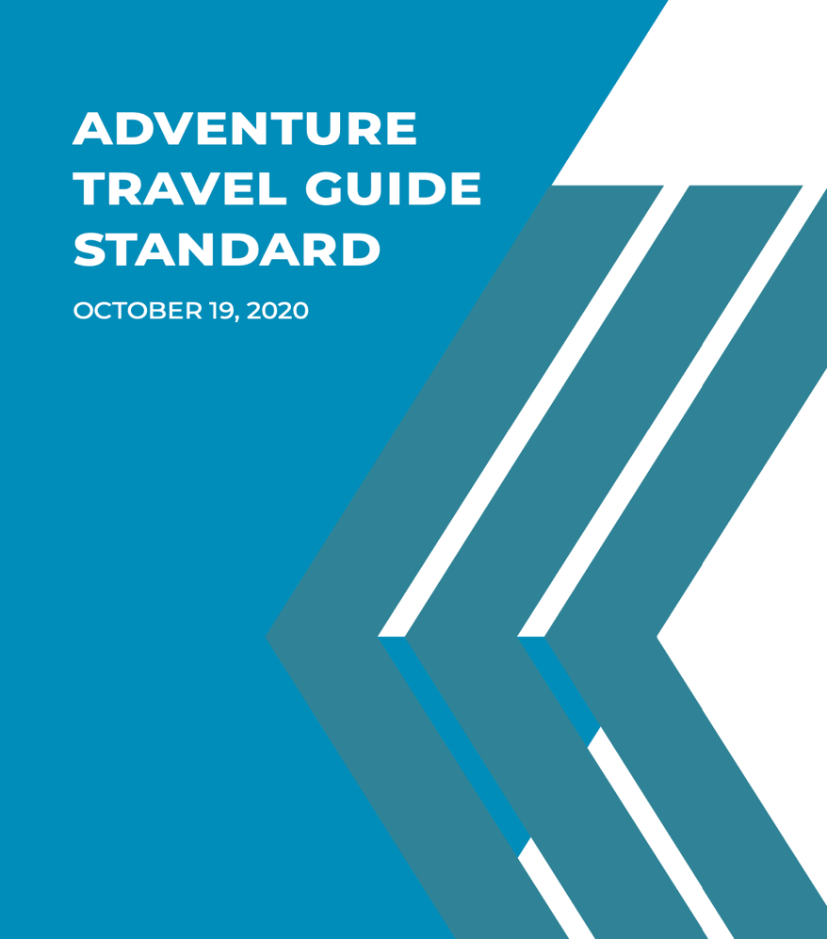
Background on ATGS
2014 - Working Group Formed
Representatives from 18 Countries
Spearheaded by ATTA
10+ Months
2016 - Published first international Adventure Travel Guide Standard
2019 - First revision begun
2021 - Second Edition published
Notes:
GT

Slide 12
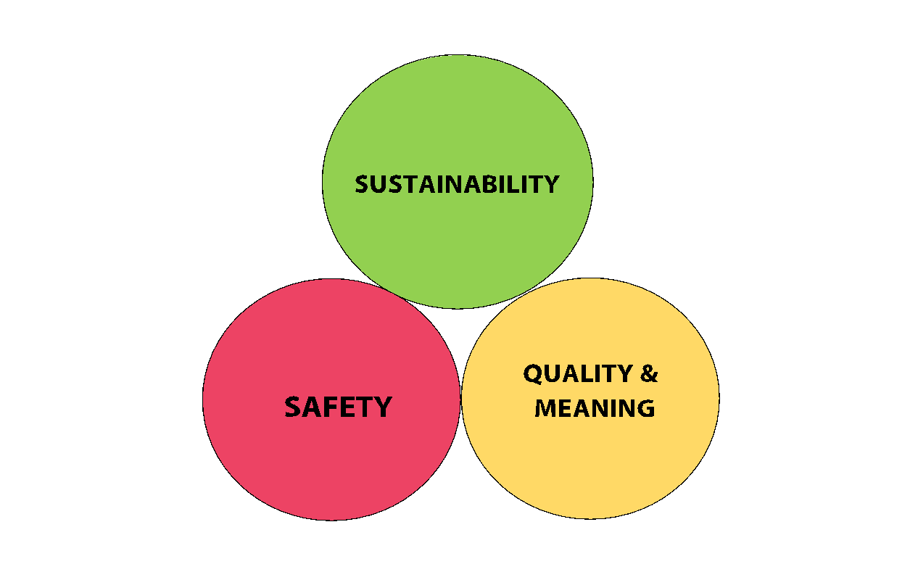
Core Responsibilities of an Adventure Travel Guide
Notes:
Sustainability
Adventure travel depends upon vibrant, resilient communities, ecosystems and landscapes. Adventure travel participants expect to participate in adventure travel activities in places that are protected from negative social and environmental impacts and that their contributions to the local economy enhance that goal. As a result, adventure travel guides play a fundamental role in safeguarding the environmental, social and economic sustainability of the communities and ecosystems where guiding and related adventure activities take place.
SAFETY
While there is inherent risk to traveling, and especially in adventure travel, a guide must be constantly aware of his / her role minimizing the likelihood of accidents and incidents. If an incident or accident occurs, a guide must be prepared with appropriate skills to address the needs of the guest.
Quality & Meaning
Travel can impact destinations in both positive and negative ways. While travel and tourism make important contributions to local economies, the increasing threats and impacts of climate change has called into question the very act of traveling for recreation. We are moving out of an era where to travel just for sheer recreation is viewed as acceptable and therefore traveling must seek a higher purpose.
At the same time, travelers’ expectation of quality has been elevated due to the availability of information and customer rating systems. These customer service considerations in adventure tourism combined with the increased emphasis on sharing meaningful content has expanded the responsibilities of the guide and elevated the customer experience aspect to the level of safety and sustainability.

Slide 13
How to use the ATGS?
Individual Guide
Adventure Travel Business
Academia & in press
Trade Bodies & DMO’s
Strategic
Notes:
Myles
Don’t see this list as exhaustive. We should all be open to any way that we can develop our guiding workforce and share and promote best practice around the world. Remember what was once wisely said at ATWS in Quebec in 2009 “Your Brand is in their hands”
Examples for each:
1.Career reflection, professional development framework. Institute for Outdoor Learning (IOL) professional development coaching and assessment.
2.In-house Wilderness Scotland Guide training. Wilderness Guide Training Programme (WGTP)
3.Two Modules on Adventure Tourism undergraduate degree course – University of The Highlands & Islands (UHI). Forthcoming article in Horizons IOL magazine. Forthcoming book The Adventure Tourist: Being, knowing, becoming.
4.Wild Scotland Best Practice Guidance – alignment with ATGS
5.Europarc Federation and European Network of Outdoor Sports (ENOS) Potential for ATGS around Sustainability aligning with the work of the SEE project.

Slide 14
Adventure Travel Guide Core Competencies
Sustainability
Technical Skills & First Aid
Safety & Risk Management
Customer Service & Group Management
Natural & Cultural History Interpretation
Notes:
2. Activity skills, Navigation, Meteorology, Natural phenomena interpretation, Equipment & Vehicles
3. Risk Inventory, Analysis & Treatment (RIAT), Emergency Action Plan (EAP), Standard Operating Procedures (SOP), ISO 21101 Certification
4. Guide outside the comfort zone, Manage conflicts, Manage and aim to exceed Expectations, Hospitality and advocate
5. Nature & Culture history, Folklore, Fauna & Flora, Content Delivery & Storytelling, Forging Emotion connections potentially transformational, Authenticity and balance

Slide 15
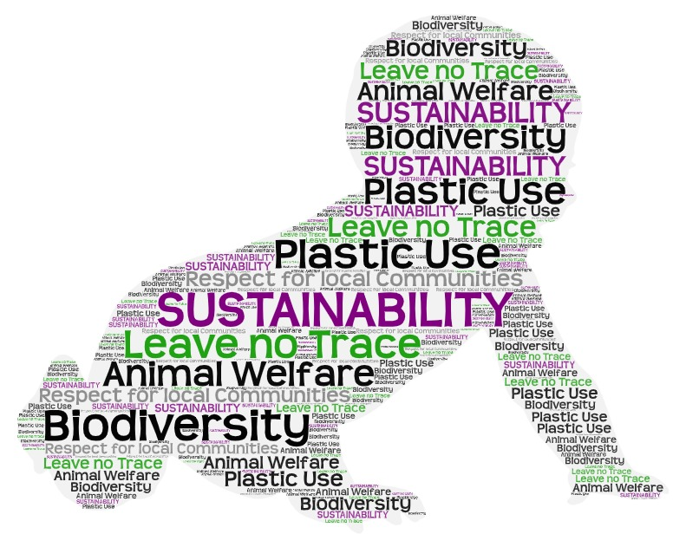
Notes:
The rapid growth of global travel in recent decades has also contributed to an increase in impacts both positive and negative.
According to a study published in 2018, tourism accounts for 8% of global emissions, with air travel being a major component. Development for tourism can also lead to urban sprawl and the destruction of critical wildlife habitats. Irresponsible destination management can have a devastating impact on local communities and residents.
Intricately interwoven, the climate emergency and biodiversity crisis are no longer disputable. Atmospheric carbon dioxide has increased 25% in the last 50 years, and species are being lost at 1000 times their natural rate. According to the International Union for the Conservation of Nature (IUCN), we are witnessing the greatest mass extinction crisis since dinosaurs disappeared from our planet 65 million years ago.
However, sustainably carried out adventure travel can be a positive force as well. In many parts of the world, tourism offers the financial incentive that persuades communities and governments to halt destructive development, like mining, intensive agriculture or logging.
Besides tourism having a role in securing environmental protection, the most responsible experiences recognise that local communities must be empowered, too. Operators should strive to not only equip local people with the skills and resources to deliver meaningful travel experiences, but to ensure that tourism revenue remains in the local economy.
Having less of an impact is no longer enough. To be truly sustainable, our travel experiences must contribute to solving environmental and societal problems.

Slide 16
Sustainability
Impacts - Leave No Trace
Respect to local communities - Overtourism
Climate Emergency/biodiversity loss – relate local to global
Human AND animal rights/welfare
Avoid plastic – especially single use
Educate – balanced view

Slide 17
ATGS Governance Board
Volunteer group made up of guides & adventure travel professionals.
Purpose to oversee the ongoing maintenance of the standard
Conduct outreach
Represent all 7 continents
Notes:
Ana

Slide 18
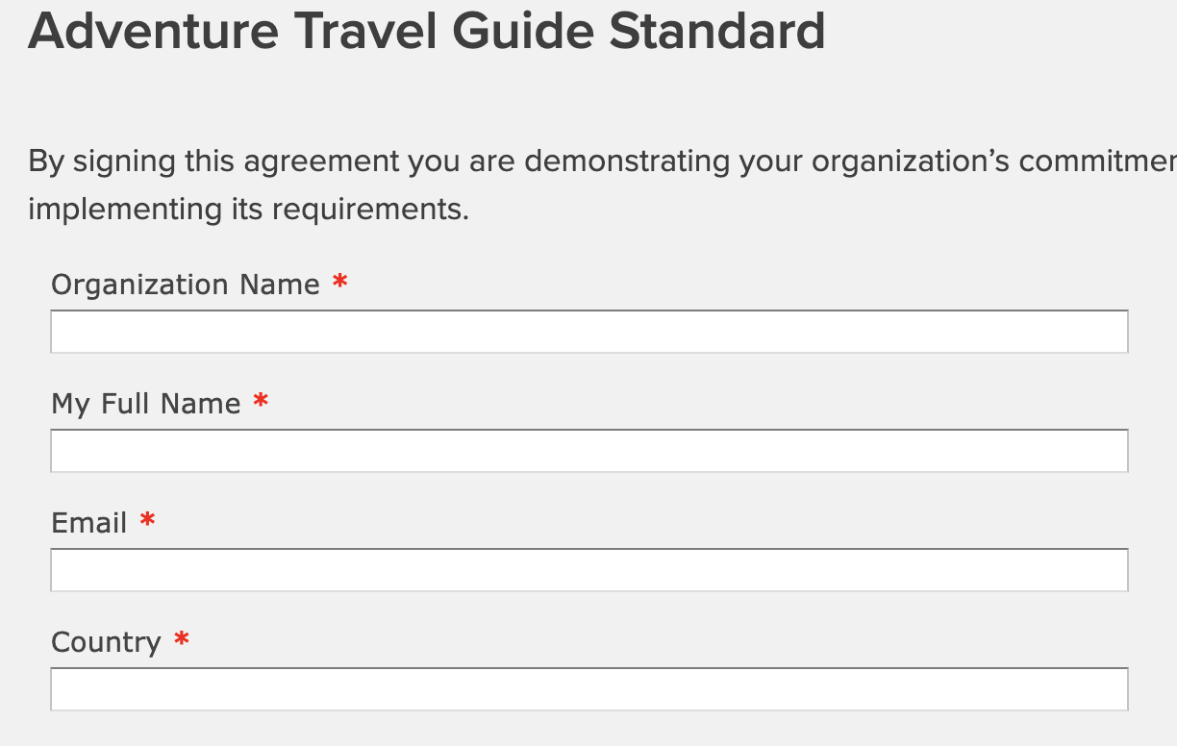
Support the Guide Standard
www.adventuretravel.biz/ education/guide-standard/ adventure-travel-guide-standard

Slide 19
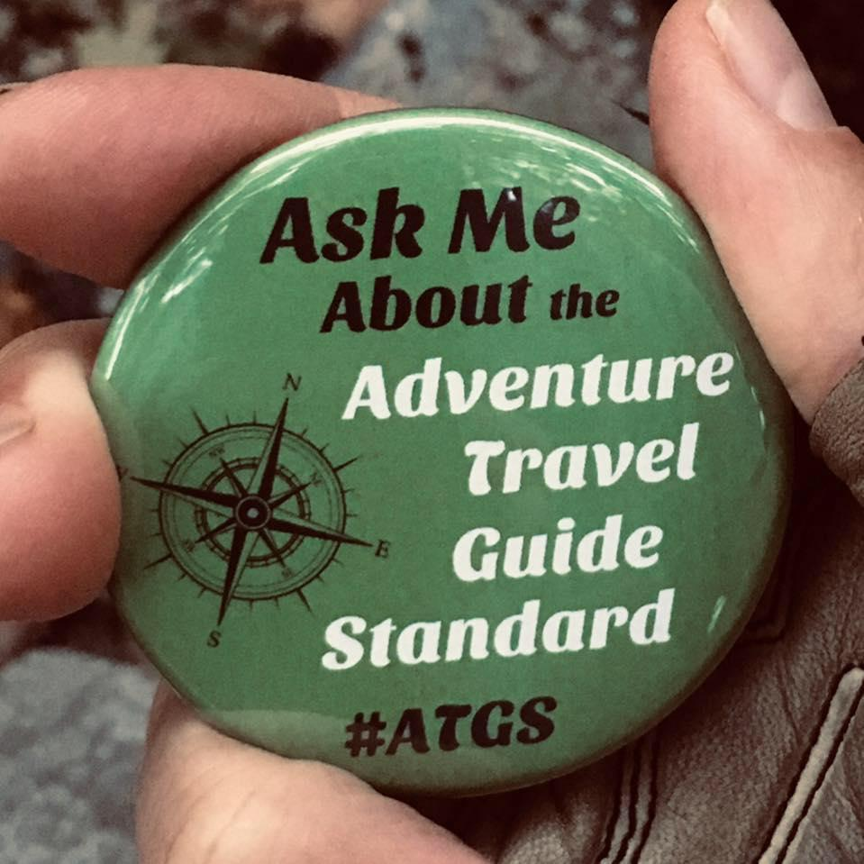
ENGAGE & SUPPORTING THE ATGS
Follow the Standard on Facebook: @ATGuideStandard
Commit yourself or your guides to following the criteria of the Standard
Join the Governance Board, 2026 will be here soon!
Host a local events and trainings and share the Standard with peers, guides, etc.
Translate the Standard into local language(s)
Share your training materials
Share feedback on the Standard with the GB, for the 2026, 3rd edition

Slide 20
¡Gracias! Obrigada! Merci! Takk skal du ha!
Tapadh leat! Thank you!
Editors
Jean-Claude Razel/ France/Brazil
Myles Farnbank/ Scotland
Stephen Taranto/ Bolivia
Gustavo Timo/ Brazil
Dan Moore/ United States
Content Team
Ana Ines Figueroa/ Argentina
Chun Wright/ United States
Ervin Mejia/ Norway
Hayley Wright/ Montenegro
Javi Gálvez/ Spain
John Baston/ United States
Raffaele Di Biase Cuomo/ Chile
Notes:
GT

Slide 21
Thank you! info@mylesfarnbank.com
Notes:
Dan prep 1-3 questions to ask Governance Board to get Q&A rolling, if needed.

