Slide 1
What does climate change mean to us, Protected Area Managers?
Olivier de Sadeleer, Project Manager - LIFE Natur’Adapt,
Climate Change Adaptation, EUROPARC Federation"

Slide 2
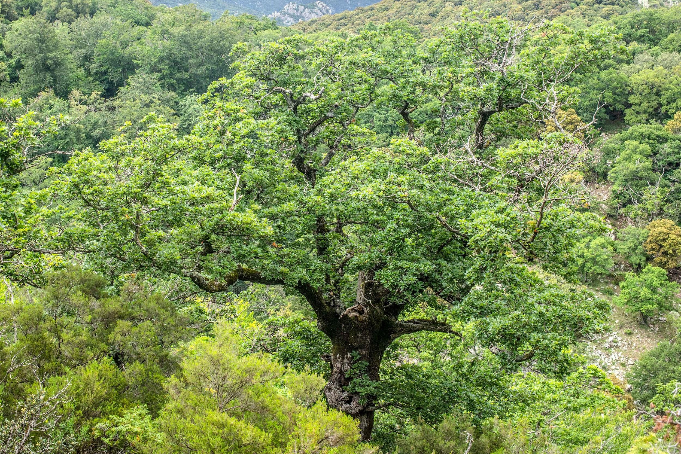
Good afternoon and welcome
Photo: La Massane NNR

Slide 3
About this session…
Put our heads around PA management
in the face of climate change
Meet each other
Read more on www.naturadapt.com

Slide 4
About this session…
A mix of information, peer-to-peer exchanges & self-reflection

Slide 5
About this session…
Please share, reuse & upcycle

Slide 6
It’s all about attitude :)
You are as much a participant as a contributor
This session is a laboratory. There are no wrong answers
Creativity comes from diversity
Kindness is the foundation of cooperation
Most of us are non-native English speakers

Slide 7
It’s all about attitude :)
You are as much a participant as a contributor
This session is a laboratory. There are no wrong answers
Creativity comes from diversity
Kindness is the foundation of cooperation
Most of us are non-native English speakers
>>> Silence, pls <<<

Slide 8
Before we start…
If you are seated next to a colleague or a friend
[please change seat]

Slide 9
Your turn…
Do you think that tackling climate change is a priority?
[If yes, stand up]

Slide 10
>>> Silence, pls <<<

Slide 11
2018 survey results*
* 497 responses - 43% FR - 57% EU
Non EU excluded :-/
Should climate change be a priority?
YES for 77% of respondents
…in the short term for 87%
* DE SADELEER O., COUDURIER C., 2019. Intégration du changement climatique dans la gestion des espaces naturels protégés - Initiatives existantes et attentes des gestionnaires européens. LIFE NaturAdapt – Rapport d’Europarc et de RNF. 24p. Read the survey result summary here

Slide 12
2018 survey results*
* 497 responses - 43% FR - 57% EU
Non EU excluded :-/
Is Climate change an integral part of PA management planning practice?
* DE SADELEER O., COUDURIER C., 2019. Intégration du changement climatique dans la gestion des espaces naturels protégés - Initiatives existantes et attentes des gestionnaires européens. LIFE NaturAdapt – Rapport d’Europarc et de RNF. 24p. Read the survey result summary here

Slide 13
2018 survey results*
* 497 responses - 43% FR - 57% EU
Non EU excluded :-/
Is Climate change an integral part of PA management planning practice?
Not really :/
67% of respondents had not done a vulnerability assessment
1/3 of respondents were not taking climate change into account
Only 7% reported a detailed climate change assessments
* DE SADELEER O., COUDURIER C., 2019. Intégration du changement climatique dans la gestion des espaces naturels protégés - Initiatives existantes et attentes des gestionnaires européens. LIFE NaturAdapt – Rapport d’Europarc et de RNF. 24p. Read the survey result summary here

Slide 14
Your turn…
Meet your neighbours
[In groups of 4, introduce yourselves - 7min.]

Slide 15
>>> Silence, pls <<<

Slide 16
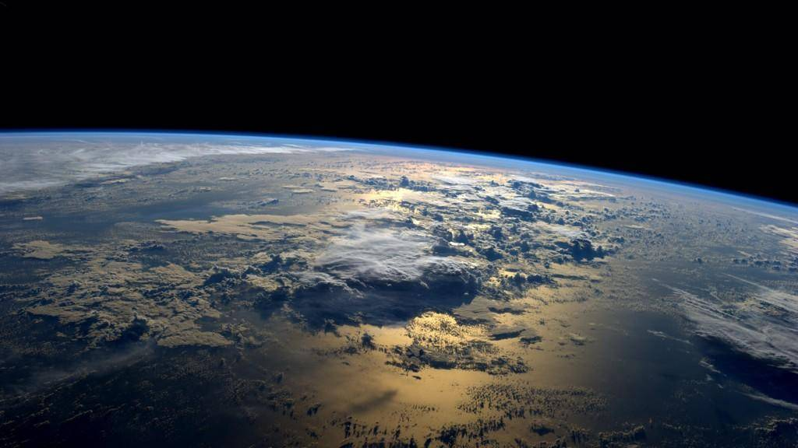
Helping Protected Areas to integrate climate change into their management practice

Slide 17
A bit of context. LIFE Natur’Adapt
LIFE Natur’Adapt aims at integrating Climate Change in PA management practice
Read more on www.naturadapt.com

Slide 18
A bit of context. LIFE Natur’Adapt
LIFE Natur’Adapt aims at integrating Climate Change in PA management practice
It is a bottom-up experiment lead by RNF within a consortium of 10 partners joined by 15 test sites
Read more on www.naturadapt.com

Slide 19
A bit of context. LIFE Natur’Adapt
LIFE Natur’Adapt aims at integrating Climate Change in PA management practice
It is a bottom-up experiment lead by RNF within a consortium of 10 partners joined by 15 test sites
with the enthusiastic support of…
Read more on www.naturadapt.com

Slide 20
Your turn…
People involved with LIFE Natur’Adapt
[Please stand up]

Slide 21
Among ourselves, we talked about...
Climate
in the past, the present and the future!
Read more on www.naturadapt.com

Slide 22
Among ourselves, we talked about...
Vulnerability assessments & prospective stories
Read more on www.naturadapt.com

Slide 23
Among ourselves, we talked about...
Adaptation strategies, planning & measures
Read more on www.naturadapt.com

Slide 24
Together, we are producing …
Methodology • Online course
Toolbox • Collaborative platform
Read more on www.naturadapt.com

Slide 25
Your turn…
What does climate change mean to you, as a person ?
Self-reflection in silence - make a note - 4 min.]

Slide 26
Your turn…
How do you feel about it?
[please clap when your mood
appears on the screen]
© Pixar

Slide 27
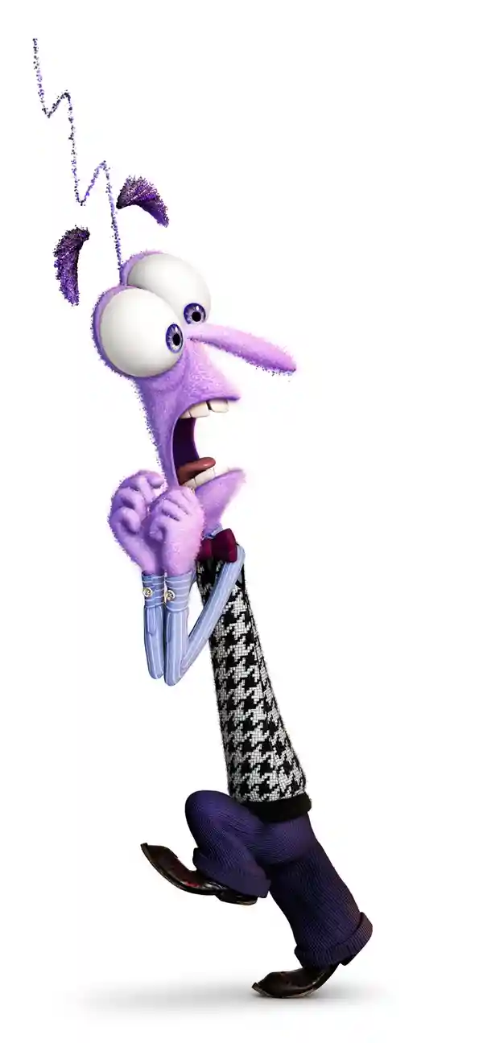
Your turn…
How do you feel about it?
[please clap when your mood appears on the screen]
ScARed
© Pixar

Slide 28
Your turn…
How do you feel about it?
[please clap when your mood appears on the screen]
sad
© Pixar

Slide 29
Your turn…
How do you feel about it?
[please clap when your mood appears on the screen]
ANGRY
© Pixar

Slide 30
Your turn…
How do you feel about it?
[please clap when your mood appears on the screen]
optimist
© Pixar

Slide 31
>>> Silence, pls <<<

Slide 32
What does science say?
Picture: NASA
Special thanks to Dr. Jean-Baptiste Bosson, Glaciologist, Scientific officer, Asters- CEN Haute Savoie ( Partner of LIFE Natur’Adapt) & member of National Council for Nature Conservation,

Slide 33
What is climate?
Atmospheric conditions vary in time and space
Temperature and Precipitation (Pressure, Sunshine, Cloudiness, Humidity, Wind...)
Weather =
Characterisation of these conditions in the short term and in specific areas
Climate =
Statistical distribution calculated over 30 years of these conditions in a given region and period.
It is based on averages, deviations, durations, frequencies, normals.

Slide 34
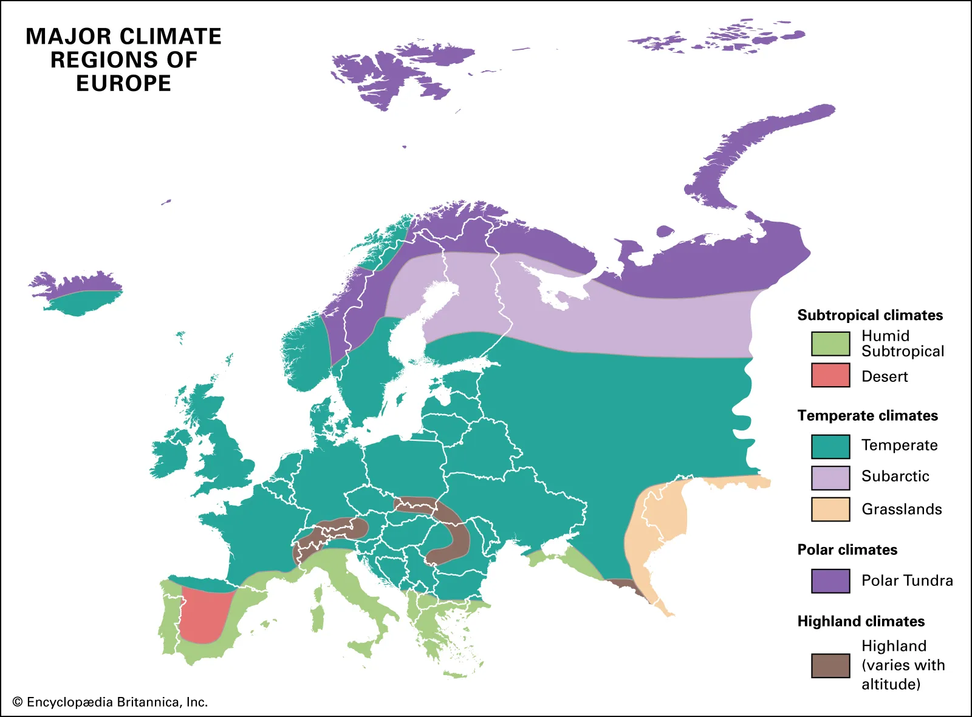
Major Climates of Europe

Slide 35
What is climate?
Atmospheric conditions vary in time and space
Temperature and Precipitation (Pressure, Sunshine, Cloudiness, Humidity, Wind...)
Hydrosphere (ocean, marine currents...)
Biosphere
(living organisms on land and in the oceans)
Cryosphere
(ice caps, glaciers, ice packs...)
Lithosphere (tectonics, relief, volcanism...)

Slide 36
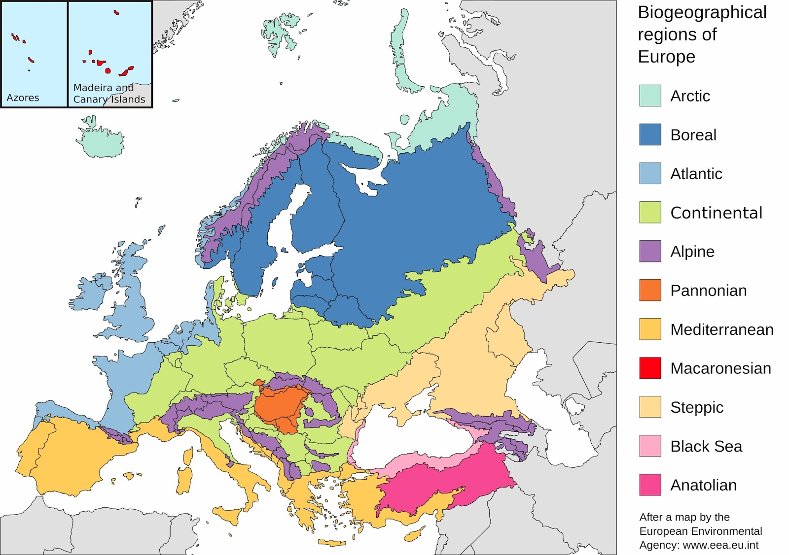
Biogeographical regions of Europe

Slide 37
Why global warming?

Slide 38
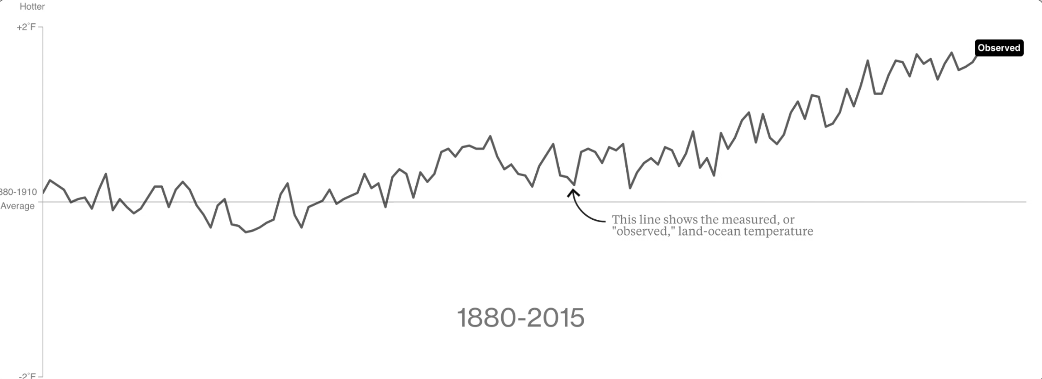
Measured or observed land & ocean temperatures
Source: Bloomberg based on data from NASA/GIEC

Slide 39
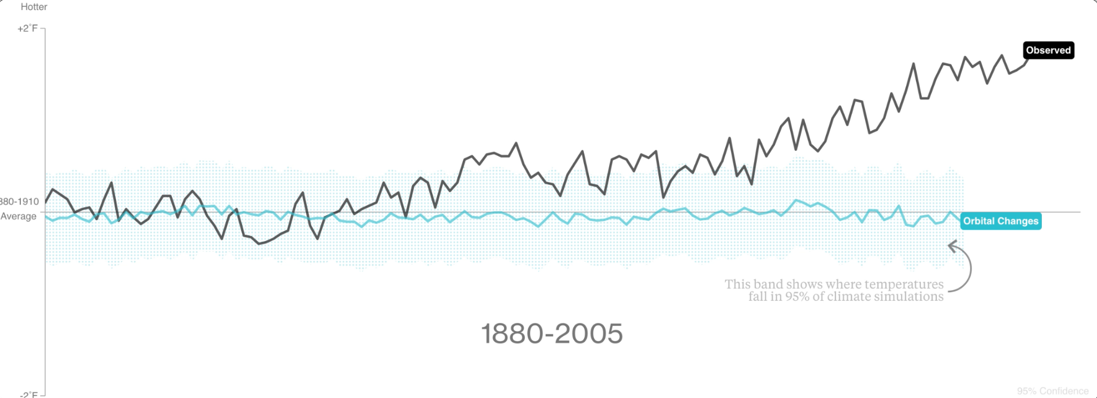
Impact of orbital change on T°
This band shows where temperatures fall in 95% of climate simulations
Source: Bloomberg based on data from NASA/GIEC

Slide 40
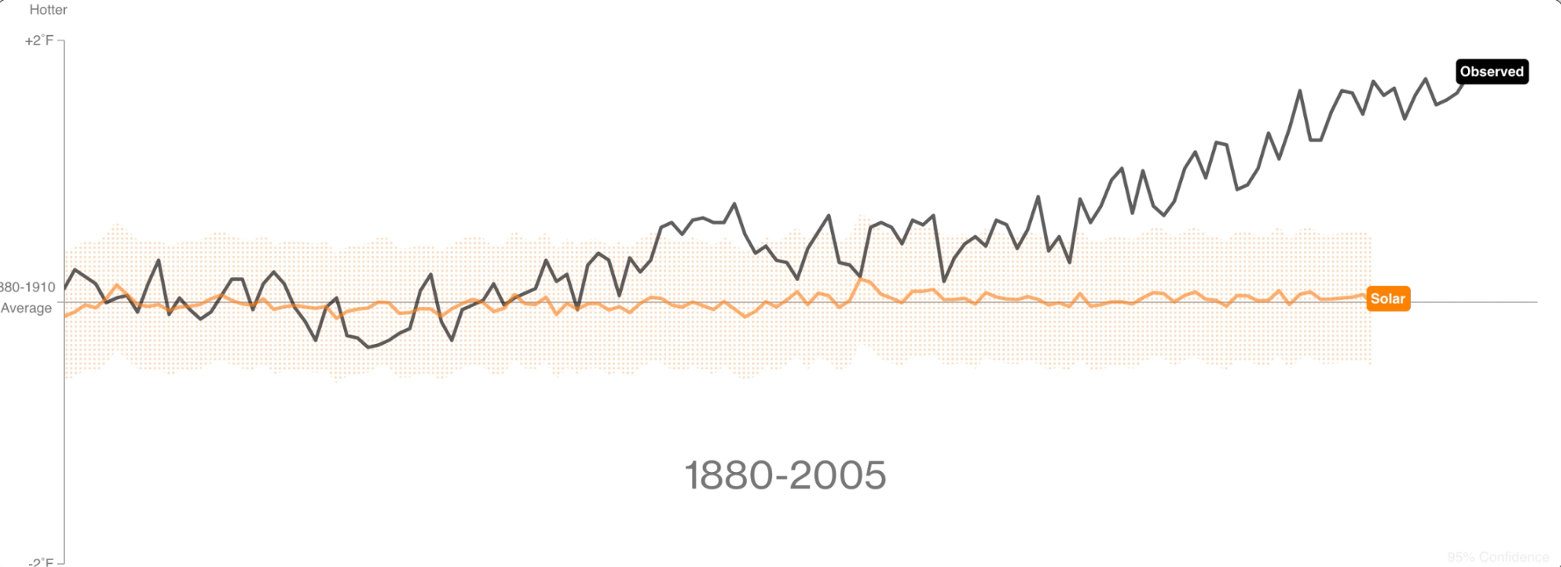
Impact of solar activity on T°
This band shows where temperatures fall in 95% of climate simulations
Source: Bloomberg based on data from NASA/GIEC

Slide 41
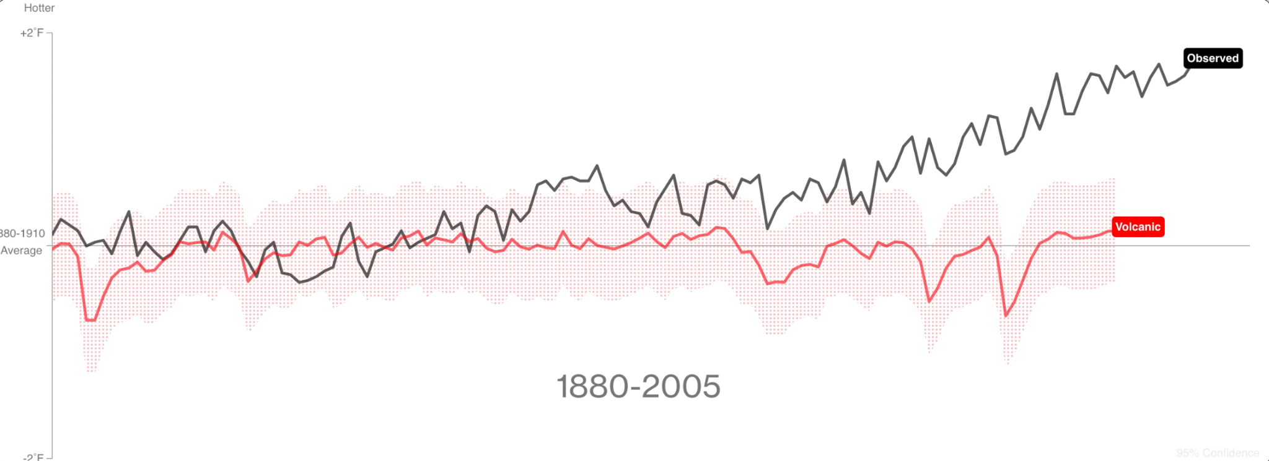
Impact of volcanic activity on T°
This band shows where temperatures fall in 95% of climate simulations
Source: Bloomberg based on data from NASA/GIEC

Slide 42
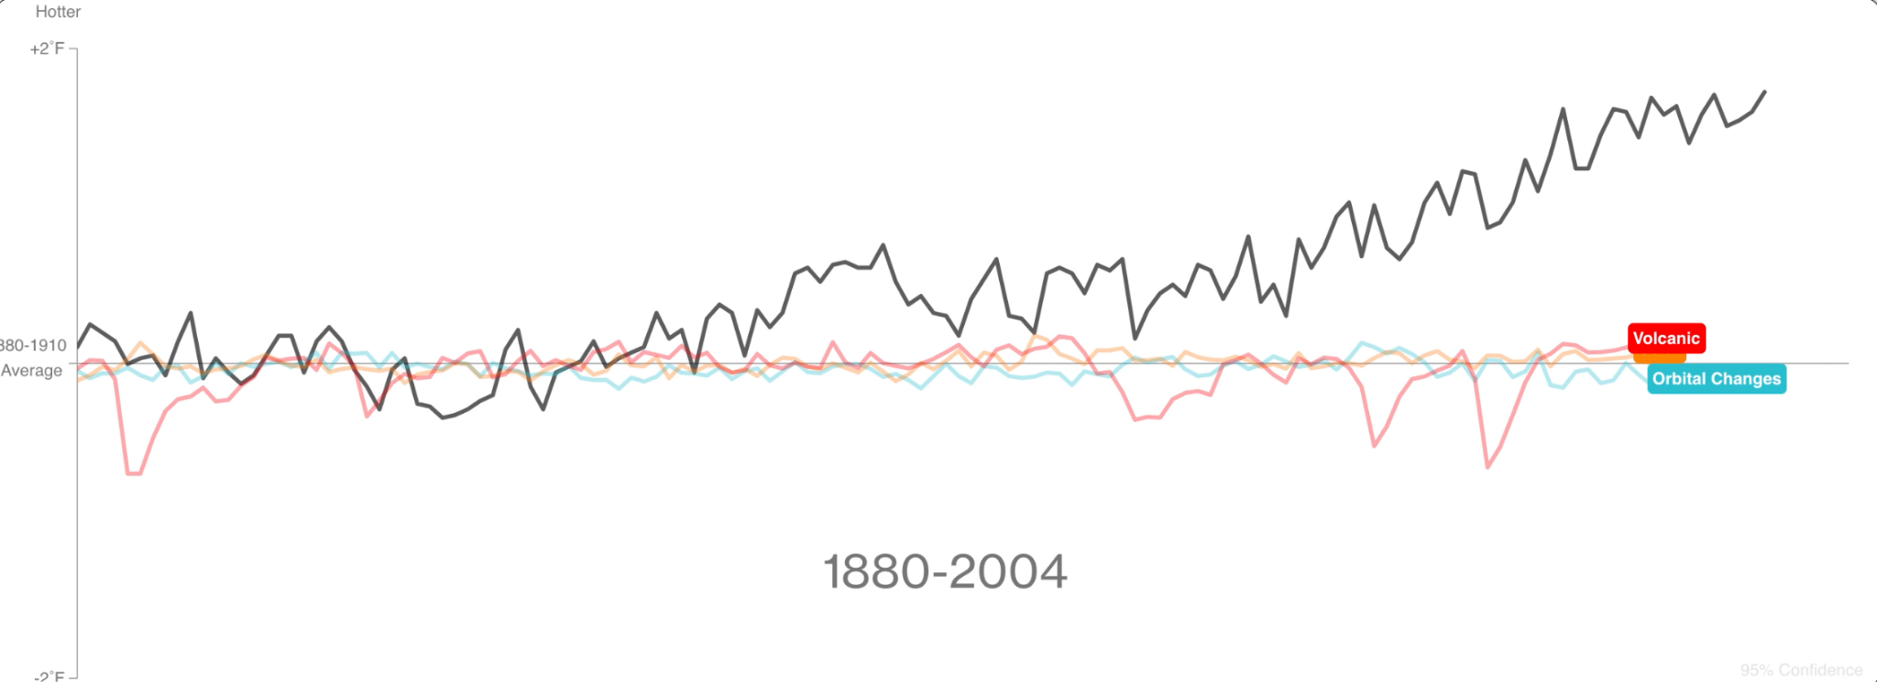
Impact of natural factors on T°
Source: Bloomberg based on data from NASA/GIEC

Slide 43
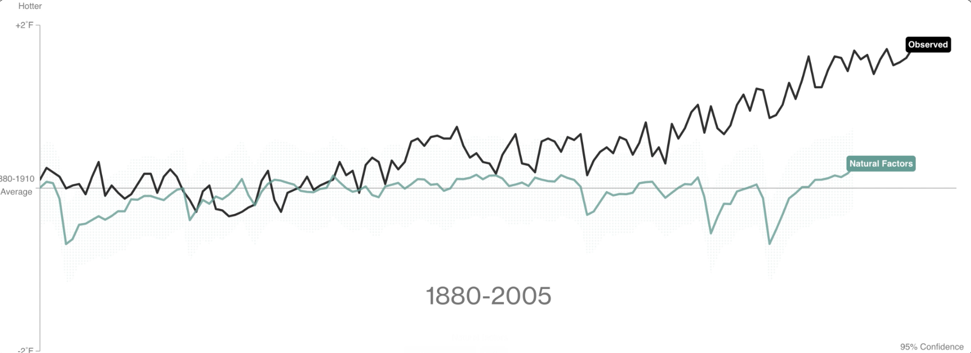
Impact of natural factors on T°
Source: Bloomberg based on data from NASA/GIEC

Slide 44
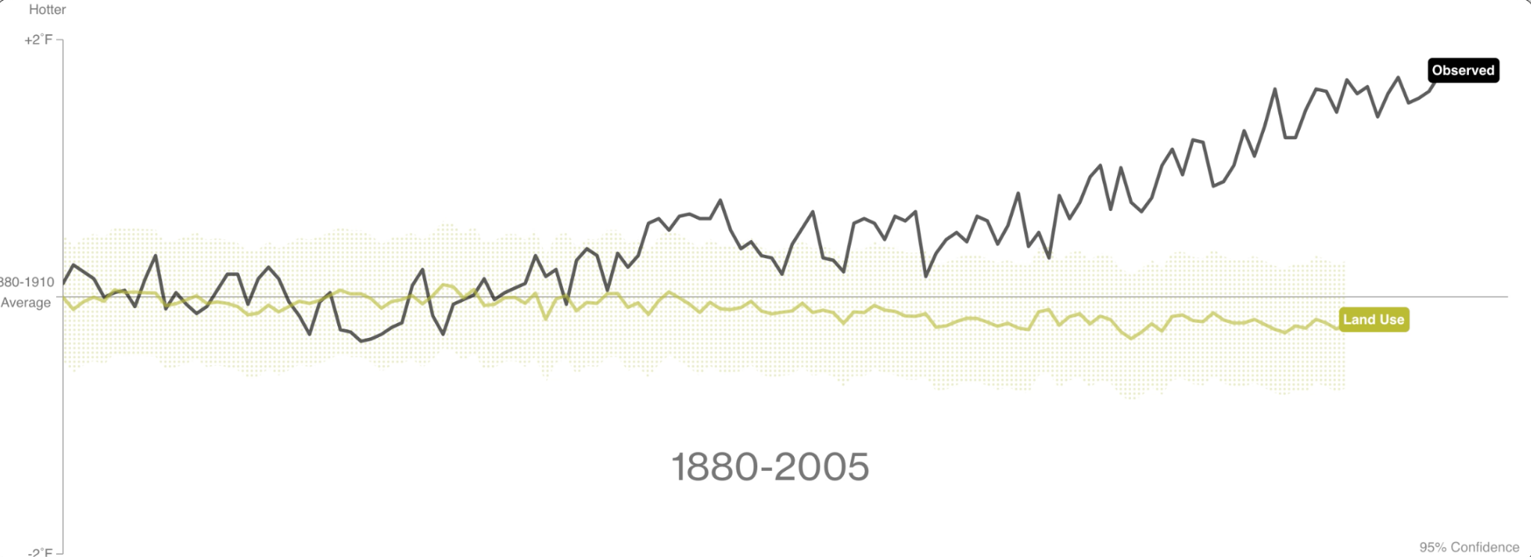
Impact of land use change on T°
This band shows where temperatures fall in 95% of climate simulations
Source: Bloomberg based on data from NASA/GIEC

Slide 45
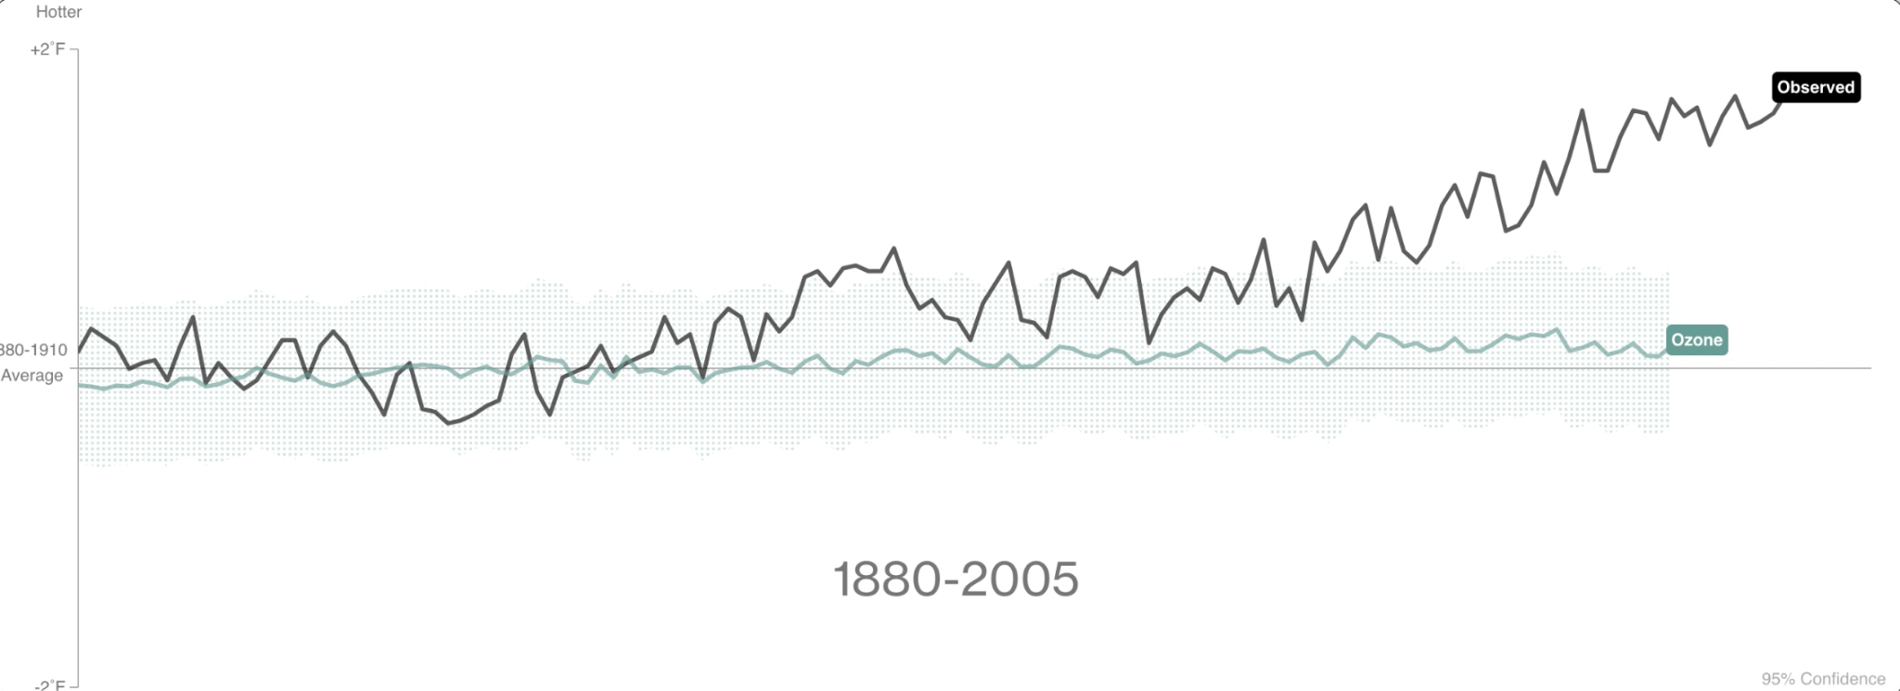
Impact of ozone pollution on T°
This band shows where temperatures fall in 95% of climate simulations
Source: Bloomberg based on data from NASA/GIEC

Slide 46
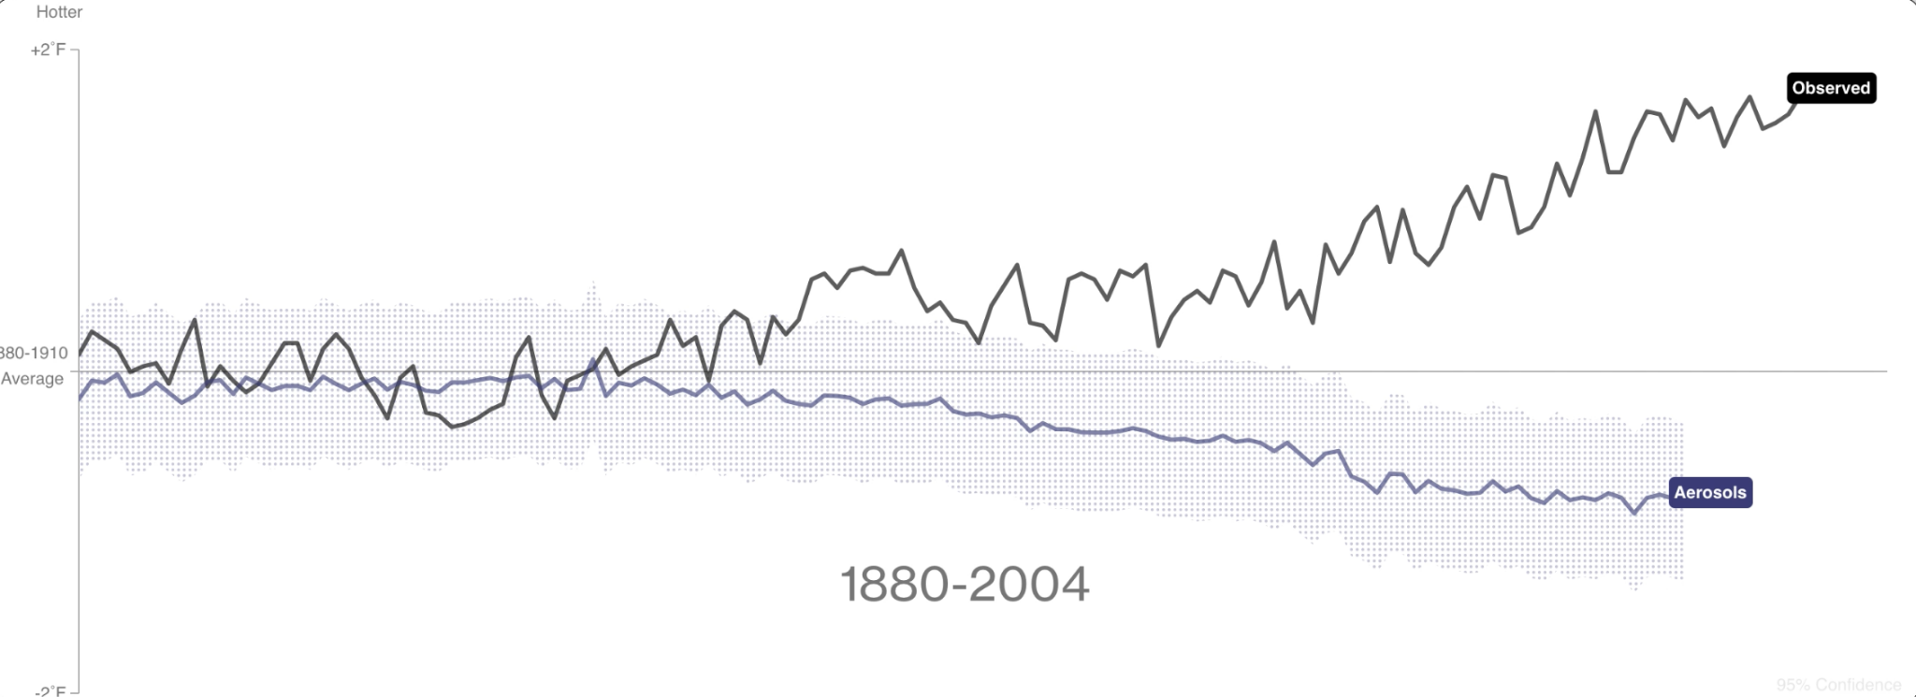
Impact of aerosols’ pollution on T°
This band shows where temperatures fall in 95% of climate simulations
Source: Bloomberg based on data from NASA/GIEC

Slide 47
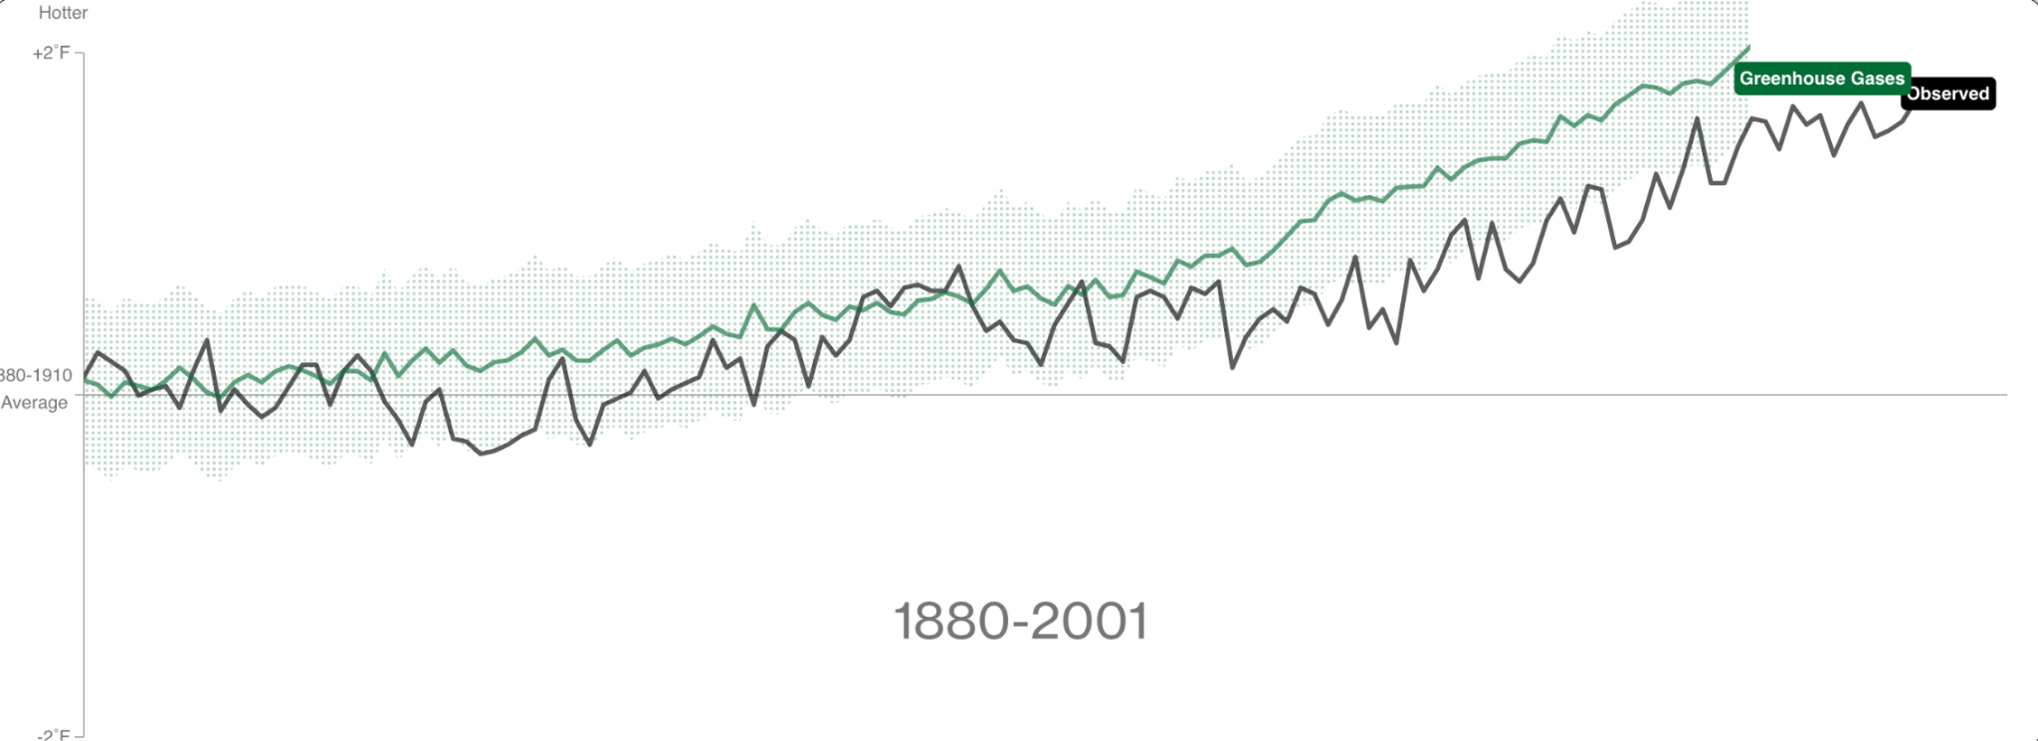
Impact of GreenHouse Gases on T°
This band shows where temperatures fall in 95% of climate simulations
Source: Bloomberg based on data from NASA/GIEC

Slide 48
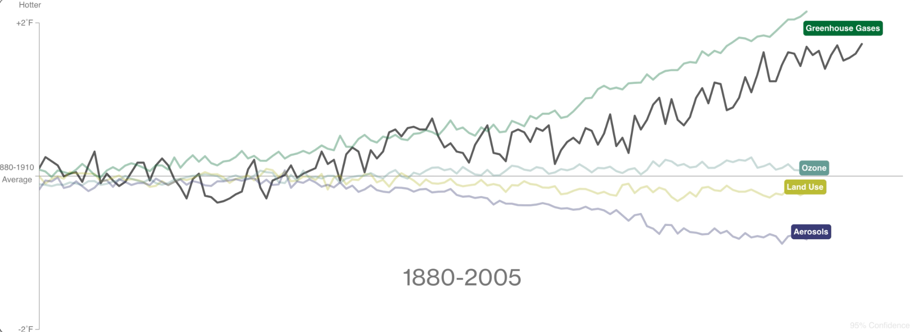
Impact of human factors on T°
Source: Bloomberg based on data from NASA/GIEC

Slide 49
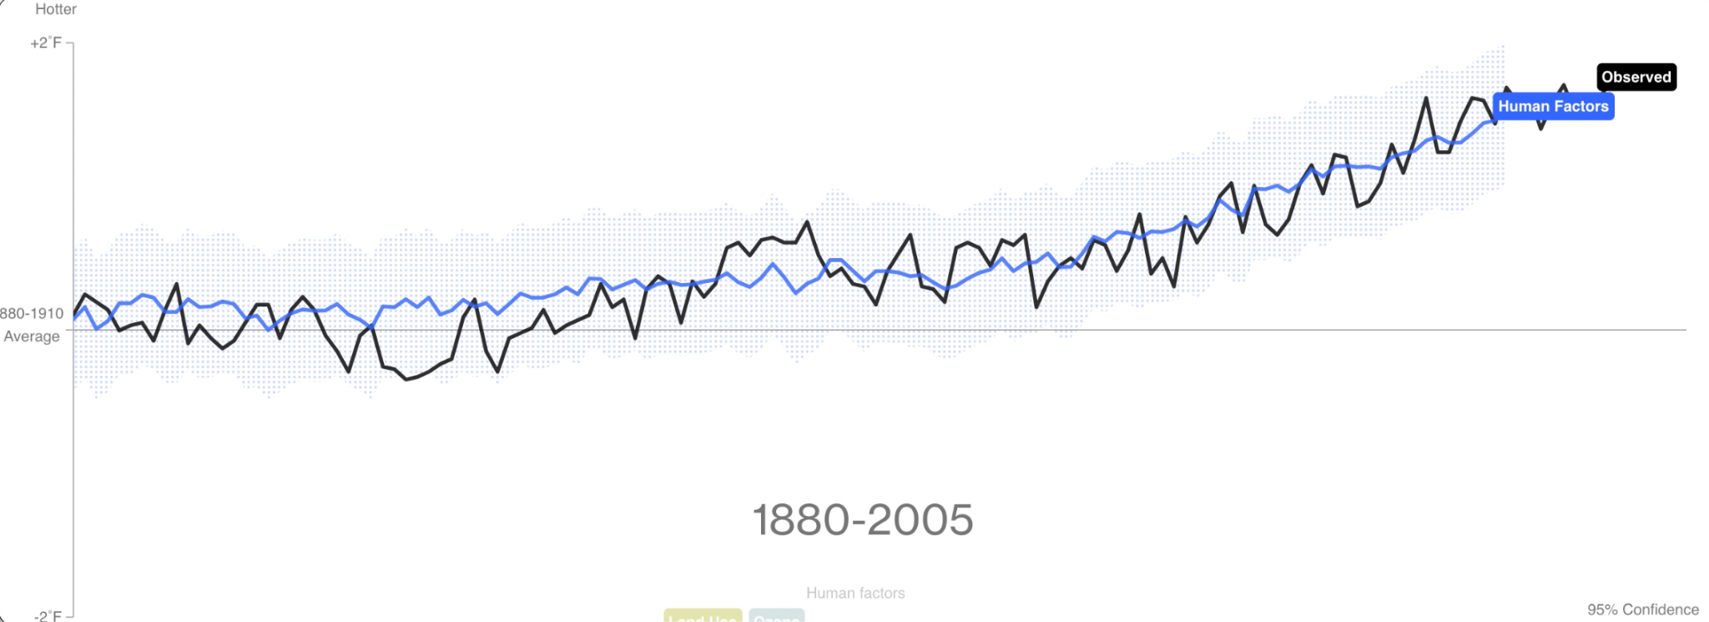
Impact of human factors on T°
Source: Bloomberg based on data from NASA/GIEC

Slide 50
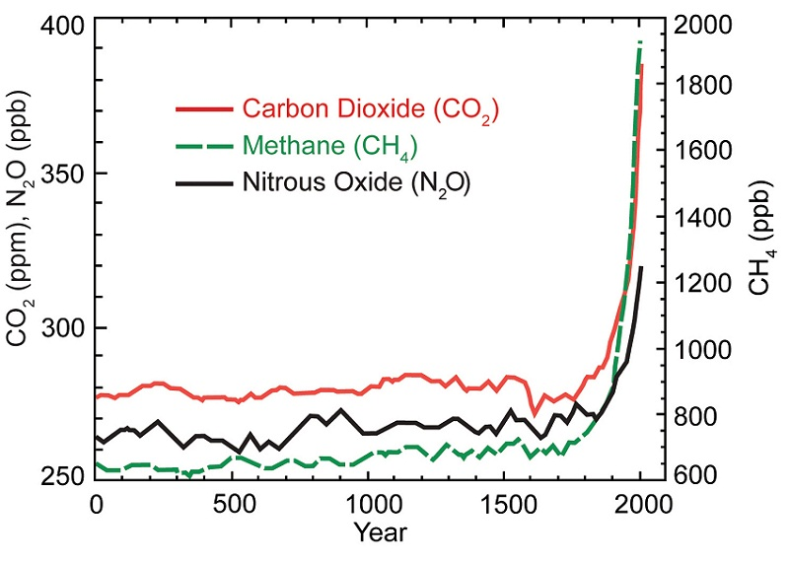
Evolution of GHG emissions
Source: EPA, 2017

Slide 51
Source: EPA, 2017
Steffen et al., 2015
Sheffen et al, 2015

Slide 52
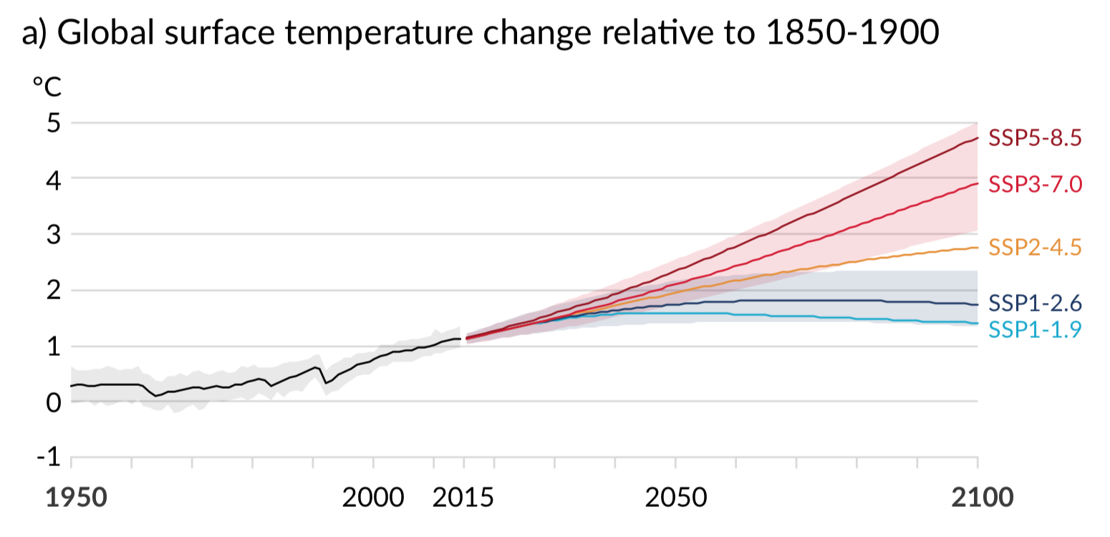
Scenarii of T° evolution: Past present and future
NO Alpes
GIEC, 2021

Slide 53
Scenarii of T° evolution: Past present and future
!! T° evolution in the Alps
NO Alpes
GIEC, 2021

Slide 54
ACCELERATED CHANGE
Atmospheric conditions vary in time and space
Temperature and Precipitation (Pressure, Sunshine, Cloudiness, Humidity, Wind...)
Hydrosphere (ocean, marine currents...)
Biosphere
(living organisms on land and in the oceans)
Cryosphere
(ice caps, glaciers, ice packs...)
Lithosphere (tectonics, relief, volcanism...)

Slide 55
“Two” avenues
Adaptation Mitigation

Slide 56
Key learnings
Climate change = norm on geological time scale
Contemporary climate change is almost exclusively anthropogenic
Already major consequences on Earth > Melting glaciers, coral bleaching, rising sea levels, climate refugees, etc.
Already major consequences on Communities > unprecedented social and environmental consequences
Climate, environmental (biodiversity, water, etc.) and social issues intricately linked

Slide 57
What does climate change mean to us, PA Managers?
Photo: La Massane NNR

Slide 58
Your turn…
[climate change analysis]
Do you observe negative climate changes and/or effects?
[In groups of 4 - make a list - 10’’]

Slide 59
>>> Silence, pls <<<

Slide 60
>share your thoughts<

Slide 61
2018 survey results*
Do European Protected Area managers observe climate change ?
YES, they do…
Increasing temperatures // prolonged droughts
heavy rainfall, very concentrated in time
rising sea and ocean levels // soil erosion
disruption of seasonal and phenological cycles
DE SADELEER O., COUDURIER C., 2019. Intégration du changement climatique dans la gestion des espaces naturels protégés - Initiatives existantes et attentes des gestionnaires européens. LIFE NaturAdapt – Rapport d’Europarc et de RNF. 24p. Read the survey result summary here

Slide 62
Your turn…
[vulnerability]
How will those changes affect the PA you are managing
[Self-reflection - make a list - 6’’]

Slide 63
>>> Silence, pls <<<

Slide 64
Your turn…
[planning for adaptation]
How will those changes affect the PA you are managing
[In groups of 3 - Select one vulnerability from your list and discuss possible solutions -15’ (5’ each)]

Slide 65
>>> Silence, pls <<<

Slide 66
>share your thoughts<

Slide 67
In short our experience tell us that…
it is URGENT to integrate climate change adaptation and nature conservation

Slide 68
In short our experience tell us that…
we can transform climate change challenges into an opportunity for Protected Areas, for nature and people
Notes:
innovate and support the development of adaptive management of protected areas
strengthen a participatory approach of nature conservation
position protected areas at the heart of the ecological transition and regional climate change adaptation strategies

Slide 69
Your turn…
What will you DO next month?
[self reflection in silence - make a note for yourself -2’]

Slide 70
Your turn…
Who will you CONTACT upon your return?
[self reflection in silence - make a note for yourself - 2’]

Slide 71
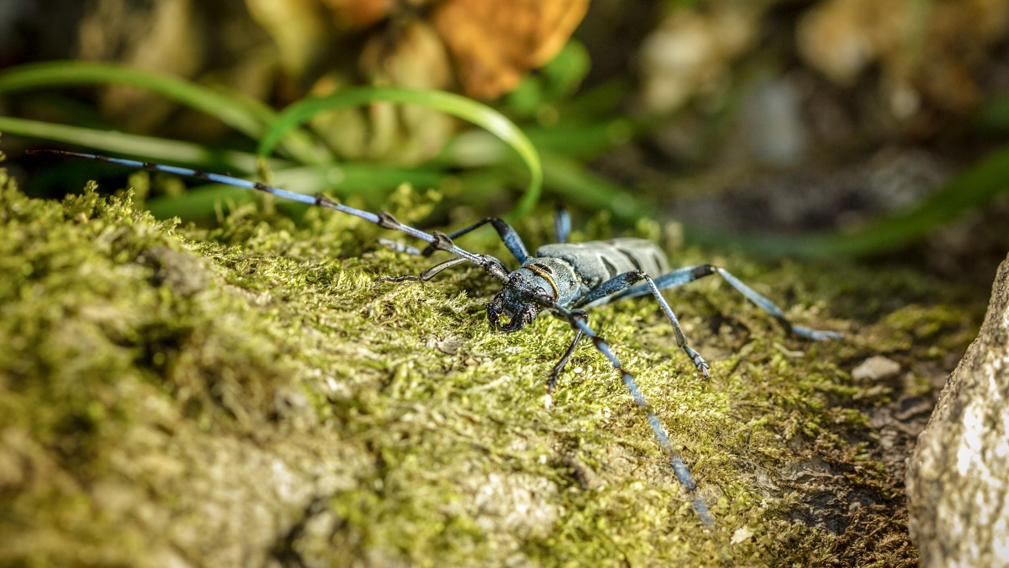
coming next LONG BREAK
Photo: La Massane NNR

Slide 72
But first some announcements…
To be continued Pls come back here at 5pm sharp

Slide 73
With the financial support of
has been organised by the committed teams of
LIFE17 CCA/FR/000089 - LIFE #CC #Naturadapt

