Slide 1
Giving Feedback

Slide 2
Effective Communication
Information

Slide 3
The reality
Information
Feedback

Slide 4
Feedback
Why do we need feedback?
How should we give feedback?
How can we receive feedback?
  Do we have to accept it all?

Slide 5
Giving Feedback
To be effective feedback should focus on:
Clear and Specific points
Behaviour that can be changed – allow room for action
Observed facts, not supposed intentions
What you saw / felt, not judgement
The most important points
Agreed purpose / groundrules
Good aspects ....... as well as areas for improvement
Giving value to the receiver, not release for the giver!

Slide 6
Johari’s Window
Known
to self
Unknown
to self
--
Known
to others
Open
Blind
--
Unknown
to others
Hidden
Unknown

Slide 7
Johari’s Window
Known
to self
Unknown
to self
--
Known
to others
Feed
back
Open
Blind
--
Unknown
to others
Hidden
Unknown

Slide 8
Solicited feedback
Unknown to self
Feedback
Known
to others
Blind

Slide 9
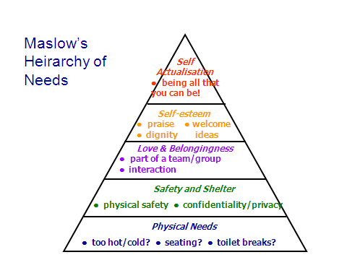

Slide 10
Giving Feedback
To be effective feedback should focus on:
Clear and Specific points
Behaviour that can be changed – allow room for action
Observed facts, not supposed intentions
What you saw / felt, not judgement
The most important points
Agreed purpose / groundrules
Good aspects ....... as well as areas for improvement
Giving value to the receiver, not release for the giver!

Slide 11
Asking for feedback
Why/when would you ask for feedback?
When was the last time you asked for feedback on something?
When was the last time you received feedback?
Do you see compliments as feedback?

Slide 12
Receiving Feedback
Planning:
Think about your ideas and work beforehand
Arrange a time/place where you won’t be disturbed, and don’t leave it too long after the event
Ask for help/solutions with specific difficulties
Be clear about the kind of help you want (or don’t want!).
Be open to hearing the feedback – it’s pointless otherwise
Listen actively

Slide 13
Receiving feedback
In receiving feedback:
• breathe!
• listen carefully
• ask questions for clarity
• acknowledge the feedback
• acknowledge valid points
• take time to sort out what you heard

Slide 14
Receiving Feedback
Try not to
Take it personally, or get hurt/angry
Interrupt with reasons if the feedback is “negative”
Dismiss the points if you don’t agree with them
If you don’t agree – get another point of view
Remember negative points forever! Remember the positive ones instead
And don’t dismiss positive comments

Slide 15
Feedback
Feedback focusses on behaviours and actions which can be changed, not personalities
Learn to give effective feedback
Learn to receive feedback
Understand timing is important for both of these
Weigh up comments sensibly – negatives do not “mean more” than positives

Slide 17
Communicating Assertively
Rather than passively or aggressively

Slide 18
Communicating Assertively
What would you do if:
Your workmate asked for help on a project when you already had too much to do?
One of your colleagues was late for a meeting, again?
You were criticised for some work you had put a lot of effort into?
You were bullied by someone you regularly crossed paths with?

Slide 19
Possible reactions
Aggressive
I win
Direct attack
Bulldoze their
opponent
Passive
You win
Doormat
Avoids/Gives in
Wouldn’t dare argue

Slide 20
Possible Reactions
Passive Aggressive
Both lose
Pretend doormat
Attack indirectly
I can’t win & won’t let you win
Assertive
Both win
Discussion and compromise

Slide 21
Passive, Assertive or Aggressive?
Aggressive
Your needs
Passive
Other’s needs
Assertive

Slide 22
Being assertive
A direct and honest communication of your needs, feelings and rights
Expressed in a way which doesn’t threaten the rights of others
Is focussed on specifics & involves negotiation
Make use of “I” when speaking
Increases your level of control
Tends to earn more respect from others

Slide 23
Top Tips for Assertiveness
In groups – what do you think are key features of being assertive?
Feed these back to create a list with ideas from each group

Slide 24
Some known techniques
The broken record
Keep repeating, in different ways, what you want
Identify your goal
Deflect any irrelevant arguments
Keep repeating your statement
Match your body language to your statements
Saying No
If your initial reaction is No, then go with it
Practice saying No
Ensure you actually say No
Ask for extra time if you want to think a bit more
A direct No is better than someone who doesn’t really want to be there

Slide 25
More known techniques
Negative & Positive Enquiry
Turn a negative into a positive enquiry
Not, “why do you get at me for leaving work at 5?”
Try “I need to understand. What is about my finishing time that concerns you?”
Disarming Anger
Acknowledge when someone is angry
Explain you want address the issue
Get them to sit, and speak normally
Listen actively
Try to solve the problem
Say what you could do differently

Slide 26
In summary…
Being assertive is a balanced adult approach to communication
You should try to avoid being passive or aggressive
Watch out for those behaviours in others, and learn to avoid them
You feelings and needs are important – and so are other people’s

