Slide 1
Governance of Protected Areas in Eastern Europe
Case studies

Slide 2
How was the information collected
study was conducted in 19 countries
field visits -> 54 face to face interviews in 11 countries
National level -> 16 interviews
Protected area level -> 37 case studies
questionnaires in Estonia, Lithuania, Georgia, Armenia
Skype interviews – 1 case study
desk research (less)

Slide 3
Case study selection
Preliminary questionnaires to AC
AC - agreement workshop
Typical case sampling
Extreme case sampling

Slide 4
Governance matrix for Eastern Europe
 | A Government Governance |  |  | B Multi-stakeholder Governance |  |  | C Private Governance |  |  | D Community Governance
 | Federal or national ministry or agency | Local/ municipal agency or authority | Delegated governance | Trans-boundary governance | Collaborative governance | Joint governance | By individual land-owner | By non-profit organizations (e.g. NGOs, university, etc.) | By for profit organizations (e.g. corporate land-owners) | Indigenous peoples | Local communities
Albania | √ |  | √ | √? | √
Belarus¹ | √ |  | √
Bulgaria | √ | √ | √ |  | √ |  | √ | √ | √
Croatia | √ | √ | de facto, but not de jure |  | de facto, but not de jure
Czech Republic | √ |  | √ | √
Estonia | √ | √ | √
Finland | √ | √ |  | √ | √ | de facto, but not de jure | √ |  | √
Hungary |  |  | √ | √
Latvia | √ |  | √ |  | √ |  | √ |  |  |  | √
Lithuania* | √ |  |  |  | √
Poland*
Serbia | √ | √ | √ | de facto, but not de jure
Slovakia | √ |  |  |  |  |  |  | de facto, but not de jure
Slovenia | √ | √ | √
Republic of Moldova | √ | √
Romania | √ | √ | √ |  | √
Ukraine | √ | √ | √ | √? |  |  |  |  |  |  | √?
Georgia | √ |  | √

Slide 5
A (c) Delegated governance

Slide 6
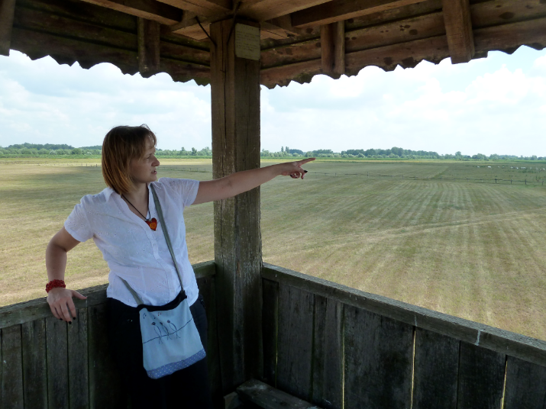
“Gajna” Significant Landscape – Croatia
280 ha along the Sava river
Managed by: Brod Ecological Society-BED (Brodsko Ekološko Društvo-BED)
delegated by the Public Institution for the Management of Protected Natural Resources of Brod-Posavina County
Landownership: state owned land (municipality)
Financing: 50% projects, 50% county administration, some revenue generating commercial activities

Slide 7
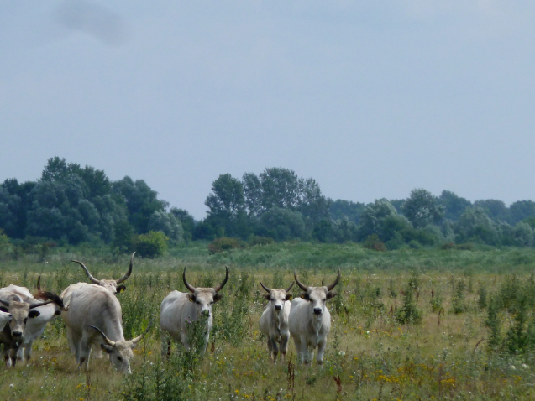
“Gajna” Significant Landscape – Croatia
Decision-maker: Public Institution for the Management of Protected Natural Resources of Brod-Posavina County
Grazing management:
maintain the pasture (reduce Amorpha)
with Podolian cattle (endengared traditional breed)
Community involvement: very low at present

Slide 8
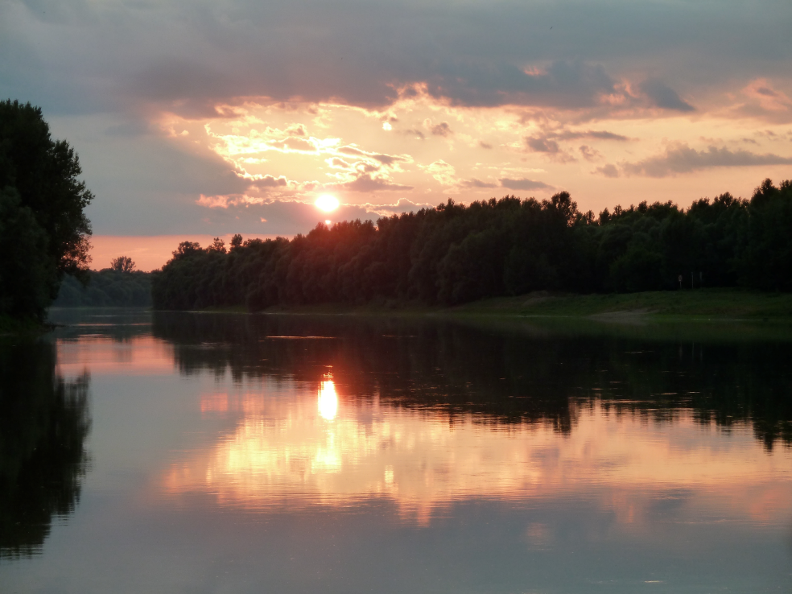

Slide 9
Logarska Dolina Landscape Park – Slovenia
established - 1987 by a municipality
1987 - 1992 increased visitor pressure, no management.
1992 – Logarska Dolina Nonprofit Company (Logarska Dolina d.o.o. local landowners and tourism business owners - aiming to manage the PA by initiating sustainable development activities and reducing tourism pressure).
1996 - Institute for Tourism and Sustainable Development of Solčavsko Region (Rinka Center) is established

Slide 10
Logarska Dolina Landscape Park – Slovenia
Management: Company - based on concession from the Municipality (delegated by the Municipality)
PA management team: 1 director, 1 development programme officer, 1 ranger.
Management activities: visitor management, including running the information centres, and guiding services, land management on the areas owned by members, development projects.
Reporting obligations: to the General Assembly and the Municipality, informing the Ministry.
Landowners: individuals and church

Slide 11
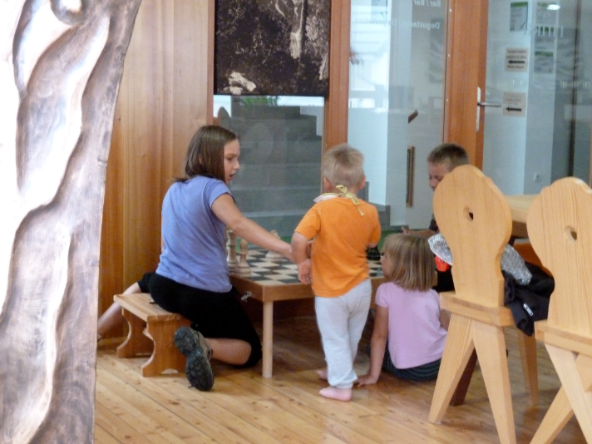
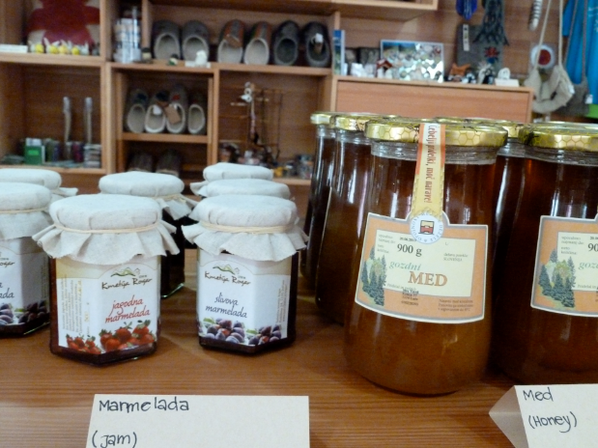

Slide 12
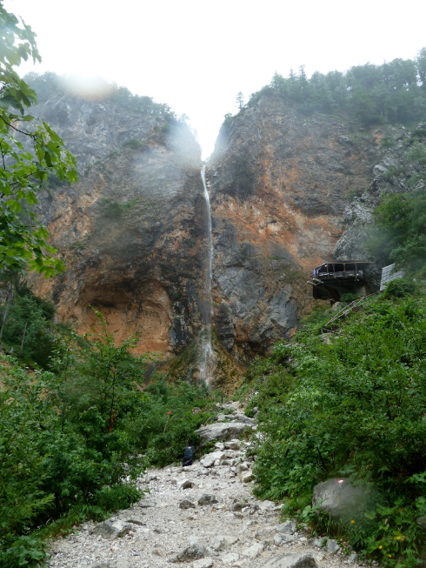
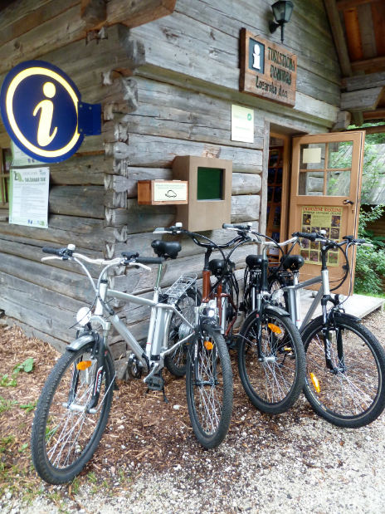

Slide 13
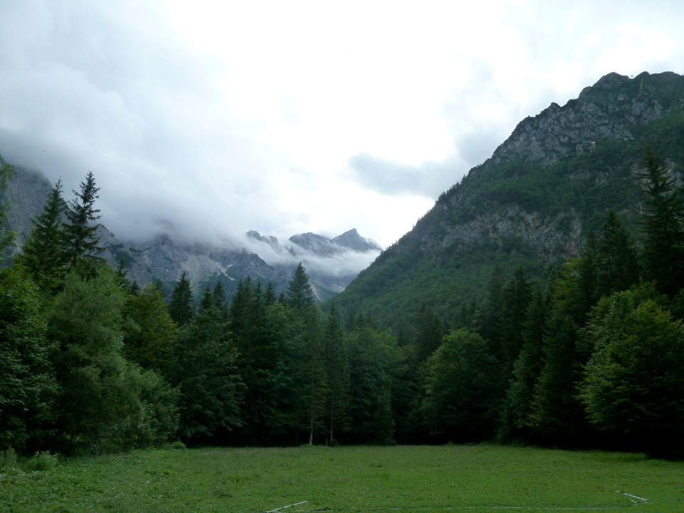

Slide 14
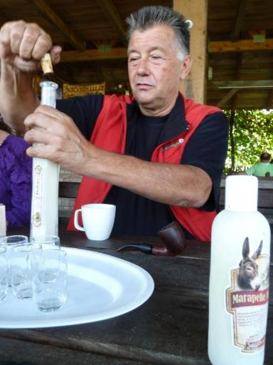
Zasavica Special Nature Reserve – Serbia
1.825 ha
Managed by: Nature Conservation Movement from Sremska Mitrovica, local NGO delegated by the Government through the designation act (Decree on protection of the Special Nature Reserve, 1997)
Landownership: state, public and private, territory of the administrative area of 7 communities

Slide 15
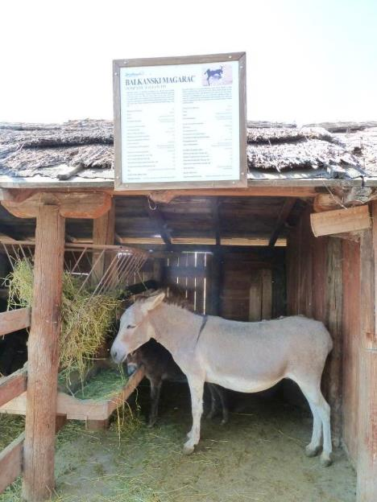
Zasavica Special Nature Reserve – Serbia
Conservation and commercial activities:
habitat management trough grazing (local breeds)
very modern camping area
animal products from the farm
innovative ideas help significantly the fundraising (dunkey products (milk, sausage, soap, moisturing cream).
Decision-makers: the NGO
Financing: revenue generating commercial activities mainly associated with conservation measures, projects and some funds from the municipalities.

Slide 16
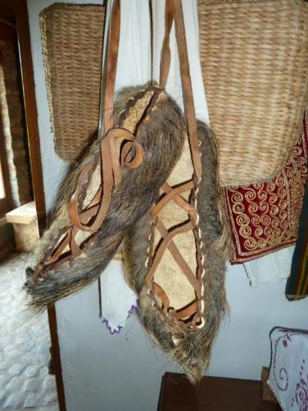
Zasavica Special Nature Reserve – Serbia
Community involvement and benefits: information meetings and events, working group for planning.
Community members – processing the products commercialized by the managers, staff members are from the local communities.
Compensation payments: provided from their own resources by the managers to locals for damages produced by beavers.

Slide 18
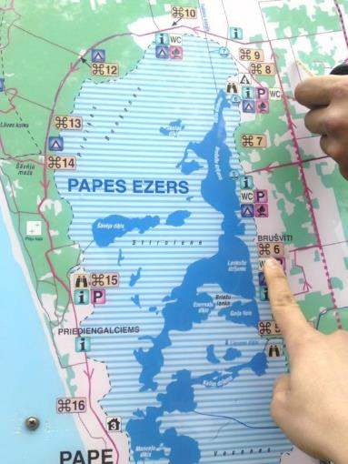
Pape Nature Park - Latvia
2004, 11.000 ha
Natura 2000 SCI and SPA, RAMSAR, IBA
Landownership:
mixed: almost 50% state – different institutions + 50% private - 600 private owners.
Management responsibility: de jure belongs to the Nature Conservation Agency – Kurzeme Regional Office.
Management activities: WWF

Slide 19
Pape Nature Park – Latvia
CONTEXT LIMITATIONS
land ownership and use rights are very divided between many actors
for each management action on private land the landowner has to agree
NGOs can’t neither managed the state land nor buy land in Latvia
renting land is costly and land owners are reluctant
lack of legal mechanisms for the delegation - impossibility of signing an agreement with the Ministry of Environment
the lack of such an agreement impedes the NGO to access funds (e.g. from EU programmes)

Slide 20
Pape Nature Park - Latvia
SUCCESS STORIES
WWF Latvia:
direct involvement in establishing the park
many projects in the area (in line with the management objectives)
develops the management plan
takes over the responsibility on a contract basis with landowners
contributes directly to its management: habitat restoration, conservation, tourism development , hydrological regime, etc

Slide 21
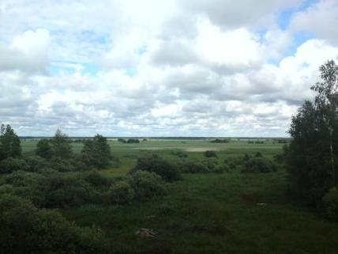
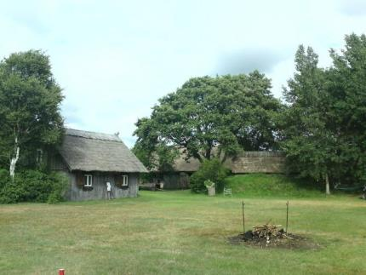
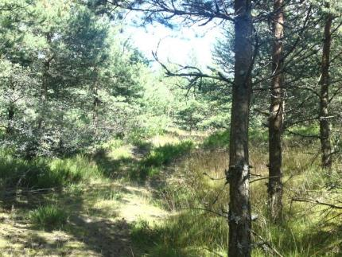
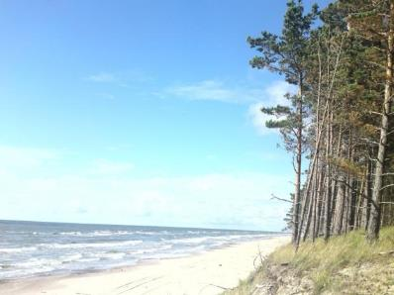
PA Governance – training session Vilm, ProPark, 03.12.2012

Slide 22
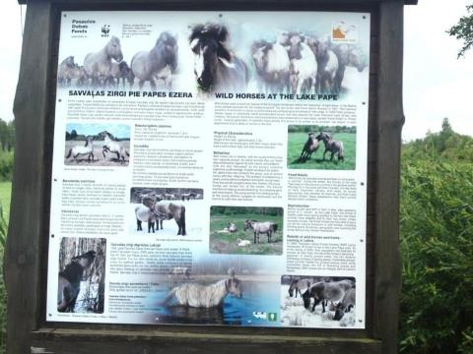
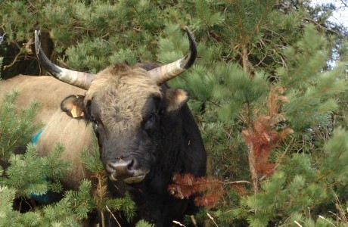
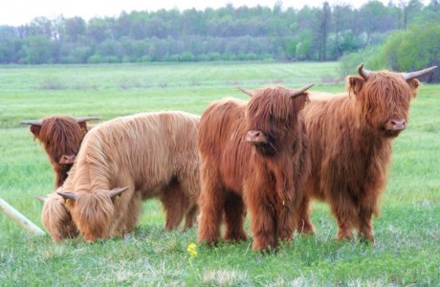
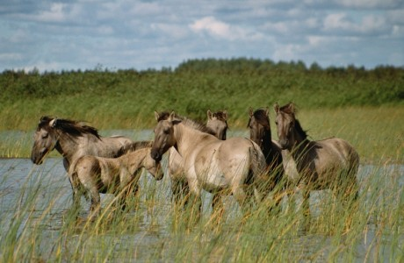

Slide 23
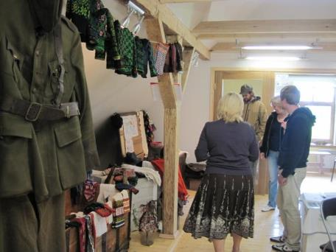
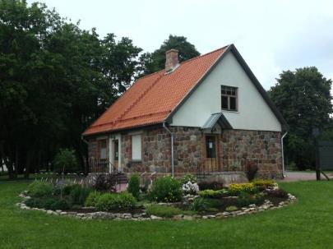
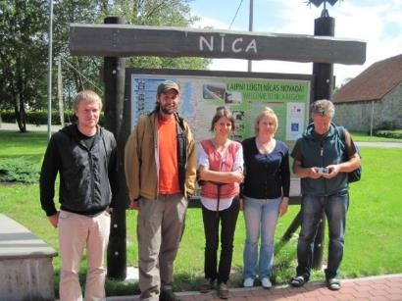
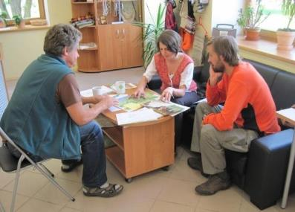

Slide 24
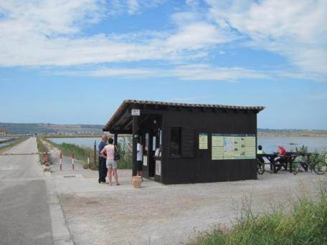
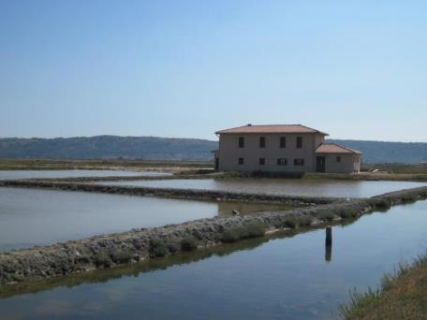
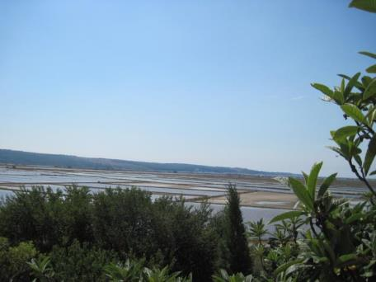
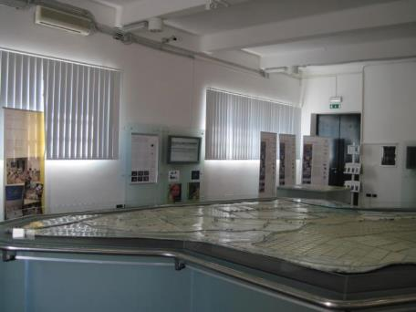
Secovlje salina Nature Park, Slovenia

Slide 25
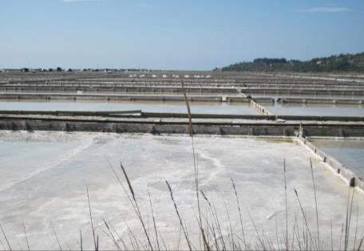
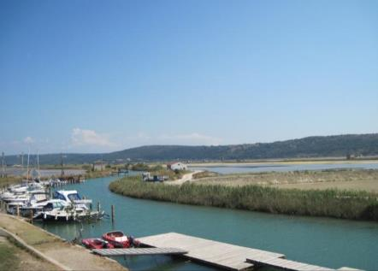
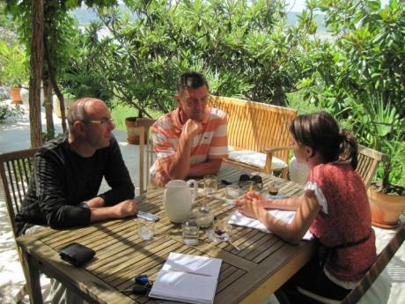
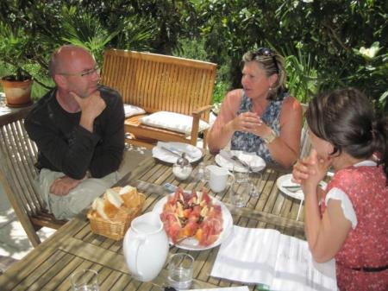

Slide 26
B (a) Trans-boundary governance

Slide 27
Saxon - Bohemian Switzerland Transboundary PA (Českosaské Švýcarsko / Sächsisch-Böhmische Schweiz)
Legal basis: Agreement between the MoE of the Czech Repulic and the MoE of Saxony about the cooperation in nature conservation between the Saxon Switzerland National Park Administration and Elbe Sandstone PLA (future Bohemian Switzerland National Park) – 1991
Long-term: Joint Vision 2012

Slide 28
Saxon - Bohemian Switzerland Transboundary PA (Českosaské Švýcarsko / Sächsisch-Böhmische Schweiz)
Mid-term: Strategy of the transboundary cooperation in nature conservation in the Saxon- Bohemian Switzerland (2004):
strategic goals: IUCN category II
research and monitoring activities
environmental education
coordination of management plans
practical management, e.g. control of invasive species

Slide 29
Saxon - Bohemian Switzerland Transboundary PA (Českosaské Švýcarsko / Sächsisch-Böhmische Schweiz)
Short-term: annual working plans for WG:
nature conservation/monitoring
forest management
environment education
visitor management
Transboundary research and monitoring
mapping of flora and fauna: no international project, just agreement on methodology and goals
Joint projects:
Forest development in Saxon-Bohemian Switzerland – Ziel 3 Project
Reintroduction of Peregrine Falcon
Reintroduction of Elbe Salmon
Visitor management:

Slide 30
Saxon - Bohemian Switzerland Transboundary PA (Českosaské Švýcarsko / Sächsisch-Böhmische Schweiz)
National Park Centre Bad Schandau
Transborder concept of exhibition right from the beginning
National Park Centre Krásná Lípa
Bilingual exhibition
2 German speaking staff
3 bilingual events
Transboundary bilingual corporate design - joint transboundary project of nature conservation authorities and tourism organizations: joint logo, regional products

Slide 31
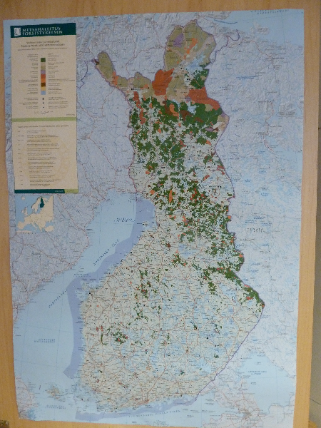
Oulanka (Finland) – Paanajarrvi (Rusia)
Europarc Trounsboundary certificate 2005
Oulanka – PAN Parks 2002,
Paanajarrvi PAN Parks 2005
August 2012: transboundary PAN Parks – joint membership.
Oulanka - difficulties to fulfill the wilderness criteria
Paanajarrvi - difficulties to fulfill the tourism entrepreneur partnership criteria
Paanajarrvi is “offering” the wilderness area that makes it up for the wilderness area of Oulanka as well (reindeer herding is a limiting factor).

Slide 32
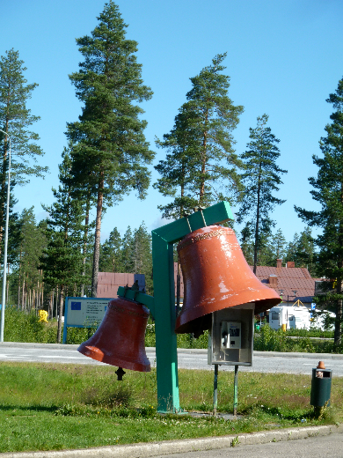
Oulanka (Finland) – Paanajarrvi (Rusia)
Joint management plan
Joint tourism strategy
Joint annual plans and activities
Joint applications for external funding.
working documents to help harmonize management (not formal - not possible to get the approval)
Since 2009 the Russian Ministry recognizes the transboundary cooperation and supports it.
official agreements, structures are not very official.

Slide 33
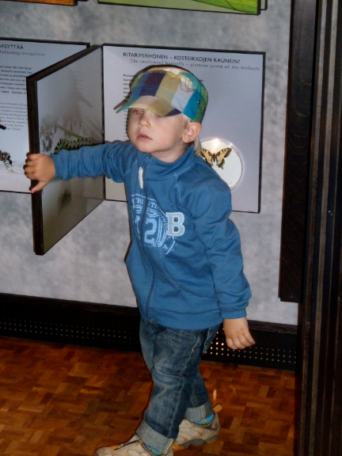
Oulanka (Finland) – Paanajarrvi (Rusia)
Important benefits:
international funding INTERREG, Neighborhood Programme, TACIS programme (visitor centre and best conservation office in Russia for PAs).
Involvement of Fins in activities in the Paanajarrvi region and the Karelian villages (cultural heritage)
Visitors numbers increased

Slide 34
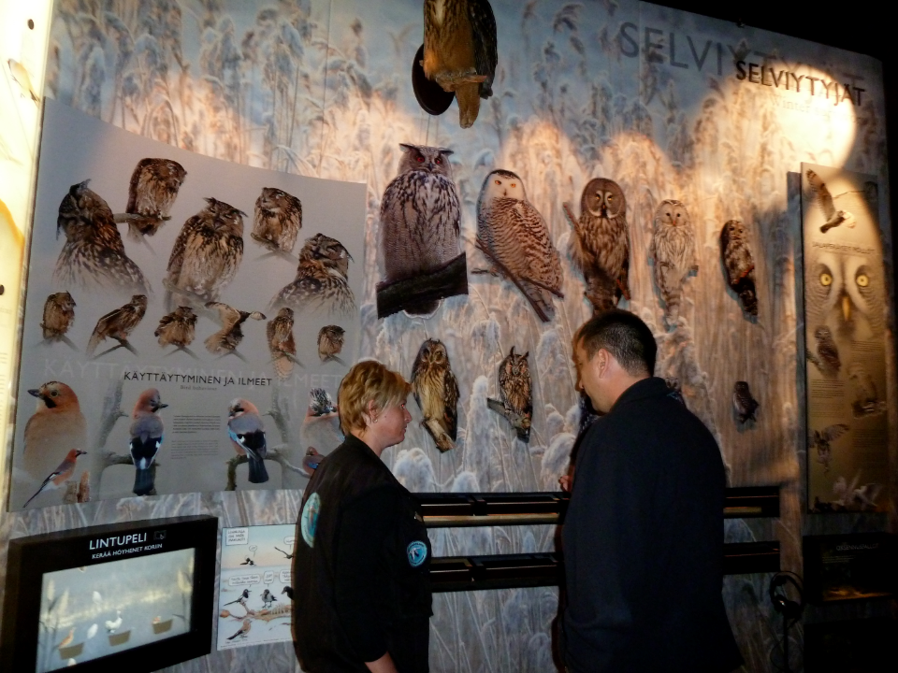

Slide 35
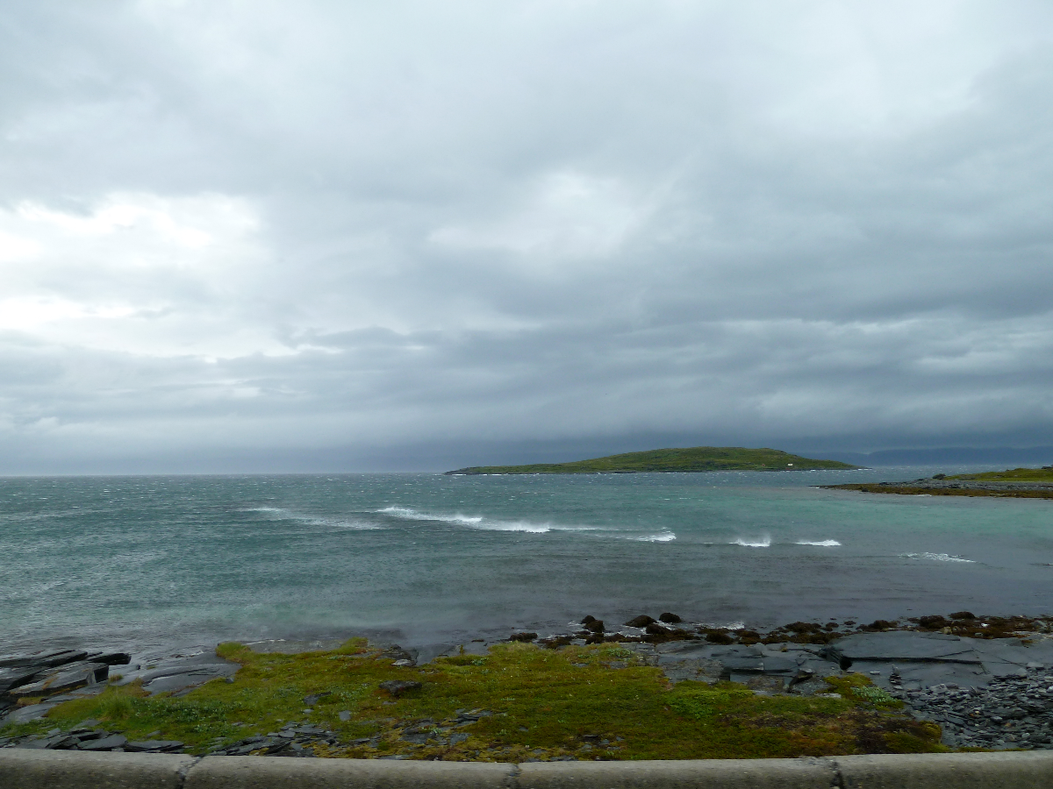

Slide 36
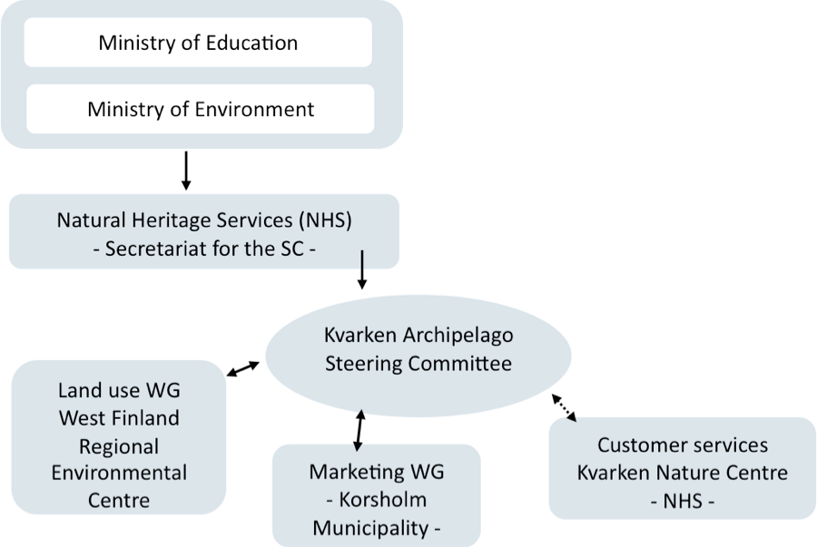
B (c) Joint governance Kvarken Archipeleago (Finland)

Slide 37
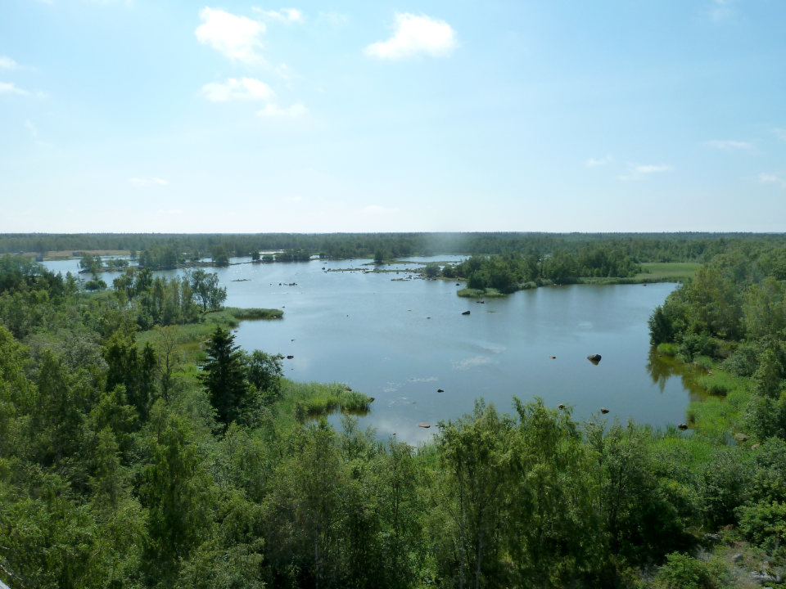

Slide 38
C. Private governance

Slide 39
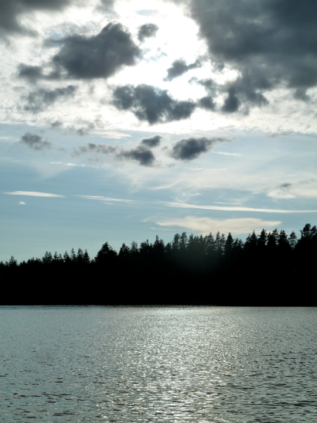
Private Nature Reserve Aarnikotka
Aarnikotka forest Nature Reserve (1,400 hectares)
Owner: UPM
Voluntary commitment for protecting the area - no compensation payment from the state.
Decision making: independent board, does not report to anybody
Objectives: recreation and restoration of natural forests

Slide 40
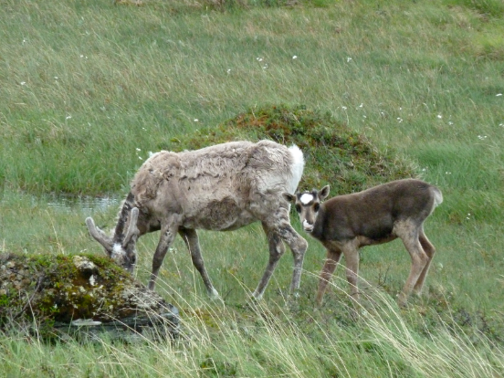
Private Nature Reserve Aarnikotka
Repovesi National Park
Local authorities: big pressures to have the area NP
Steering Group:
2 members from Metsähallitus,
2 members from UPM
2 members from the Environment Department of the Regional Center.
Chairman from UPM always.
Executive body: PA team from Metsähallitus and people working in the Municipalities
5 year national assessments and 10 years international assessments

Slide 41
C. Community governance

Slide 42
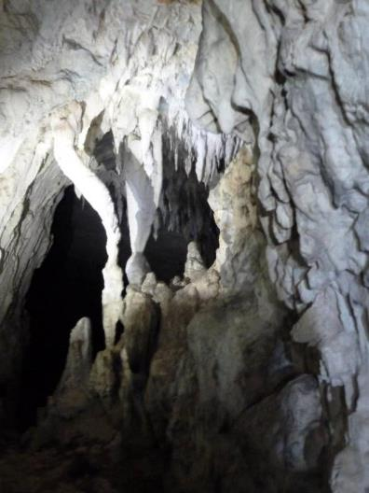
Defileul Crișului Repede – Pădurea Craiului Natura 2000 site - SCI (Romania)
Landownership: mixed (state, private, community), all on the administrative territory 18 communes and 2 towns
Designation initiative (history): CPASDB with the local communities: PA for nature conservation and local development s (since 1996)
Lack of legal model - prevented the establishment of the PA for 15 years
EU accession - Natura 2000.

Slide 43
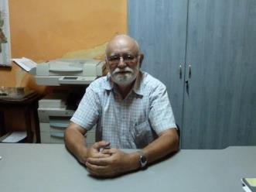
Defileul Crișului Repede – Pădurea Craiului Natura 2000 site - SCI (Romania)
Decision making platform:
a Consortium of Mayors established by CPASDB (officially the administrator of the Natura 2000 site) as legal representatives of the local communities - informal agreement.
the PA Management Unit (CPASDB) and the Consortium of Mayors form the Administrative Council of the site.
Functioning and role of the Administratie Council:
meets once or 2 times a year
approves the Management Plan and annual action plans
is in charge with the implementation of the management activities,
local authorities implement activities in partnership with the manager and in some cases with their financial contribution.

Slide 44
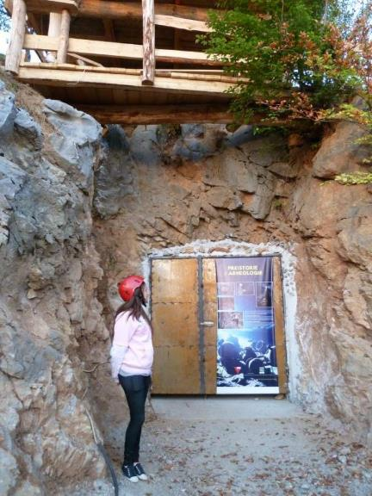
Defileul Crișului Repede – Pădurea Craiului Natura 2000 site - SCI (Romania)
Key success factors for deciding and acting together:
partnership developed around the natural and cultural values,
strong leadership, clear vision and very good facilitation skills of the PAMU (CPASDB)
pragmatic and participatory approach of the PAMU (CPASDB),
permanent communication with the partners,
investing in the local identity and increasing the visibility of the area,
continuous information and public awareness
concrete measures in support of local development.
Conclusion: bottom-up initiative in a limitative legislative context, built on the idea of benefits that the protected area can provide for the local development.

Slide 46
B (b) Collaborative governance

Slide 47
Delegation / collaborative management in Romania
Biodiversity CITES, biosecurity, Natura2000, protected areas, A pproval of EIA, projects, ..........
Ministry of Environment and Forests
Contracts
DDBR
Institutes, companies (NFA, County councils)
NGOs
Individuals
RON, € !!!
RON, € !!!
RON, € !!!
Scientific Councils
PA Administrations
PA Custodians
Consultative Councils

Slide 48
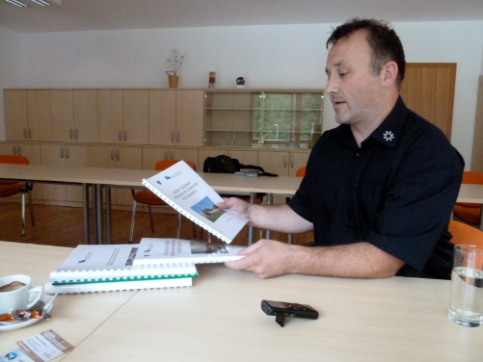
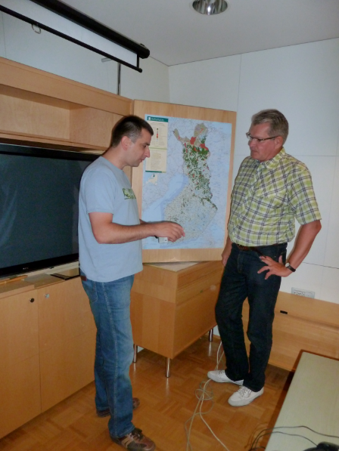
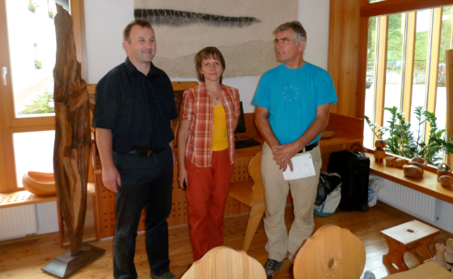

Slide 49
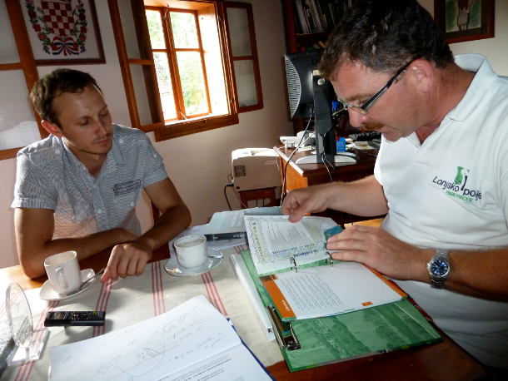

Slide 50
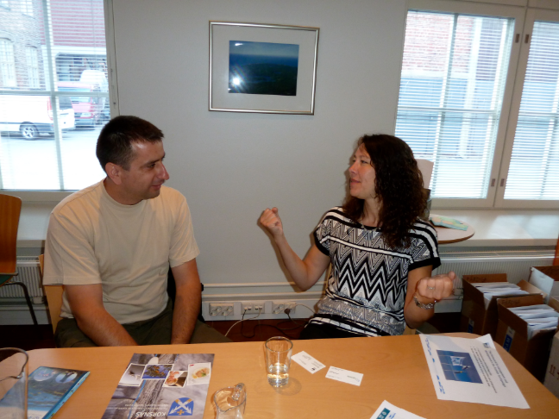
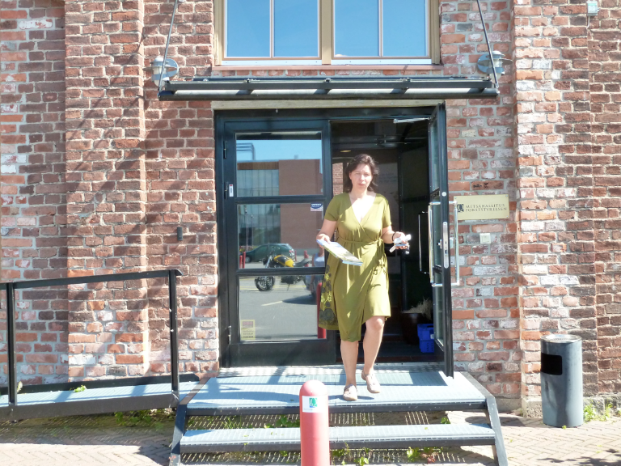

Slide 51
Alina Ioniță
Tiberiu Chiricheș
Cristian Remus Papp
Costel Bucur
Erika Stanciu
Georgiana Branescu
Laura Florescu
Laura Istrate
Alina Alexa
Adrian Hăgătiș

