Slide 1
EUROPARC webinar – 24 October 2019
Healthy Parks, Healthy People – realising the potential of Parks and Protected Areas as Europe’s ‘Natural Health Centres’
Pete Rawcliffe – Scottish Natural Heritage
EUROPARC Commission on
Health & Protected Areas

Slide 2
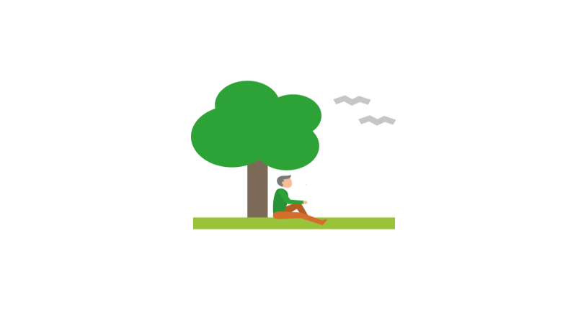
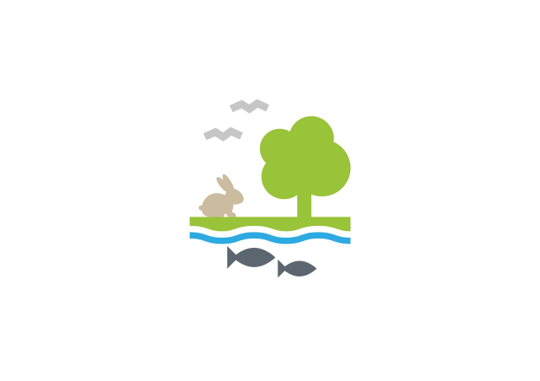
Our natural health service?
For: improved mental and physical health, lower stress and blood pressure, reduced risk of illness
Dosage: Take at least one dose a day with fresh air
Side effects: Improved mood, sleep, attention, creativity, social contact, energy and happiness
Warning: Keep in reach of children (and adults)
Healthy places support healthy people
Notes:
Living with significant Health issues: more chronic, non-infectious disease; more multiple-illnesses; more older people; more mental ill-health
Some associated with life-behaviours eg Diabetes, Heart disease, Lung cancer, Obesity, living in hostile envs – urban issues re: loneliness & social isolation
Young people’s dis-connect with env - nature-deficit disorder; less time outside than high-security prisoners…..
Physical activity outdoors & contact with nature - greater acknowledgement of valuable contribution parks & protected areas can make to public health - prevention, treatment, recovery & long-term care
Places need to be high-quality & accessible, and provide an attractive setting for people to develop a sense of connection – and seek the benefits.

Slide 3
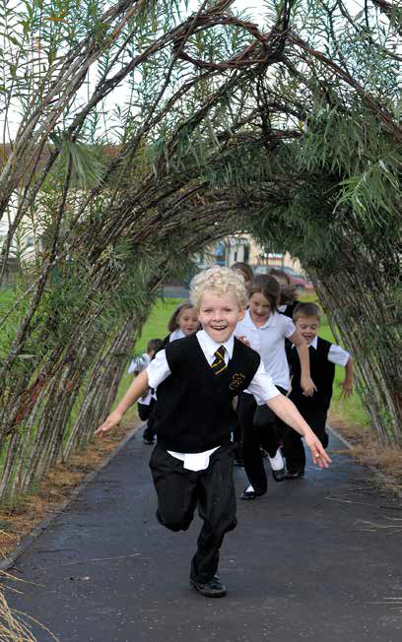
State of Play for Parks and Protected areas?
Growing engagement in health activity by PAs across Europe
Range of good practice developed / developing
Strong evidence base – needs to be communicated better; more emphasis on M&E to help make case at programme level too
Significant challenges for PAs in terms of political and professional relevance; funding; developing new partnerships with new sector / stakeholders
Significant opportunity for PAs in terms of demonstrating the benefits of nature for people

Slide 4
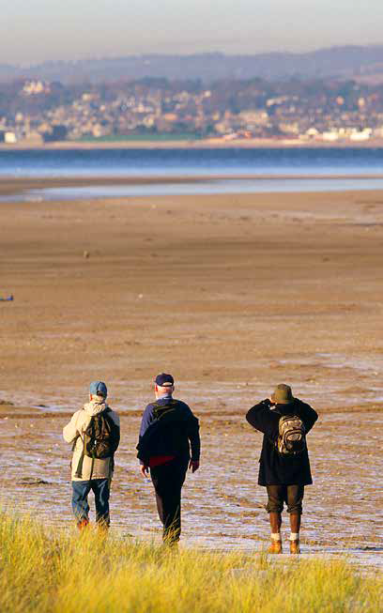
Key steps for Parks and Protected Areas?
Start building awareness and capacity in my organisation on health
Look for opportunities to make links to local health professionals
Develop new partnerships around health promoting use of Parks to reach new audiences
Do more on Monitoring and Evaluation when developing health projects
Look to build links within/to research community
Learn from good practice elsewhere

Slide 5
Case studies
14 from 10 countries
More wanted!
See
https://www.europarc.org/knowlege-hub/health-green-exercise/

Slide 6
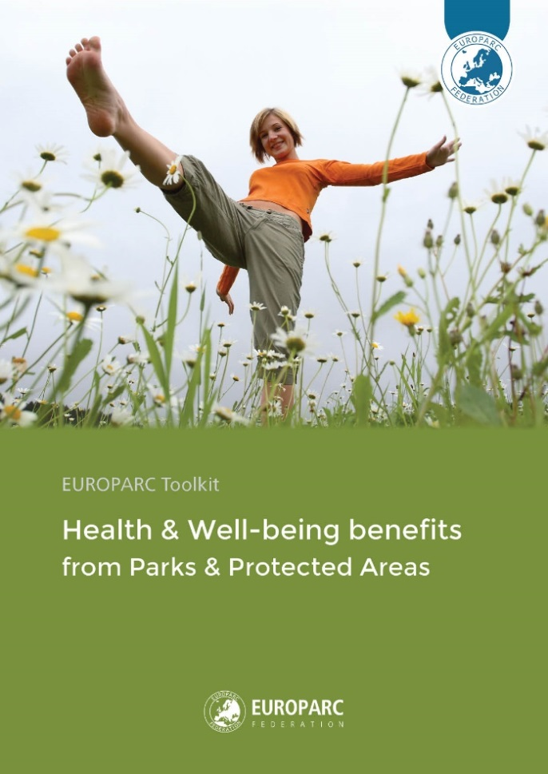
Tool-kit
Aim – help PAs contribute to delivery of health outcomes
Contents – key messages; linking health and environment policy frameworks; sources of evidence; case studies: check-list
The goal – develop the toolkit to encourage use of nature as ‘core business’ – in both the environment and health sectors
See https://www.europarc.org/toolkit-health-benefits-from-parks/

Slide 7
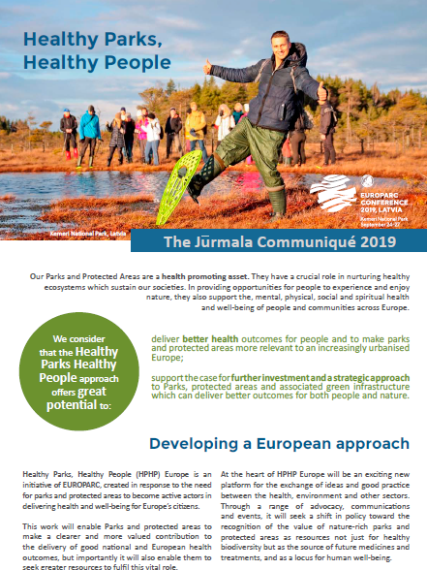
Jurmala Communique 2019
deliver better health outcomes for people and to make Parks and Protected Areas more relevant to an increasingly urbanised Europe; and
support the case for further investment and a strategic approach to Parks, Protected Areas and associated green infrastructure
See https://www.europarc.org/wp-content/uploads/2019/10/Jurmala-communique_EUROPARC2019.pdf

Slide 8
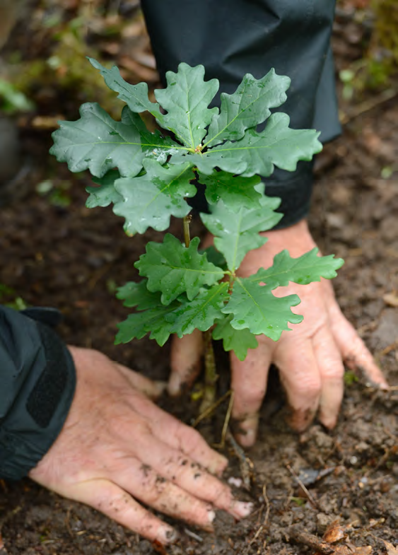
“Healthy Parks, Healthy People” Europe
Key programme areas?
Policy - development, integration, resourcing
Partnerships – health and other sectors; communities
Practice – green exercise projects; addressing health inequalities
Support – evidence base; tool-kits, knowledge exchange
Leadership – advocacy and communications, health sector champions

