Slide 1
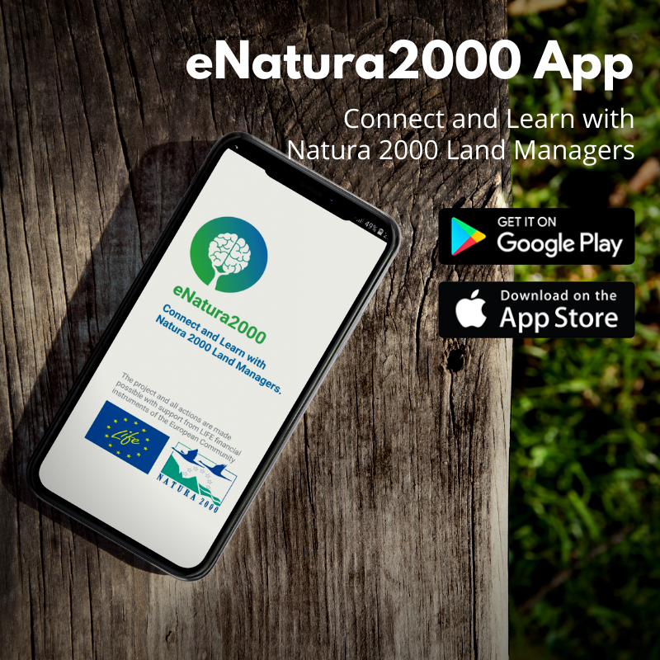
eNatura2000
Mobile App Presentation
Anne Magnus
Director at Symantra
Notes:
As one of the professional of the European Natura 2000 areas and Biodiversity community, we want you to be one of the first to discover the eNatura2000 app.
Connect and learn with Natura 2000 Land Managers.

Slide 2
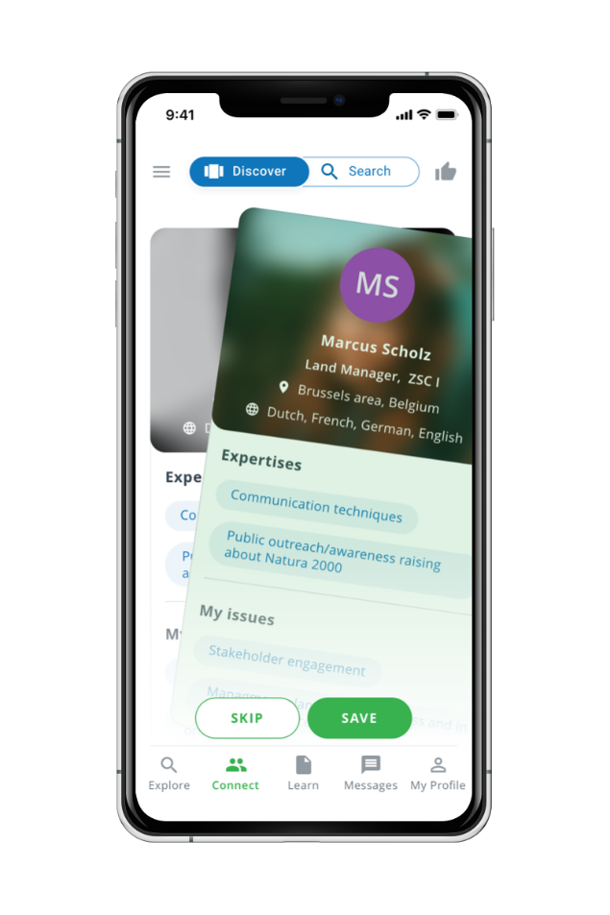
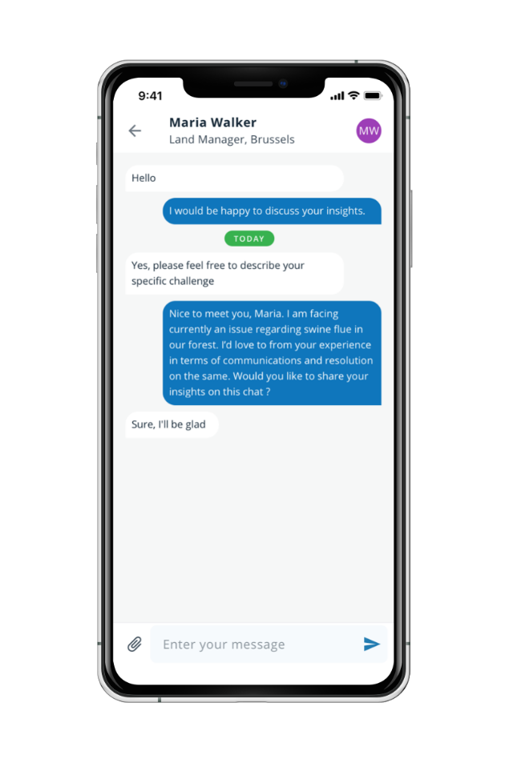
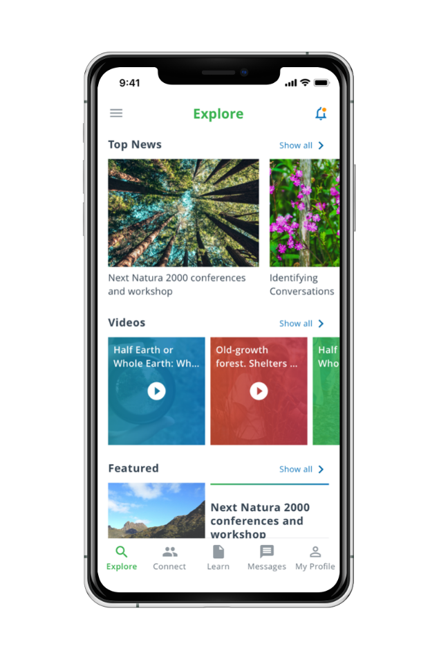
WHAT IS THE APP ABOUT?
eNatura2000 Mobile App
Connect and Learn with Natura 2000 Land Managers
Browse
your interest
Connect
& Find inspiration
Discover
& Learn
Notes:
Browse your interest Create your Profile in 1 minute. Filter your search by topics, countries, types of Natura 2000 sites, and manager's experience. Connect & Find inspiration Swipe to connect with peers who can help you solve your Natura 2000 challenges. Chat in the app or send them an email. Discover & Learn Find useful content that will help you to solve your challenges.

Slide 3
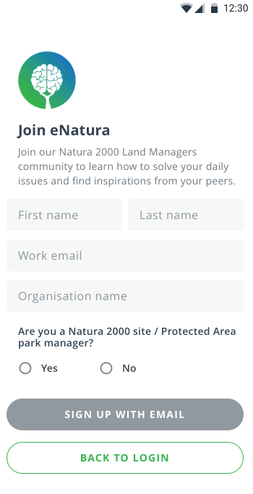
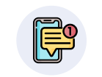
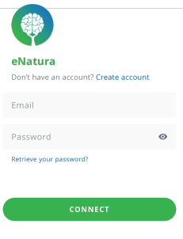
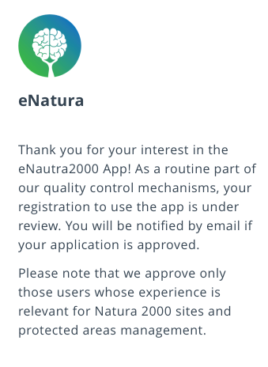
HOW TO INSTALL THE APP?
STEP 1
STEP 2
STEP 3
Search the app
Download the app
Sign up & Login
If you have an Android smartphone, open the Play Store.
If you have an iPhone, open the App Store.
Fill up the Form to Sign up.
You will receive a Message that your Registration is under approval by the eNatura Team (as it is a private qualified community of professionals).
Once approved, you will receive a Welcome email in your Inbox with your unique personal Username (your email address) and Password to Login in the app.
Click on the Connect button to enter the app.
On Playstore, click on Install button.
On Appstore, click on Download button.
Q eNatura2000 |
Downloading
Type in the Search bar the name of the «eNatura2000 ».
It will be proposed among a list of other apps.
The app gets installed. It can take a few seconds.
The app is installed. Click on the Open button to see the Sign up screen.
Notes:
Browse your interest Create your Profile in 1 minute. Filter your search by topics, countries, types of Natura 2000 sites, and manager's experience. Connect & Find inspiration Swipe to connect with peers who can help you solve your Natura 2000 challenges. Chat in the app or send them an email. Discover & Learn Find useful content that will help you to solve your challenges.

Slide 4
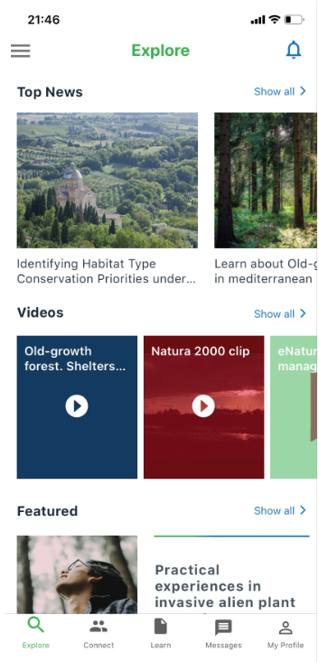
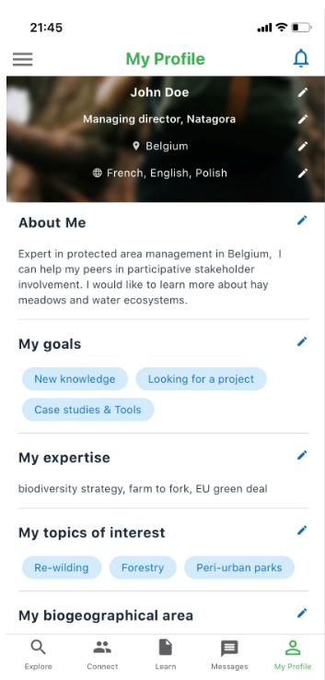
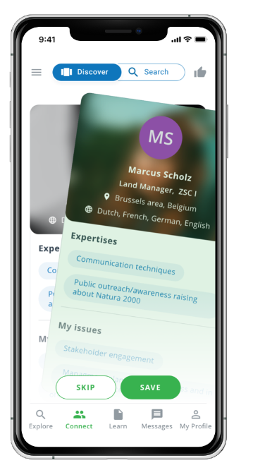
HOW TO CREATE MY PROFILE ?
Easy-to-use match-making features:
Swipe or Search Profiles, by Topics of interest or Biogeographical zones.
Connect by Email or In-App Chat.

Slide 5
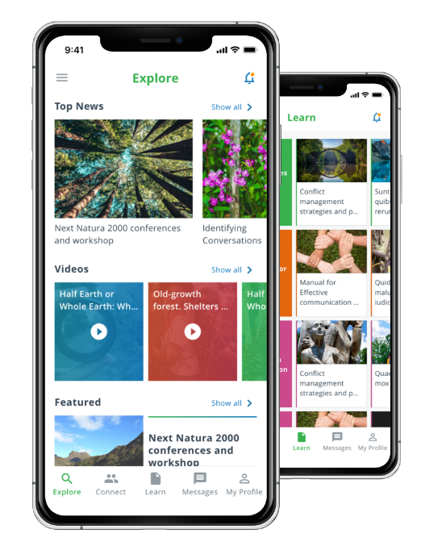
GREAT CONTENT TO EXPLORE & LEARN
The app has personalised content - per Topics of Interests:
Top News
Videos
Quiz
Have your say
Featured content
Documents
FAQ
• Policy & Practice
• Biodiversity (habitats & species)
• Management
• People & Organisations

Slide 6
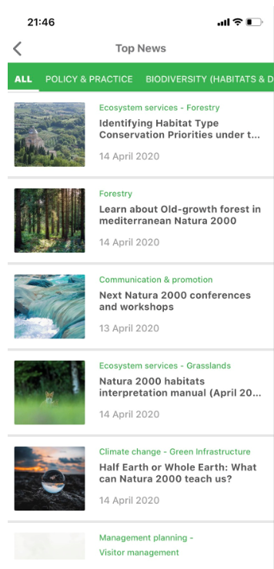
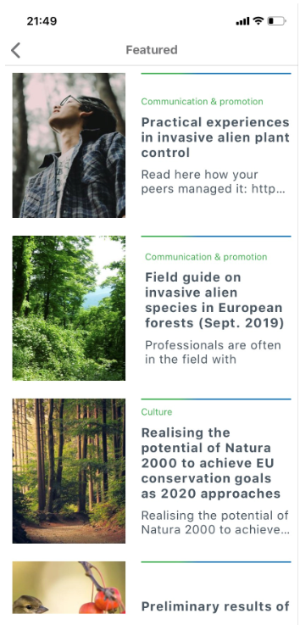
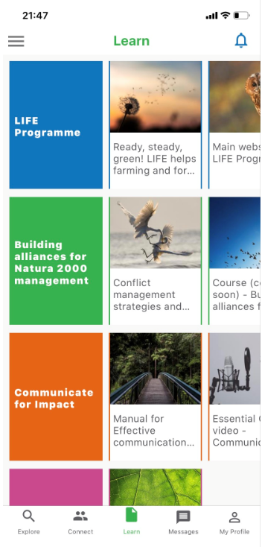
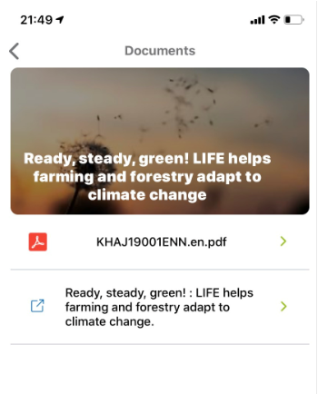
GREAT CONTENT TO EXPLORE & LEARN

Slide 7
